Slide 1
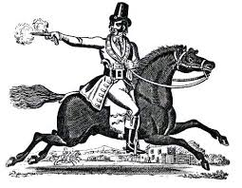
Identifying adverbs and adverbials
Just then, the highwayman came riding, up to the old inn-door

Slide 2
ADVERBS
An adverb is a word used to change (tell us more about) a verb OR an adjective OR (occasionally) a whole clause:
soon changes the verb ‘began’ faster changes the verb ‘ride’
He soon began to ride faster.
The really purple moor was misty.
really changes the adjective ‘purple’
Sadly, someone had been listening.
sadly changes the whole clause

Slide 3
IDEAS
ADVERBS
– Try changing the underlined verb, adjective and clause in these examples.
then there soon
later outside softly
He whistled a tune.
He softly whistled a tune
Bess plaited her long, black hair.
Bess plaited her extremely long, black hair.
very really surprisingly
extremely disappointingly
They were not safe.
Inside, they were not safe.
sadly unluckily now later inside there

Slide 4
ADVERBIAL
An adverbial is a word, phrase or clause which acts as an adverb and is used to modify a verb or (less commonly) an adjective.
in
inside
Adverbials can be…
over
under
without
outside
Prepositional phrases
beside
These are phrases which start with a preposition
They can be used to change
a verb.
The girl waited, in the darkness, and then looked out of the window.
‘in the darkness’ changes the verb ‘waited’.
What does out of the window modify?
Notes:
NB. A clause can be used to modify a verb but we do not focus on these with primary-age children since clauses are of many types and are used for many purposes and this can be confusing. An example of a clause acting as an adverbial is: He skipped until his arms ached. (The subordinate clause ‘until his arms ached’ modifies the verb ‘skipped’.)

Slide 5
ADVERBIAL
An adverbial is a word, phrase or clause which acts as an adverb and is used to modify a verb or (less commonly) an adjective.
Adverbials can be…
King George’s men marched that night.
Noun phrases
These are expanded noun phrases which are used to modify the verb.
that night changes the verb ‘marched’.
Muskets ready, the soldiers waited quietly.
Muskets ready changes the verb ‘waited’.
quietly also changes the verb ‘waited’.
Notes:
NB. A clause can be used to modify a verb but we do not focus on these with primary-age children since clauses are of many types and are used for many purposes and this can be confusing. An example of a clause acting as an adverbial is: He skipped until his arms ached. (The subordinate clause ‘until his arms ached’ modifies the verb ‘skipped’.)

Slide 6
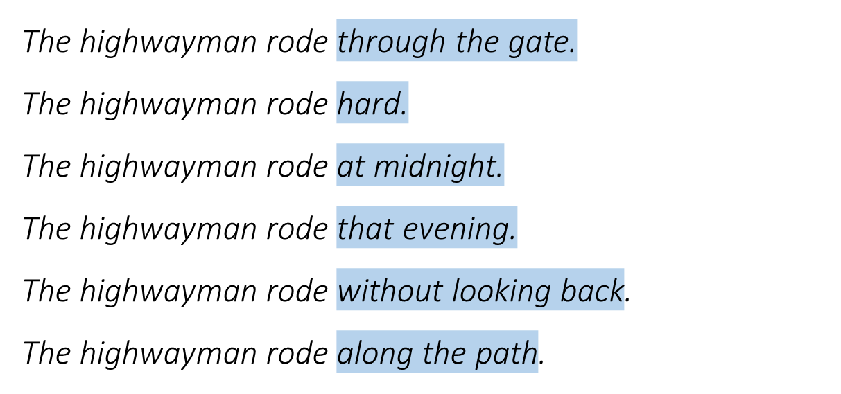
ADVERBIALS – Tell us more about time, place or manner
– Which of these adverbials answers the questions When? Where? How?

Slide 7
ADVERBIALS – Tell us more about time, place or manner
– Which of these adverbials answers the questions When? Where? How?
The highwayman rode through the gate.
The highwayman rode hard.
The highwayman rode at midnight.
The highwayman rode that evening.
The highwayman rode without looking back.
The highwayman rode along the path.
Where?
How?
When?
When?
How?
Where?

Slide 8
ADVERBIALS – Tell us more about time, place or manner
— Try adding adverbials for time, place or manner to this sentence.
— Try putting them in different places. How does the impact change?
The highwayman rode at midnight.
When adverbials appear at the beginning we call them fronted adverbials.
At midnight, The highwayman rode.
Bess twisted her hands.
With frustration, Bess twisted her hands against the knots.
Fronted adverbials are separated from the main clause by a comma.
Over the bed, Bess twisted her hands in fear.
with frustration
over the bed
before long
in fear
later that day
against the knots

