Slide 1
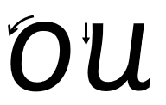

Focus sound: ou
o - Make a curve, go all the way around.
u - Start at the top, come down and curve. Go back up, come back down and flick.

Slide 2
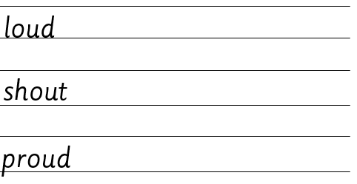
Your turn! Write ou in your book using the lines.
Then try:

