Slide 1
Equivalent Fractions

Slide 2
What does equivalent mean? equal - this means the same. So equivalent means the same value
Let’s recap

Slide 3
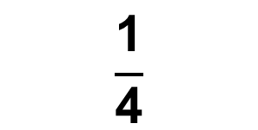
$$\frac{\text{1}}{\text{4}}$$
$$\frac{\text{2}}{\text{8}}$$
What patterns can you see?
What do you notice?

Slide 4
What patterns can you see?
What do you notice?
$$\frac{\text{1}}{\text{4}}$$
$$\frac{\text{2}}{\text{8}}$$
They are equivalent.
$$\frac{\text{1}}{\text{4}}$$
$$\frac{\text{2}}{\text{8}}$$
$$\frac{\text{1}}{\text{4}}$$
Is equivalent to
$$\frac{\text{2}}{\text{8}}$$
You can also say
Is equivalent to

Slide 5
Now you have a go
$$\frac{\text{6}}{\text{9}}$$
$$\frac{\text{2}}{\text{3}}$$
Is
equivalent to
First draw out each fraction.
Remember the bar needs to be the same size.

Slide 6
What did you work out?
$$\frac{\text{6}}{\text{9}}$$
$$\frac{\text{2}}{\text{3}}$$
Is
equivalent to
They are equivalent.

