Slide 1
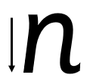
Your turn! Write n in your book using the lines.
n - Start at the top, come down, bounce back up, go over, down and flick.

Slide 2
Your turn! Write n in your book using the lines.
Then try:
nap
sun
ten

