Slide 1
Learning intention – to retrieve and infer information from a text

Slide 2
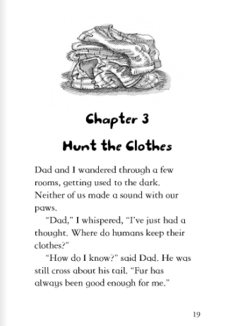
Why didn’t either of the monkeys make a sound?
How was dad feeling? How do you know?

Slide 3
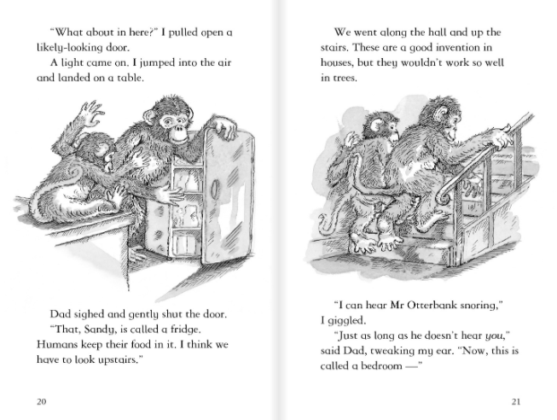
Where did Sandy look for clothes first?
What impression do you get of Sandy’s dad in this part of the story? Why?
Where were the animals heading?
Do you think they will get caught? Explain your answer.

Slide 4
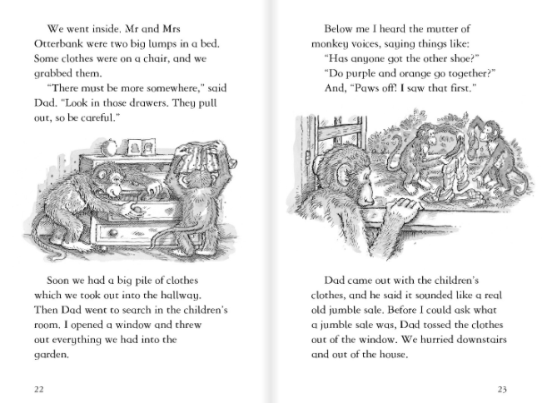
Why did dad tell Sandy to be careful when opening the drawer?
How were the monkeys feeling at this point? What tells you this?

Slide 5
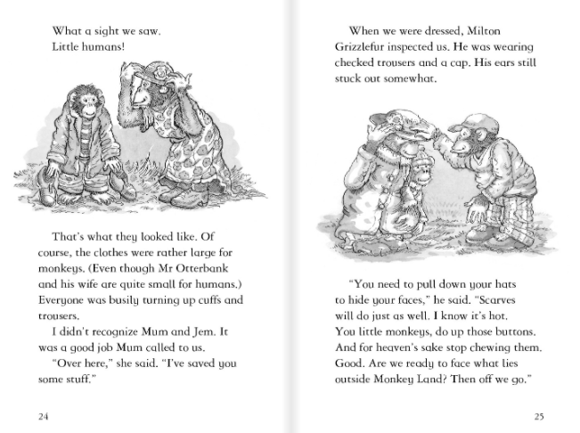
What sight did they see?
What was wrong with the clothes even though Mr and Mrs Otterbank were quite small for humans?
How did they make the clothes fit?
Why did Milton Grizzlefur inspect the monkeys?

