Slide 1
Types of houses and homes

Slide 2
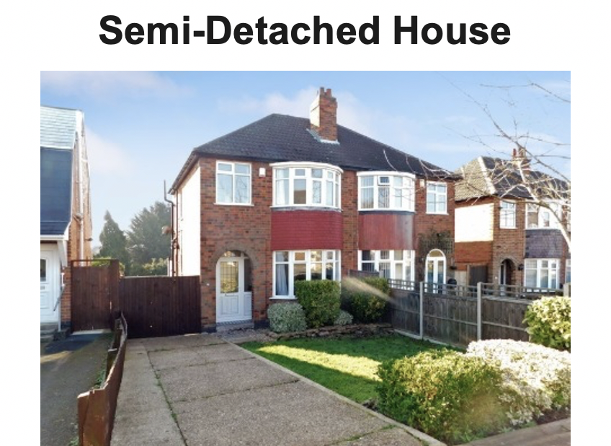
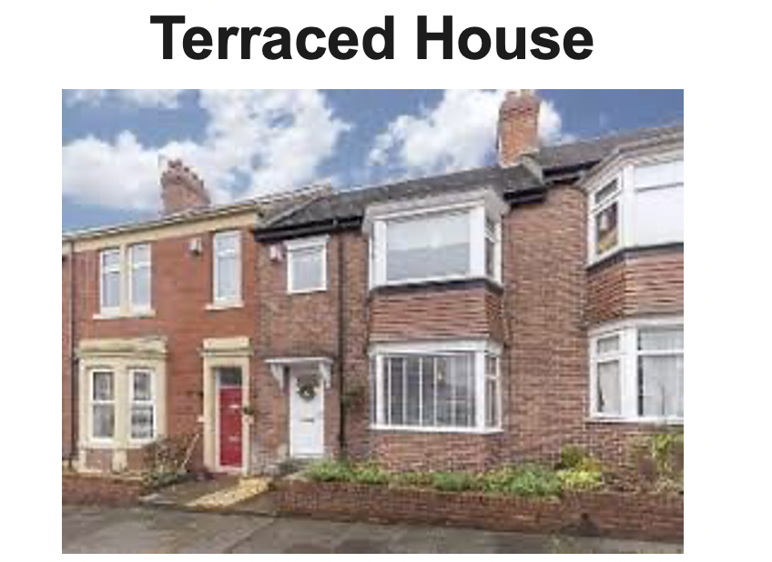

Notes:
Here are two very popular choices of house, semi-detached houses are connected to another house on one of it’s sides. A terraced house is connected to houses on both sides. Think about the houses near school, are there more terraced or semi-detached houses?

Slide 3
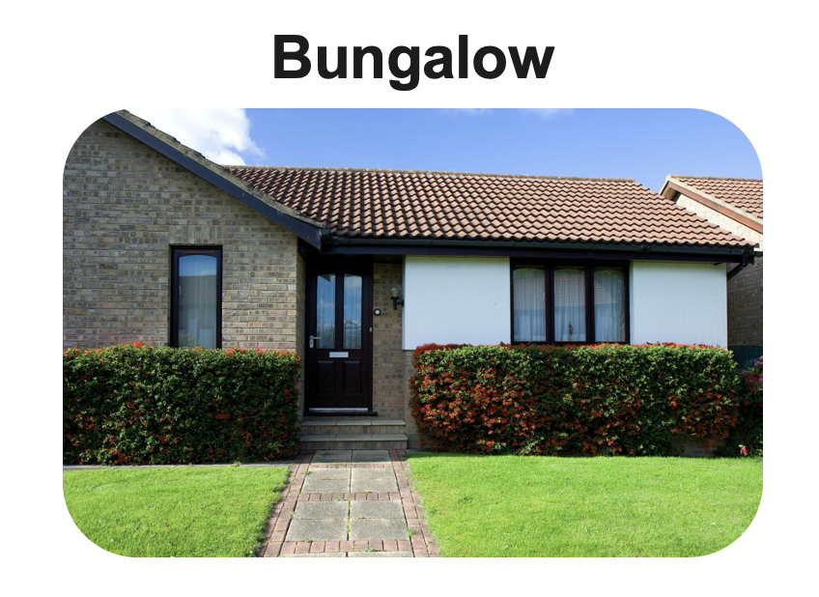
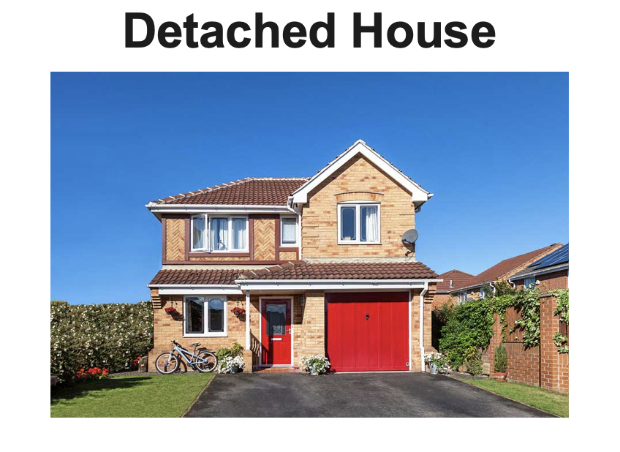
Notes:
Bungalows are another type of house, but the difference is that they don’t have stairs. A detached house is a type of house that has nothing connected to either side.

Slide 4
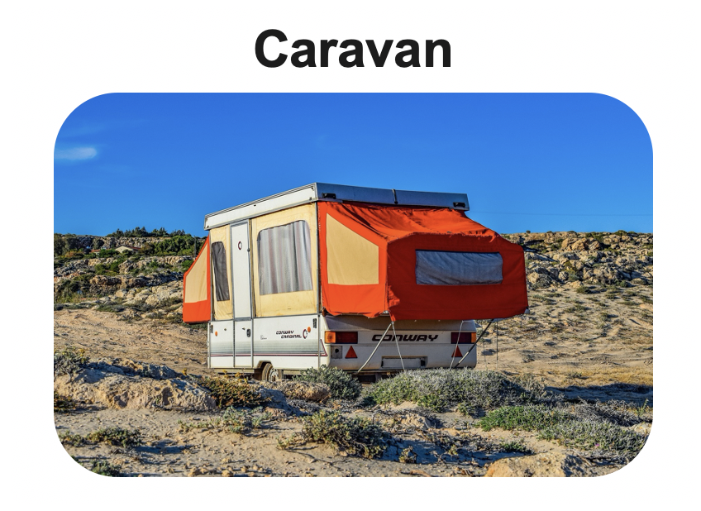
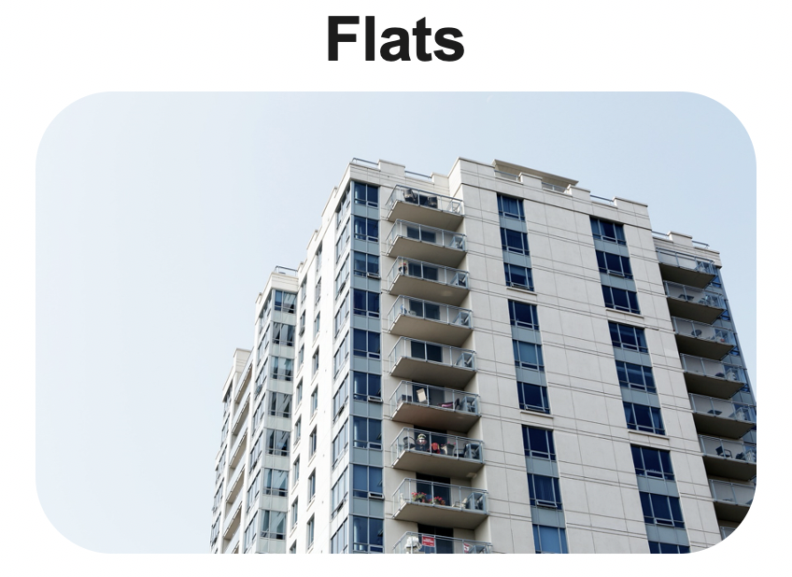
Not all homes are houses…
Notes:
Not all houses are homes, some people live in caravans or flats. A caravan is a vehicle designed for living in. A flat is usually in a building with lots of others, they are often on one floor with no stairs.

Slide 5
Your turn…
Can you draw your home?
Think about which type it is, what it is made of and how old it could be.
Notes:
Can you draw your home?
Think about what it is made of and how old it could be.

Slide 6
Commentary:
Slide 1:
Slide 2: Here are two very popular choices of house, semi-detached houses are connected to another house on one of it’s sides. A terraced house is connected to houses on both sides. Think about the houses near school, are there more terraced or semi-detached houses?
Slide 3: Here are two very popular choices of house, semi-detached houses are connected to another house on one of it’s sides. A terraced house is connected to houses on both sides. Think about the houses near school, are there more terraced or semi-detached houses?
Slide 4: Not all houses are homes, some people live in caravans or flats. A caravan is a vehicle designed for living in. A flat is usually in a building with lots of others, they are often on one floor with no stairs.
Slide 5: Can you draw your home?
Think about what it is made of and how old it could be.

