Slide 2
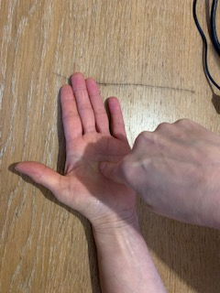
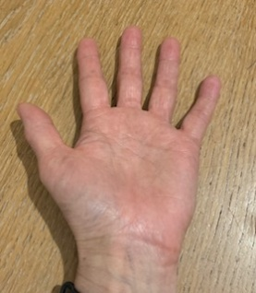
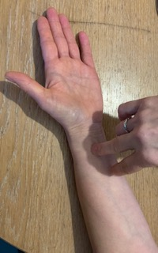
Round and round the garden like a teddy bear
(Open your hand out and then get your finger and draw a big circle round your
hand)
One step ,two step
(Move your fingers up your arm)
Tickle you under there
(Then tickle under your arm or chin)

Slide 3
Round and round the garden like a teddy bear One step,two steps Tickle you under there

