Slide 1
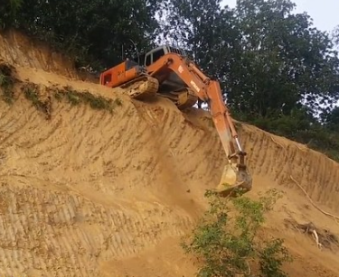

Fantastic Mr Fox
Chapter 6
The Race
What do you think this chapter may be about?
Do you think the farmers will catch the foxes?

Slide 2
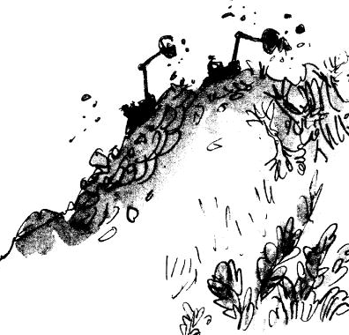
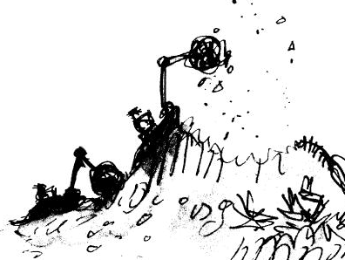
Chapter 6
The Race
Now there began a desperate race, the machines against the foxes. In the beginning, the hill looked like this:
After about an hour, as the machines bit away more and more soil from the hilltop, it looked like this:

Slide 3
Sometimes the foxes would gain a little ground and the clanking noises would grow fainter and Mr Fox would say, ‘We’re going to make it! I’m sure we are!’ But then a few moments later, the machines would come back at them and the crunch of the mighty shovels would get louder and louder. Once the foxes actually saw the sharp metal edge of one of the shovels as it scraped up the earth just behind them.
‘Keep going, my darlings!’ panted Mr Fox. ‘Don’t give up!’
‘Keep going!’ the fat Boggis shouted to Bunce and Bean. ‘We’ll get him any moment now!’

Slide 4
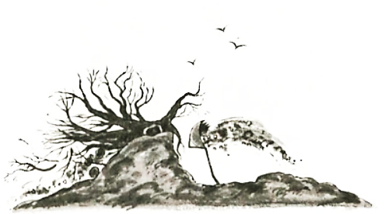
‘Have you caught sight of him yet?’ Bean called back.
‘Not yet,’ shouted Boggis. ‘But I think you’re close!’
‘I’ll pick him up with my bucket!’ shouted Bunce. ‘I’ll chop him to pieces!’
But by lunchtime the machines were still at it. And so were the poor foxes. The hill now looked like this…
The farmers didn’t stop for lunch; they were too keen to finish the job.
‘Hey there, Mr Fox!’ yelled Bunce, leaning out of his tractor. ‘We’re coming to get you now!’
‘You’ve had your last chicken!’ yelled Boggis. ‘You’ll never come prowling around my farm again!’

Slide 5
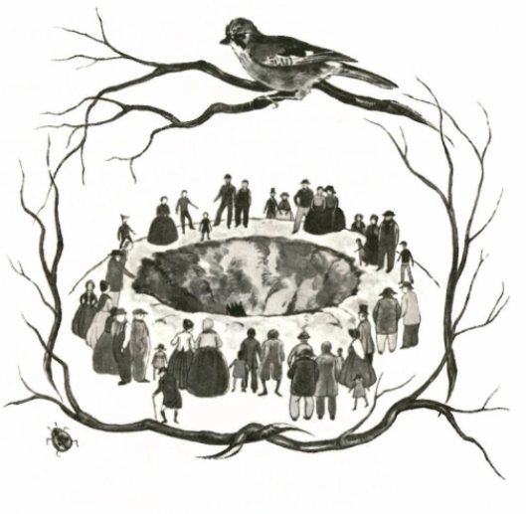
A sort of madness had taken hold of the three men. The tall skinny Bean and dwarfish pot-bellied Bunce were driving their machines like maniacs, racing the motors and making the shovels dig at a terrific speed. The fat Boggis was hopping about like a dervish and shouting, ‘Faster! Faster!’
By five o’clock in the afternoon this is what had happened to the hill…
The hole the machines had dug was like the crater of a volcano. It was such an extraordinary sight that crowds of people came rushing out from the surrounding villages to have a look. They stood on the edge of the crater and stared down at Boggis and Bunce and Bean.

Slide 6
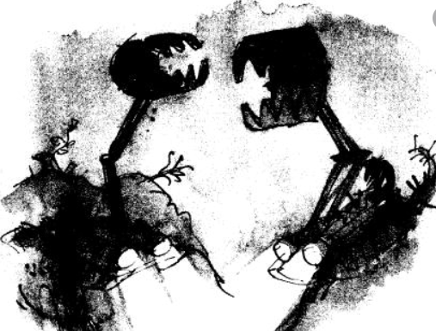
‘Hey there, Boggis! What’s going on?’
‘We’re after a fox!’
‘You must be mad!’
The people jeered and laughed. But this only made the three farmers more furious and more obstinate and more determined than ever not to give up until they had caught the fox.

Slide 7
Task
West Foxwood Environmental Services
West Foxwood City Council
89, Little Twig Way
West Foxwood
Woodleshire
WD16 6FA
16th October 2020
Dear Messrs Boggis, Bunce and Bean
It has been brought to our attention that you have recently moved heavy machinery into the Fox Woods with intent to destroy the surrounding environment. This action is against all the rules of Environmental Protection and the use of Heavy machinery.
In accordance with council policy you have 48 hours from receipt of this letter to remove the heavy machinery and to vacate the woods. Failure to do so could result in a heavy fine and possibly a jail sentence.
Council inspectors will visit the site on Friday morning at 09:00 to ensure that the area has been cleared.
Should you have any queries or objection to this order, please do not hesitate to contact me directly.
Yours Sincerely
Clara Robinson
Case Manager
West Foxwood Environmental Services
c.robinson@westfoxwood.gov.uk
017993 684311
Letter to the farmers

Slide 8
Task
Word Bank
Unfortunately important
Robber dangerous
Essential evil
Concern nosey
Yours sincerely
You are one of the farmers. You have to send a reply to this letter.
Here is a starting sentence you can use to reply to Ms Robinson. You can use this to get going or write your own opening sentence.
Dear Ms Robinson
Thankyou for your concern and letter regarding our work in Fox Wood.
Here are some things you could consider using in your reply.
Explain why you are digging up the hill – there is a thief living in the hill who is stealing all you chickens and he is costing you a fortune.
Think about the farmer you are;
Are you a nice person or are you rude and nasty?
Do you think you will right a polite letter back or a rude letter?
Have fun writing a rude letter or a polite letter but be consistent. Here are a few ideas
‘Should mind their own business.’
‘Keep your nose out of things that do not concern you.’
‘That you’ll do what you want to get the fox.’
‘There is nothing you can do to stop me!’
Top Tips
Use full sentences.
Write in the first person (I will…)
Use paragraphs (introduction, main points, final thoughts)
Use conjunctions to make interesting sentences (because, even though, as, and, as well as)
Use different ways to start each sentence.

