Slide 1
Learning Intention
Characteristics of living things

Slide 2

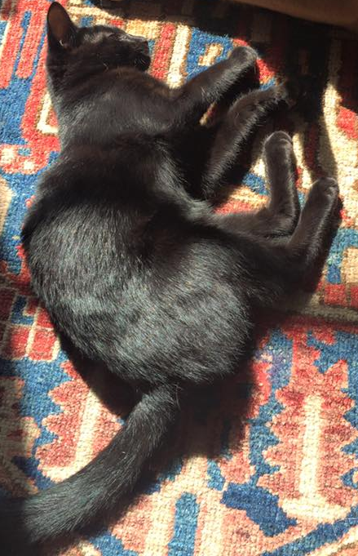
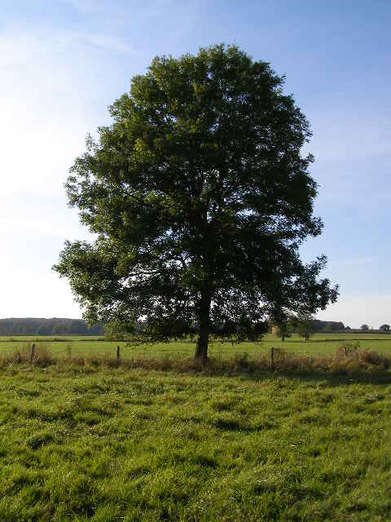
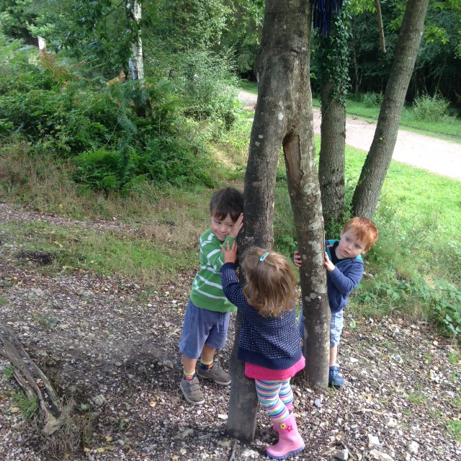
What makes a living thing?

Slide 3
Although all living things look different to each other even if they are the same species, there are 7 things that all living things do.
These 7 things are called life processes.
A thing is only living if it does all 7 of these life processes.

Slide 4
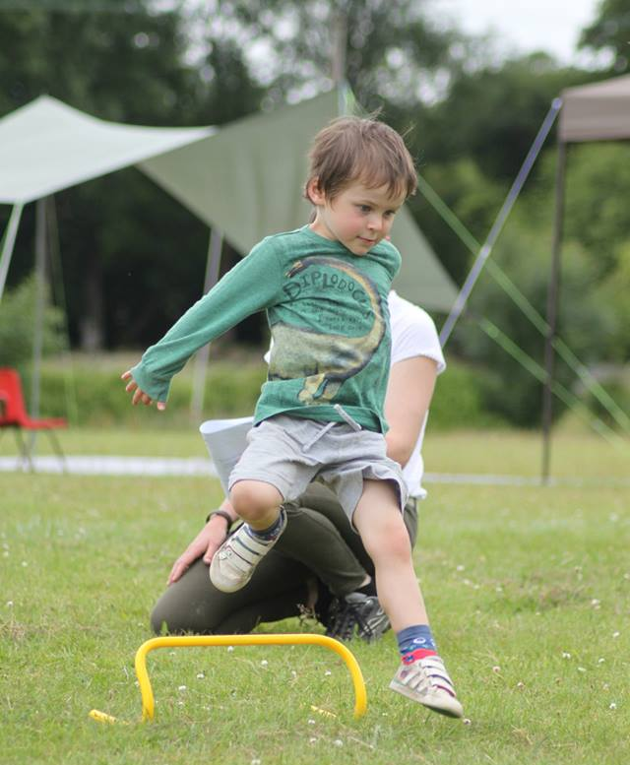
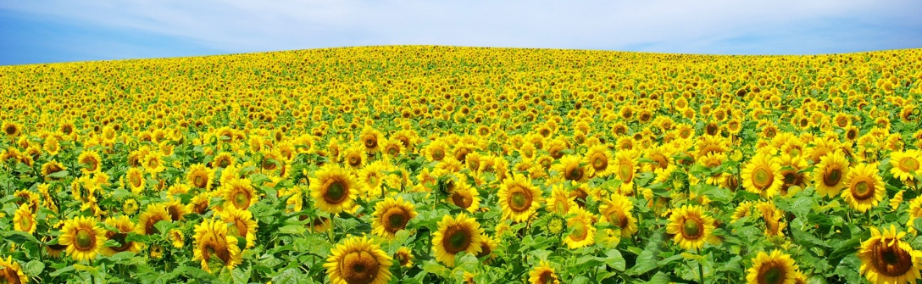
All living things move.
Animals move their body. From big movements like a jump, to small movements like a wink.
Plants turn, or grow, towards the light.

Slide 5
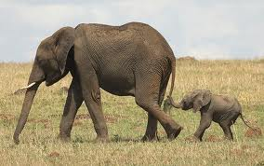
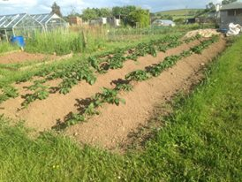
All living things reproduce.
Animals have babies.
New plants grow from seeds.

Slide 6
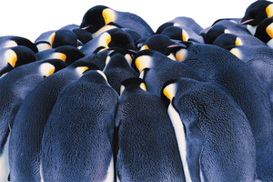
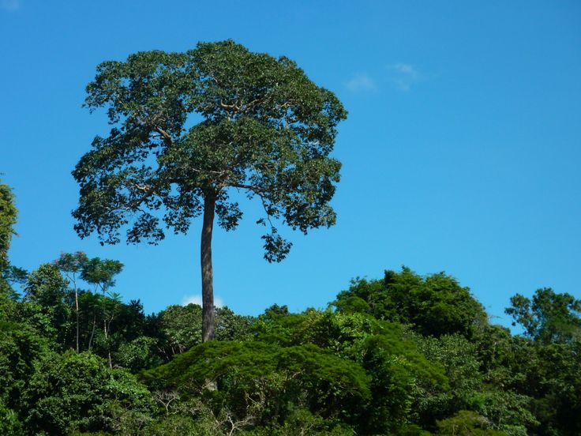
All living things are sensitive.
Living things are sensitive to their surroundings.
Animals react to changes in the temperature around them.
Plants grow towards sunlight and send their roots deeper if they need to find more water.

Slide 7
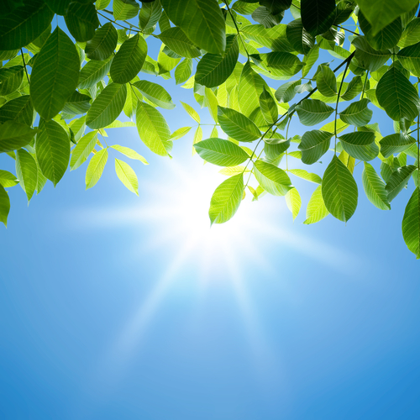
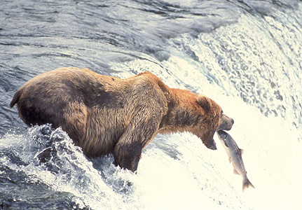
All living things need nutrition.
Living things need food for energy.
Plants make their own food using energy from the sun.
Animals eat plants and/or
other animals.

Slide 8
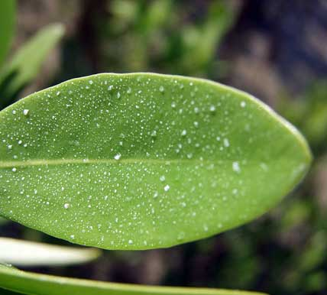
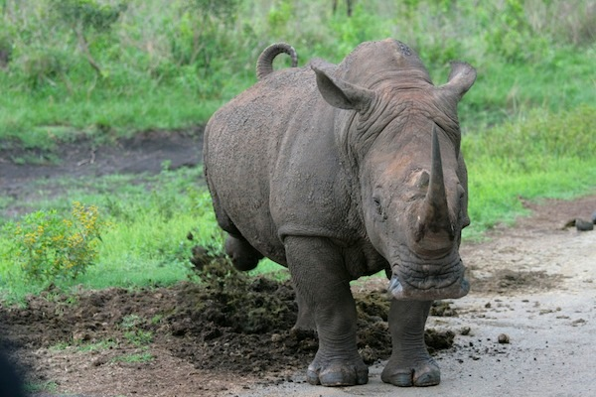
All living things excrete.
Plants and animals both need to get rid of waste gas and water.
Animals also need to get rid of other waste products.

Slide 9
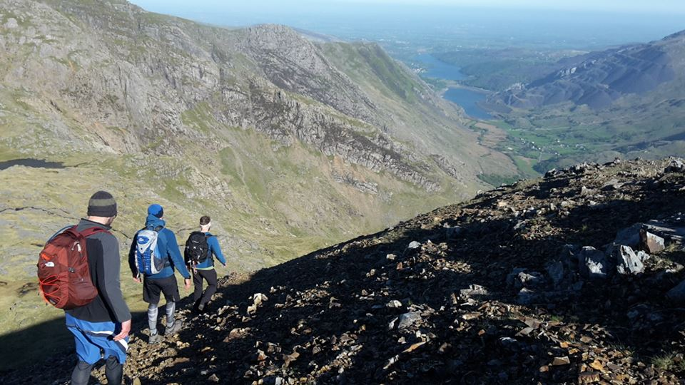
All living things respire.
What will you use your energy for today?
Plants and animals use oxygen in the air to turn food into energy.

Slide 10
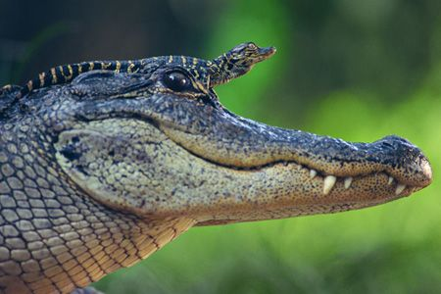
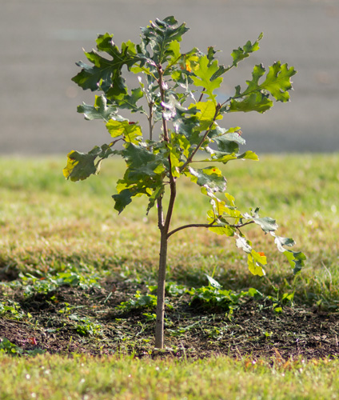
All living things grow.
Young animals grow into adults and plant seedlings grown in to mature plants.

Slide 11
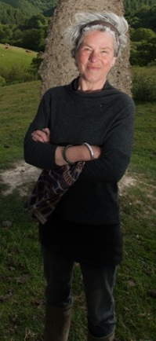
M – movement
R – reproduction
S – sensitivity
N – nutrition
E – excretion
R – respiration
G - growth

Slide 12
Now it’s your turn
You will are going to create a detailed poster to explain the seven characteristics of living things. On your poster you should include either an animal or plant drawings to support your explanations. Make the poster bright and eye-catching and fairly simple so the message is not confused.

Slide 13
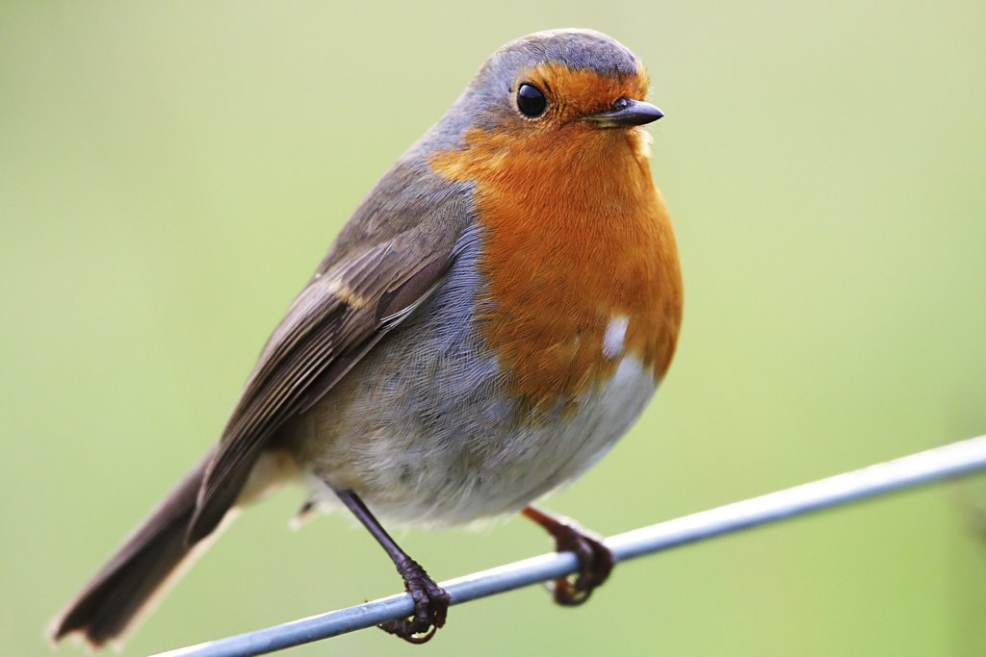
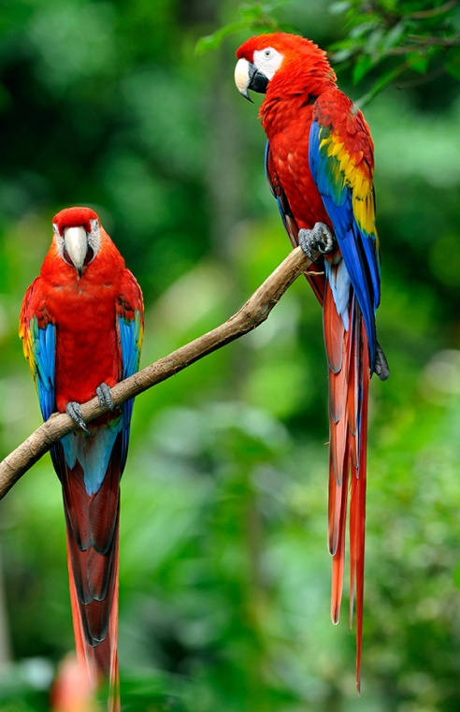
Challenge
Can you talk to someone at home about the following
Name some living things we will find living in the wild in our local environment.
List some living things we will definitely not find locally.
Remember to think of some plants and animals.

