Slide 1


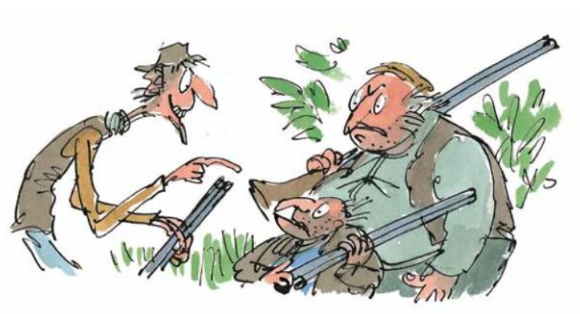
Direct speech
Never
never never!
We don’t let
him go!

Slide 2
Key vocabulary
Words that are used instead of said
shouted
declared
cried
yelled
asked
screamed

Slide 3
Direct Speech
What is direct speech?
Direct speech is when characters in a story speak to each other or have a conversation. This is an example from chapter 3.
“Well my darling,” said Mr Fox. “What shall it be tonight?”
“I think we’ll have duck tonight,” said Mrs Fox. “Bring us two fat ducks, if you please. One for you and me, and one for the children.”
“Ducks it shall be!” said Mr Fox. “Bunces best!”

Slide 4
Todays Task
Todays task is to listen and read chapter 7 of Fantastic Mr Fox
Next try to find an example of speech where Boggis, Bunce and Bean are talking to each other.
You will find speech by looking for the inverted commas and the said words.
“Well my darling,” asked Mr Fox. “What shall it be tonight?”
Inverted commas
‘said’ word

Slide 5
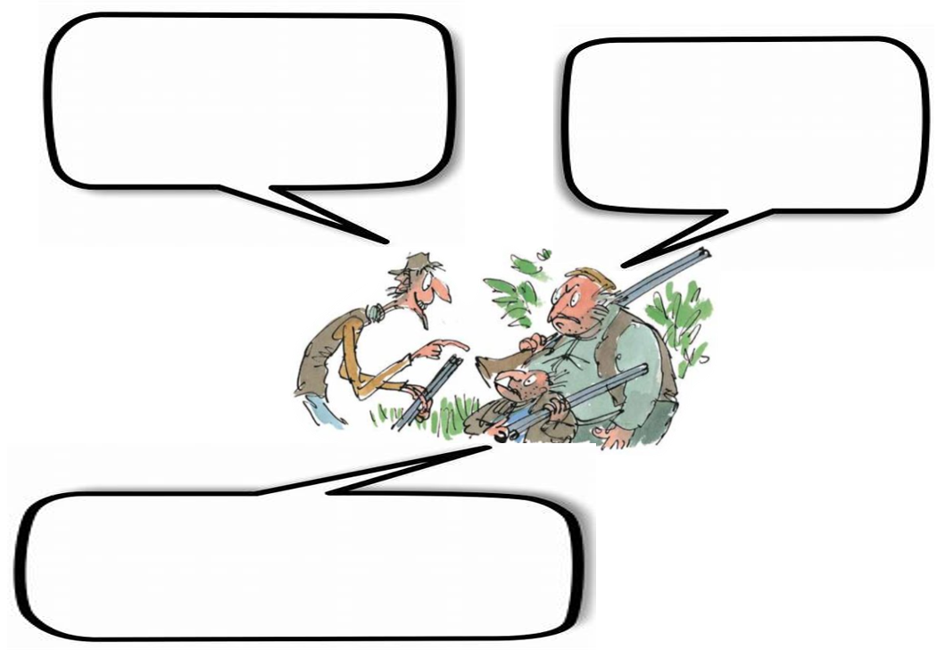
Now add the speech to the picture with the speech bubbles or draw a picture of Boggis Bunce and Bean with speech bubbles.
Remember which character is which to make sure you have the right words being spoken by the right character!

Slide 6
Fantastic Mr Fox – Chapter 7 “We’ll never let him go!”
At six o’clock in the evening, Bean switched off the motor of his tractor and climbed down from the driver’s seat. Bunce did the same. Both men had had enough. They were tired and stiff from driving the tractors all day. They were also hungry. Slowly they walked over to the small fox’s hole in the bottom of the huge crater. Bean’s face was purple with rage. Bunce was cursing the fox with dirty words that cannot be printed. Boggis came waddling up. “Dang and blast that filthy stinking fox!” he said. “What the heck do we do now?”

Slide 7
“I’ll tell you what we don’t do,” Bean said. “We don’t let him go!”
“We’ll never let him go!” Bunce declared.
“Never-never-never!” cried Boggis.
“Did you hear that, Mr Fox!” yelled Bean, bending low and shouting down the hole. “It’s not over yet, Mr Fox! We’re not going home till we’ve strung you up dead as a dingbat!” Whereupon the three men all shook hands with one another and swore a solemn oath that they would not go back to their farms until the fox was caught.
“What’s the next move?” asked Bunce, the pot-bellied dwarf.

Slide 8
“We’re sending you down the hole to fetch him up,” said Bean. “Down you go, you miserable midget!”
“Not me!” screamed Bunce, running away.
Bean made a sickly smile. When he smiled you saw his scarlet gums. You saw more gums than teeth. “Then there’s only one thing to do,” he said. “We starve him out. We camp here day and night watching the hole. He’ll come out in the end. He’ll have to.”
So Boggis and Bunce and Bean sent messages down to their farms asking for tents, sleeping-bags and supper.

Slide 9
Now add the speech to the picture with the speech bubbles or draw a picture of Boggis Bunce and Bean with speech bubbles.
Remember which character is which to make sure you have the right words being spoken by the right character!

Slide 10
