Slide 1
Year 1 Science My Weather Report
Wed 20th

Slide 2
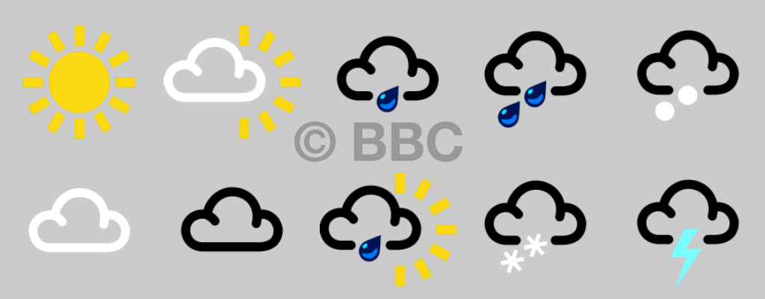
Which weather type is it?

Slide 3
Wed 20th
Notes:
If we take a look at this weather report, it starts from Wednesday and goes to next Monday. Let’s look at Wednesday first, look for the ’w’ and the green circle. Ok, what was the weather like then? Two raindrops suggest that it was heavy rain on Wednesday. Now looking ahead to next Monday, look for the ‘m’ and the red circle. Is the weather the same on Monday and Wednesday? No, on Monday it says it will be sunny. Let’s wait and see! Today is Friday, let’s look for ‘f’ and the purple circle, what does that symbol mean? Partly sunny and partly cloudy, look outside to check.

Slide 4
Now it’s your turn!
you!
Notes:
Next week you’re going to be the weather forecaster, so we need to keep track of the weather!

Slide 5
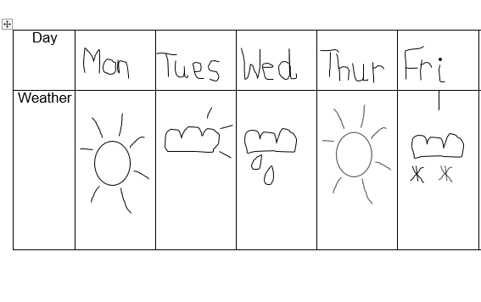
This is my weather diary that we have been filling in this week. I am going to be the weather lady.

Slide 6
Have a go at using your weather diary to be the weather person! Tell your grown up what the weather has been like this week.

Slide 7
Commentary:
Slide 2: Look at the different weather symbols, can you decide which weather type it is showing? Can you see sunny, cloudy, snowy, heavy rain? You can tell the difference between heavy and light by counting the raindrops.
Slide 3: Last week we learnt that the weather report tells us what the weather is going to be like or has been that week. Look, in the red circle we can see that on Wednesday it was raining. In the purple circle it tells us that on Friday it was cloudy with a bit of sun, and in the green circle it tells us that on Monday it was sunny.
Slide 5: Now its our turn to be the weather person! This is my weather diary from this week and I am going to pretend to be the weather lady.

