Slide 1
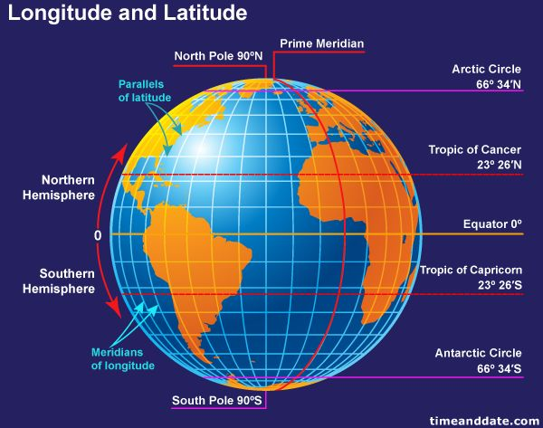
Geography
Longitude and Latitude

Slide 2
What is longitude and latitude?
What is latitude and longitude?
To help locate where a place is in the world, people use imaginary lines:
To find out how far north or south a place is, lines of latitude are used. These lines run parallel to the Equator.
To find out how far east or west a place is, lines of longitude are used. These lines run from the top of the Earth to the bottom.

Slide 3
This diagram shows that the equator is an imaginary line through the centre of Earth. It also shows that the lines of latitude run horizontally (across) and the lines of latitude run vertically (up and down).

Slide 4
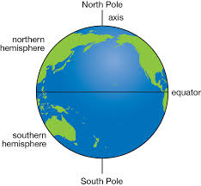
Hemispheres
The Equator is at the centre of the lines of latitude and is at 0° latitude. Anything lying south of the Equator is in the Southern Hemisphere and is labelled °S. Anything lying north of the Equator is in the Northern Hemisphere and is labelled °N. The North Pole is 90° N and the South Pole is 90° S.

Slide 5
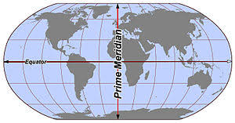
Prime Meridian or Greenwich Meridian
The line labelled 0° longitude is called the Prime Meridian or the Greenwich Meridian and runs through London. Anything lying east of the Greenwich Meridian is in the Eastern Hemisphere and is labelled °E. Anything lying west of the Greenwich Meridian is in the Western Hemisphere and is labelled °W.
Eastern Hemisphere
Western Hemisphere

