Slide 1
Learning Intention
To use descriptive language to modify sentences

Slide 2
Today we will be recapping using adverbs and fronted adverbials to modify our sentences.
What is an adverb?
Adverbs give us more information about:
Verbs (action or doing words/to show states of being)
Adjectives (describing words)
Other adverbs
Whole clauses

Slide 3
Here is an example
Adverbs can give us more information about verbs (an action, doing or state word).
The smooth, sleek snake slithered silently along the branches of the great tree.
What other adverbs could you use to say how the snake moved?
The smooth, sleek snake slithered ________.

Slide 4
Using a fronted adverbial
You could use a fronted adverbial.
This means you put the adverbial to the beginning of the sentence.
Silently, the smooth, sleek snake twisted it’s body around the rough, brown branches of the tree.
Remember that comma after the adverbial !

Slide 5
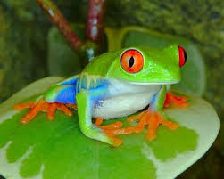
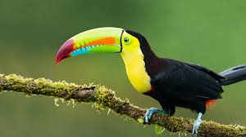
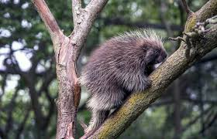
Now it’s your turn
Toucan
Porcupine
Tree frog
For each of these animals create two sentences
With an adverb
With a fronted adverbial
Then think about the animals from your plan – what adverbials will you include in your writing do you think?

