Slide 1
Alternative English 2
Starter
Practise sounding out these words using Fred Talk. Can you try writing them? This will help you to write the end of your story.
and took gold dad

Slide 2
Teacher turn
Listen to the words. Did you read them right?
These tricky words will also help you to write the ending:
and took gold dad
the home to their

Slide 3
Use the story map to retell the story using what you have learned about the beginning, middle and end of the story.
Tell the story in your own words. Then listen to the adult retell the story.

Slide 4
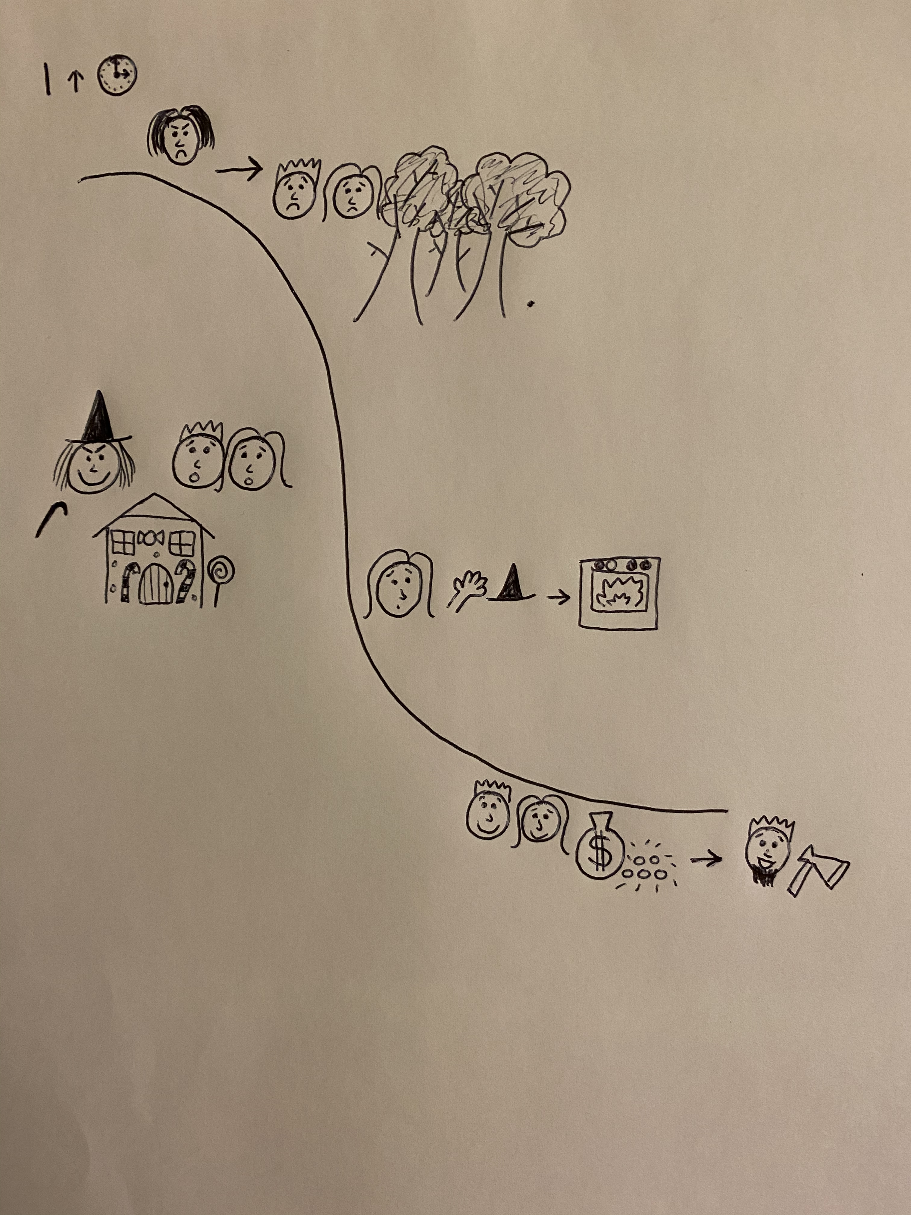

Slide 6
Listen to the adult retell the end of the story.
Try to write the next sentence using the story map and word bank to help.
Remember what we have learned about capital letters and full stops - where should they go?

Slide 7
Word bank
Hansel
Gretel
home

