Slide 1

Learning intention
Features of a diary entry

Slide 2
Writing a diary entry
When you write a diary entry, you are writing about a day in the life of a real person or character. The diary entry needs to sound as if the person or character has written it so it needs to be written from their point of view. It also needs to be exciting and interesting to read.
To get this right, just follow a few easy steps...

Slide 3
Date
A diary entry always has to have a date included.
Either at the top:
Or in the first part of the text:
6th July 1980
Dear Diary,
Today, I made an upsetting announcement which could affect the whole world – the number of bees is declining. Following a lifetime of interest in bees, my recent discoveries have saddened me greatly. We need to so something about this.
Today, I proved my intelligence even though I only received a simple education, when I fought for the right to put my name to my invention. Early this morning, I arrived at the courtroom to face the man who was determined to steal my ideas.

Slide 4
Diary Writing must… be written in the first person
This means including pronouns such as ‘I’, ‘my’, ‘we’ and ‘our’.
These words are special because they tell us the diary is being
written by someone and they are talking about themselves.
Look at the next two examples.
Which one uses the correct words to be written in the ‘first person’?

Slide 5
Diary Writing must… be written in the first person
As I have travelled to many different countries, I have discovered so many new facts about the people and places.
As she has travelled to many different countries, she has discovered so many new facts about the people and the places.
First person
Not first person

Slide 6
Diary Writing Must…
use past tense for the main events.
Diaries are usually written about an event that has already occurred so should be written in the past tense.
Which of these examples is written in past tense?

Slide 7
Diary Writing Must…
use past tense for the main events.
As a child, I learnt how to swim. I swam from one end of the pool to the other. I really enjoyed it, it was great fun!
Past tense
As a child I am learning how to swim. I am swimming from one end of the pool to the other. I am really enjoying it, it is great fun!
Present tense

Slide 8


Diary Writing Must…
tell events in chronological order.
In a diary we usually write about the events of our day in the order they happened.
We only include the most important or interesting events.
Which of these events would you include in a diary?
I ate breakfast.
We boarded the largest ship in the dock.
The seas were choppy as we left the harbour.
We had to wear lifejackets to keep us safe.
I looked at the water.
You might choose to include information about breakfast
and looking at the water if it is relevant or unusual.

Slide 9
Diary Writing Must…
describe the events from the writer’s point of view.
A diary is a personal recount usually about a specific event.
The writer will give their own ideas and opinions about the subject.
They will use first person point of view language, such as ‘I think…’,
‘I believe…’
Where does this writer give their point of view?
Following nearly a lifetime of interest in bees, my recent discoveries have saddened me greatly. I think we need to do something about this.
Following nearly a lifetime of interest in bees, my recent discoveries have saddened me greatly. I think we need to do something about this.

Slide 10
Diary Writing Must…
use an informal style.
Diaries are usually written for our own eyes so they are not usually written in a formal style.
Look at the examples below. Which uses the more informal style?
Without bees we’ll lose many of the plants that we rely on (they need the bees to pollinate them) and breakfast won’t ever be the same again – imagine a world with no cereals!
Without bees to pollinate plants, many will die out. This will result in humans having to alter the foods we eat, including breakfast cereals.
Informal
Formal

Slide 11
Diary Writing Must…
use time conjunctions and adverbials.
A diary describes lots of events which we have to write in order.
We can use time conjunctions and fronted adverbials.
Look at the examples below. Can you identify any time conjunctions or adverbials that have been used?
Early this morning, I arrived at the beach to get the sunniest spot. It was going to be a hot day!
Over the coming years, I will do everything I can to make sure Pandas do not become extinct.
Early this morning, I arrived at the beach to get the sunniest spot. It was going to be a hot day!
Over the coming years, I will do everything I can to make sure Pandas do not become extinct.
Top Tip
If we just use one word, such as ‘then’, to link the events in our diary, it can get very boring!

Slide 12
Find the features
Which features that we have talked about, can you see in the following example?
Dear Diary,
Yesterday, I made the most amazing discovery when I was experimenting in my shed!
As I mixed a variety of things together, I noticed a very unusual reaction which shocked me.
time conjunctions
and adverbials
5th July 2018
5th July 2018
Dear Diary,
Yesterday, I made the most amazing discovery when I was experimenting in my shed!
As I mixed a variety of things together, I noticed a very unusual reaction which shocked me.
date
first person
opinion
past tense

Slide 13
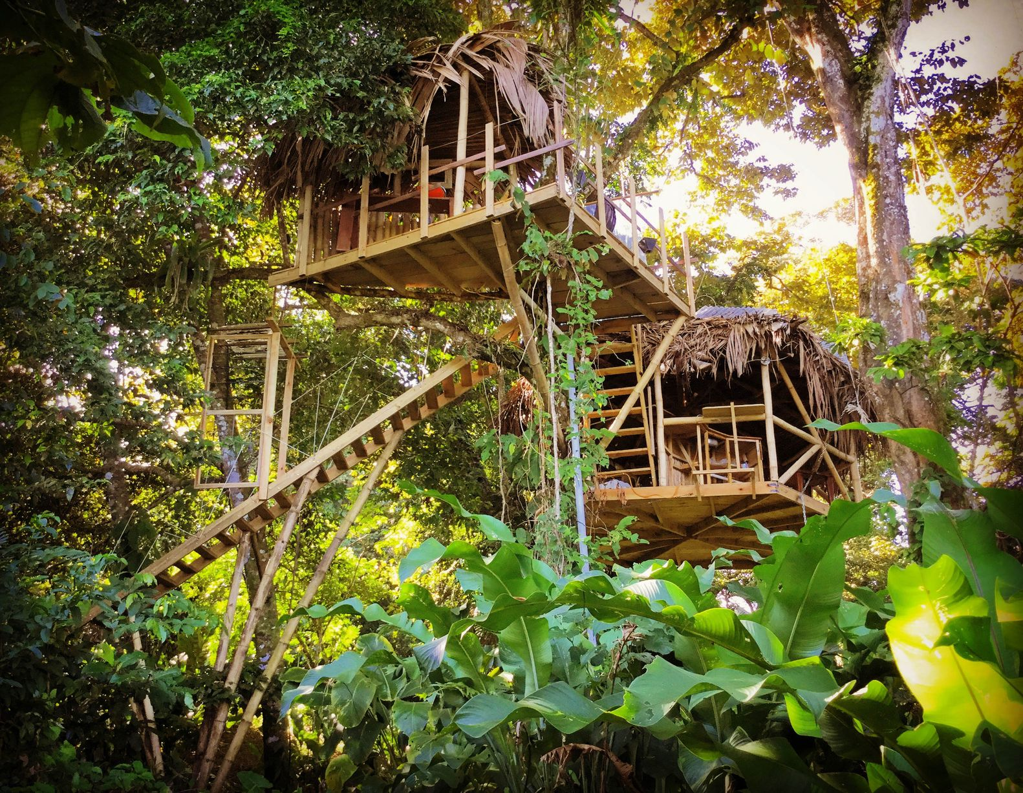
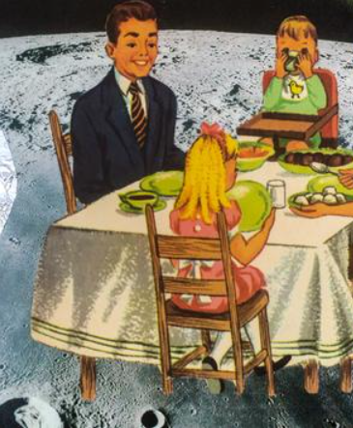
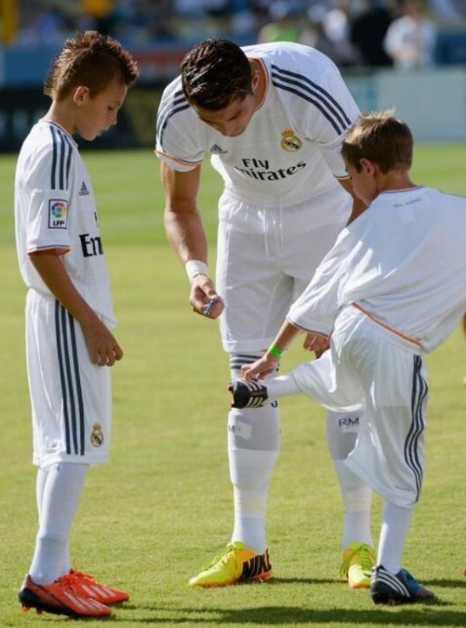
Your task
Write a very short diary entry (about 100 words) about what you have done so far today. It you think it is too boring, you could add something imaginative if you wish.
Like waking up in the jungle, having breakfast on the moon or playing football in the garden with Ronaldo or Messi!

