Slide 1
English
Learning intention: Relative clauses

Slide 2
Relative pronouns
Relative pronouns take the place of nouns or pronouns. They are called relative pronouns because they refer back to something or someone which has already been mentioned.
who
whose
which
where
that

Slide 3
.
I crept down to the basement
, which was covered in cobwebs.
.
I saw an old man
, who was limping.
.
Sit down here
, where I have put your chair.

Slide 4
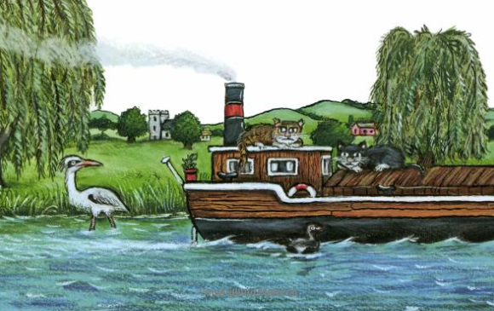
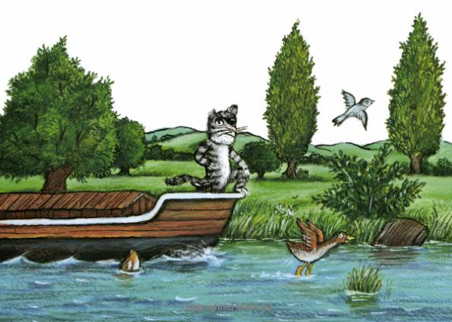
Growl tiger was a fierce cat, who lived on a barge.

