Slide 1
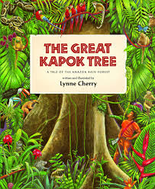
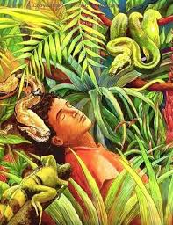
To write my version of The Great Kapok Tree

Slide 2
Let’s recap what we have looked at this week
Expanded noun phrases
This is where we have two adjectives, separated by a comma, before a noun to help give more information about the noun.
The slow, stealthy snake slithered down toward the sleeping man.
Adverbs and adverbial phrases
These give more information about a verb, it tells us how things happen.
The slow, stealthy snake slithered silently towards the sleeping man.
Fronted adverbials
This is where the adverb or adverbial phrase comes before the noun, followed by a comma.
Silently, the slow, stealthy snake slithered towards the sleeping man.

Slide 3
Your story
You are going to use these features you have practiced last week and the plan you made to create your own story, in the style of ‘The Great Kapok Tree’.
We are going to start by writing the beginning paragraph and the first animal meeting today.
On the next slides I have give you an example set of paragraphs and an explanation of why I have written it the way I have.

Slide 4
My Version (Are there ideas you like that you could magpie use?)
A curious, young woman stepped carefully further into the rainforest. All she was carrying was an axe and a bottle of water. Silently, the animals were all watching her as she swung her axe and began chopping the tree. After a while, she got tired and decided to have a sleep down by the river.
I have used an expanded noun phrase and an adverb to introduce my character in the first sentence.
I have then given a little more information about her and what she was doing, using the fronted adverbial ‘silently’ to give more detail.
Finally I have explained where she went for a sleep. Here I have used a fronted adverbial phrase ‘After a while’ to give the reader an idea of time.

Slide 5
The next paragraph (Remember to leave a space before writing this.)
A macaw lived in the Kapok tree. Elegantly, the large, multicolored bird with its strong wings flew down to where the woman was sleeping. It moved close to the woman’s ear and quietly squawked “Senhora, this is a very special tree. It is home to many animals. Please do not chop it down.”
I have introduced my first animal then described it using a fronted adverbial and an expanded noun phrase.
I have explained how the animal spoke using the word squawked then I have wrote down what the animal said in speech marks.
If your main character is a woman you would say senhora, if it’s a man you would say senhor.

Slide 6
Use this to help you create your own beginning.
My story is about a woman who sleeps by the river and the first character is a macaw.
Your ideas may be different to mine, they probably will be!
Use my example to help you but it’s not there for you to just copy. Take my ideas and make them your own. I’m sure you would be able to write an even better beginning to the story than mine.

