Slide 1
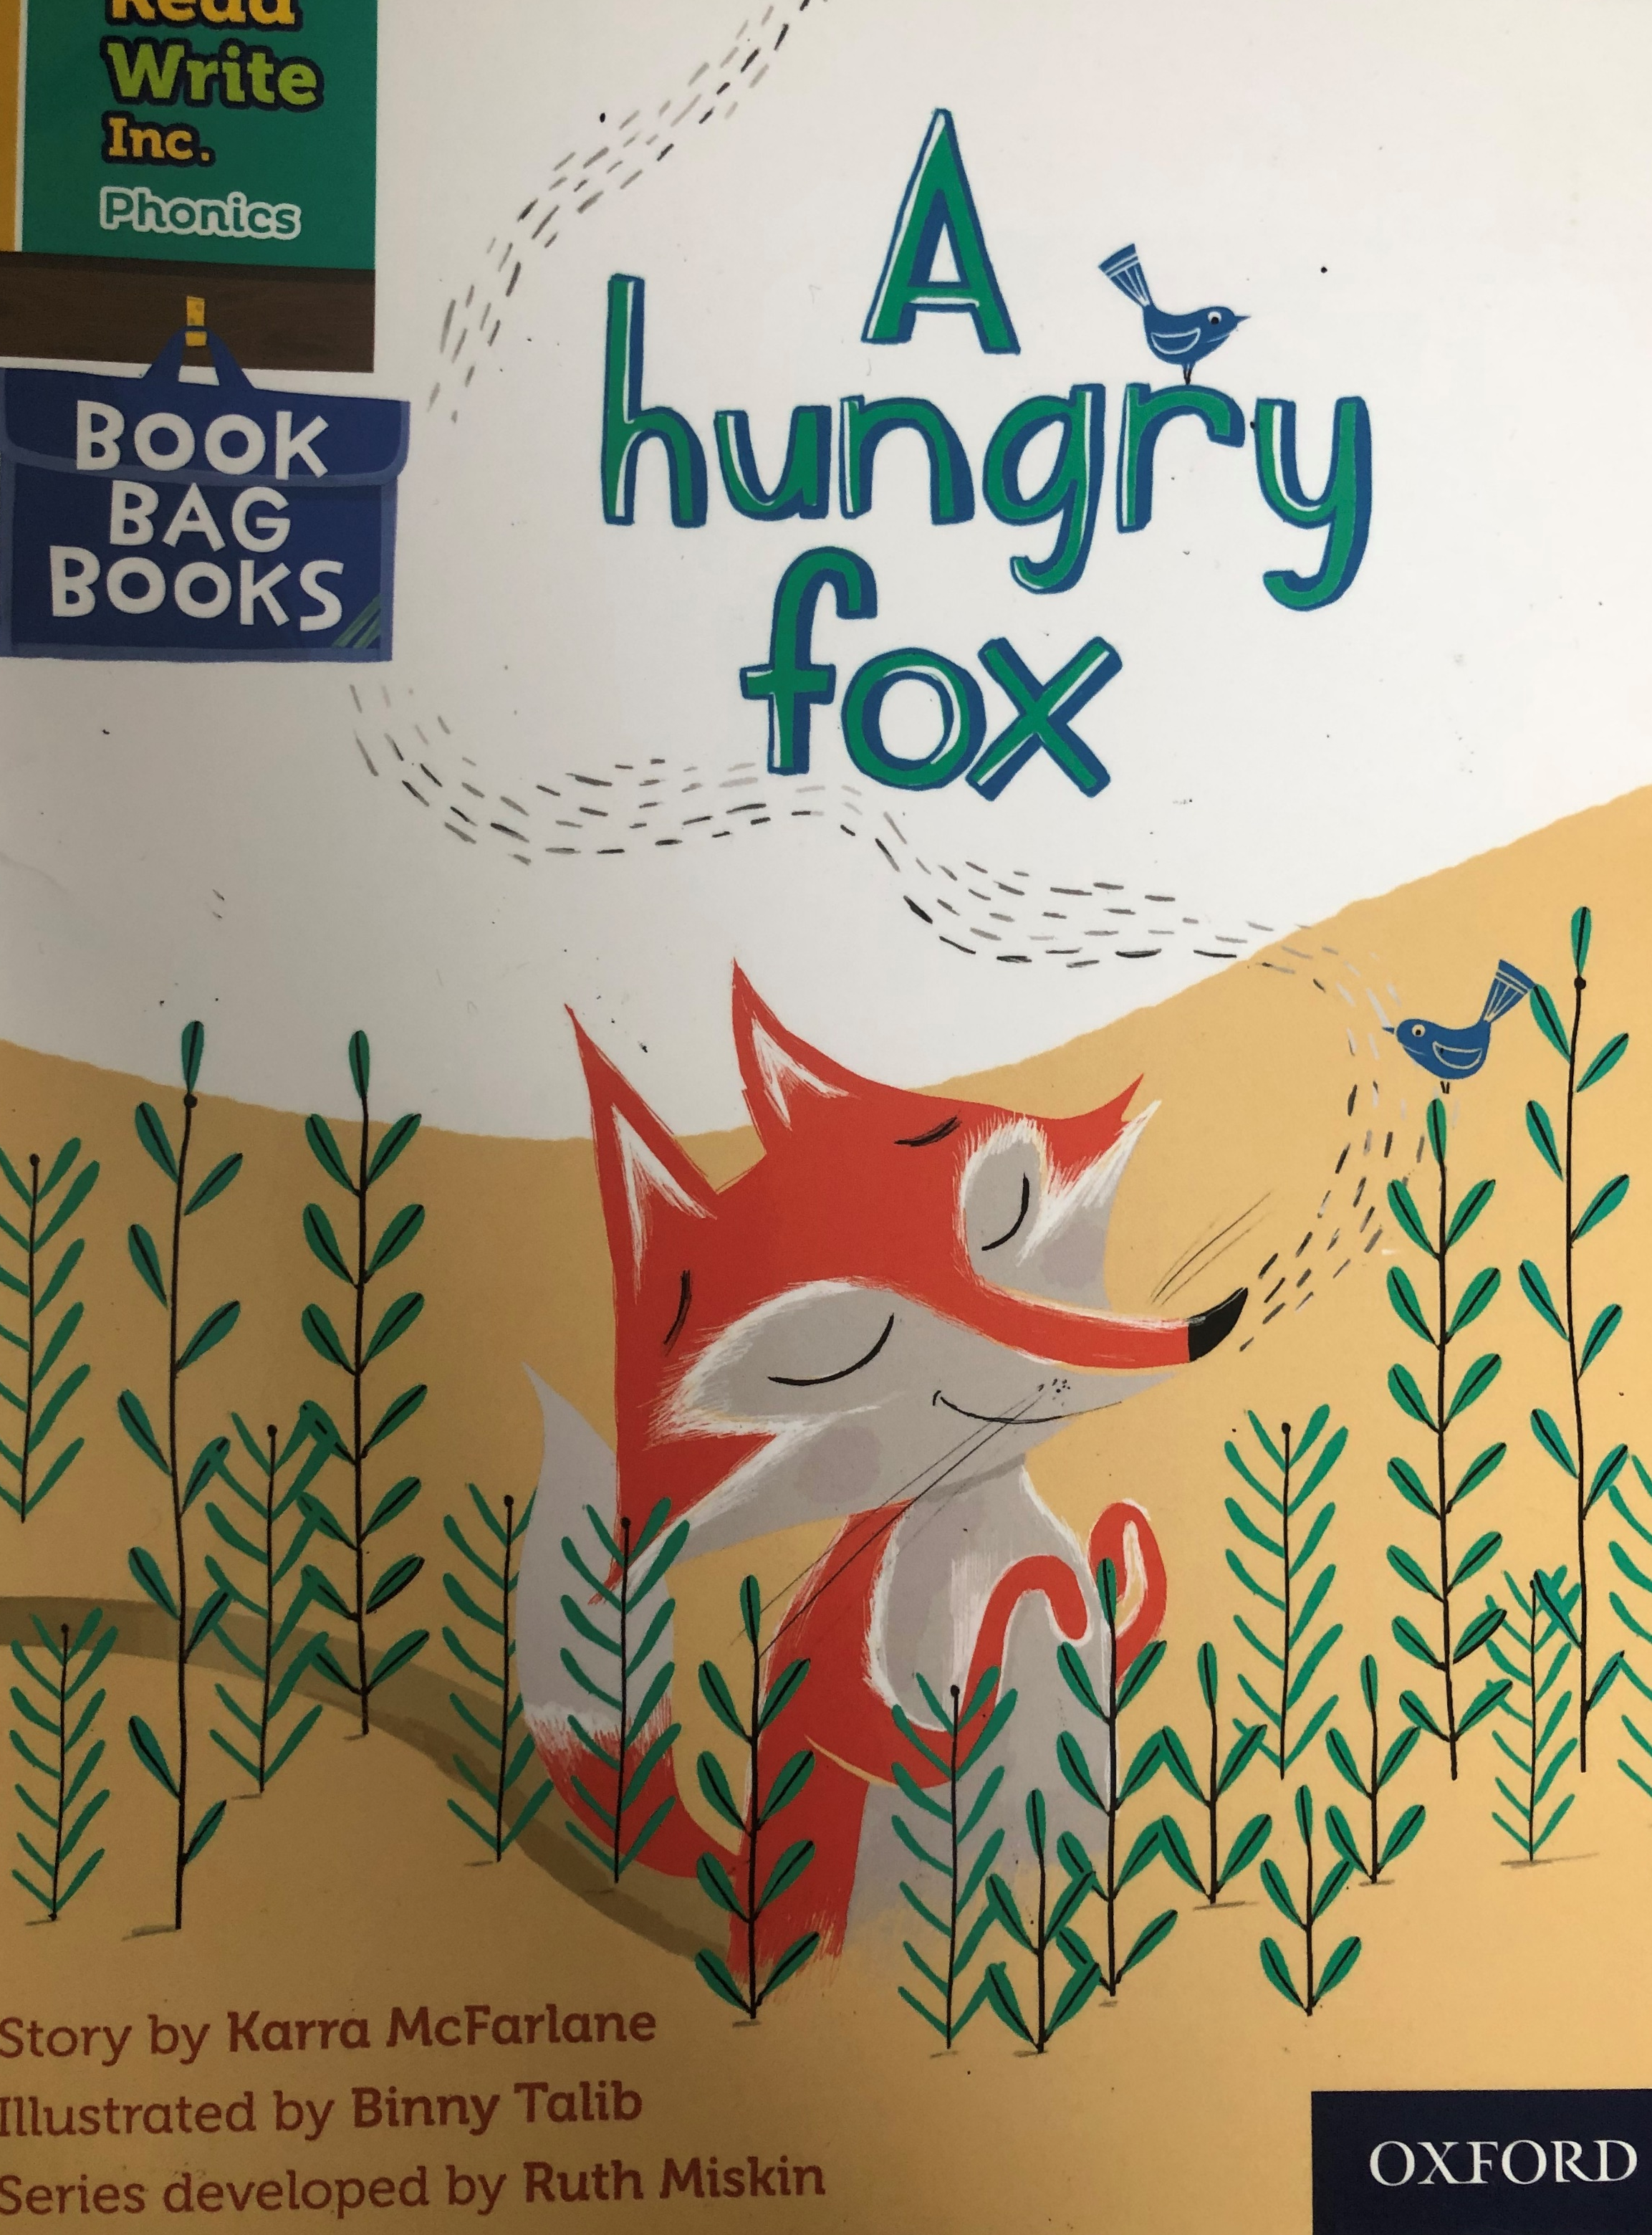

You are going to read the story ‘A hungry fox’.
In this story you will hear words with the sounds:
ea
e
Words with the ea sound are:
head
thread
Words with the e sound are:
hen
den

Slide 2
Can you write two words with ea sound and two words with e sound?
Look at the picture. What can you see? What will happen in the story?

Slide 3
Let’s read these words together. These are words you will come across in the story
Green words
snack
trotted
munching
brea th
Red words
was
wanted
some
watched
small

Slide 4
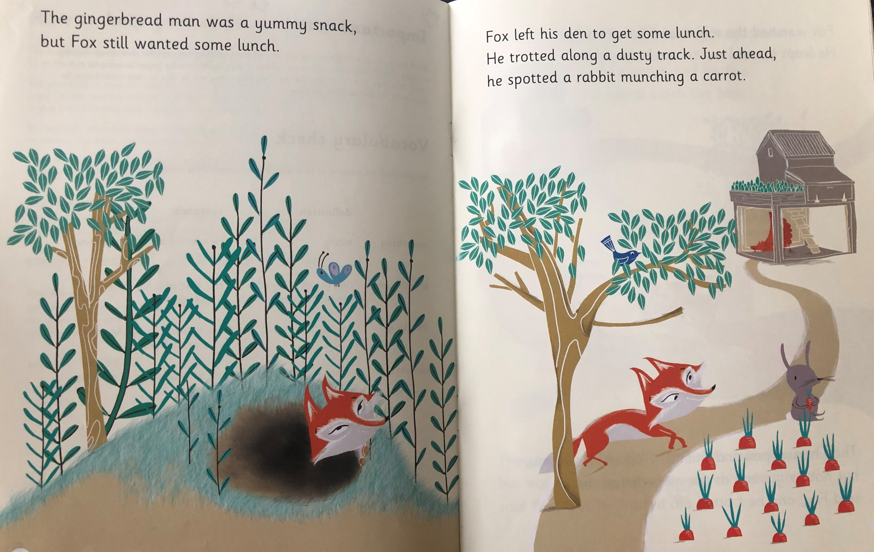
While you’re reading, write down as many words as you can with the ea and e sounds in.
What snack had Fox already had?
What did Fox spot?

Slide 5
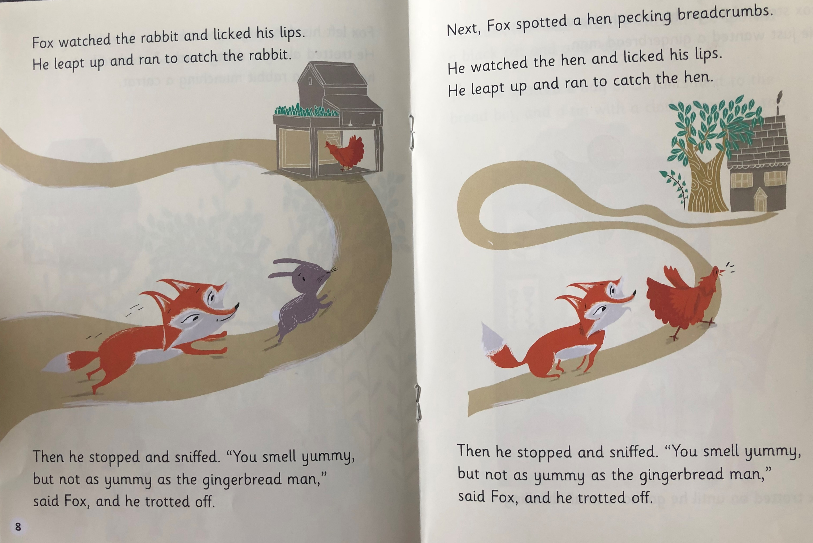
Why did Fox stop chasing the rabbit?
What was hen pecking?
What did Fox do to catch the hen?

Slide 6
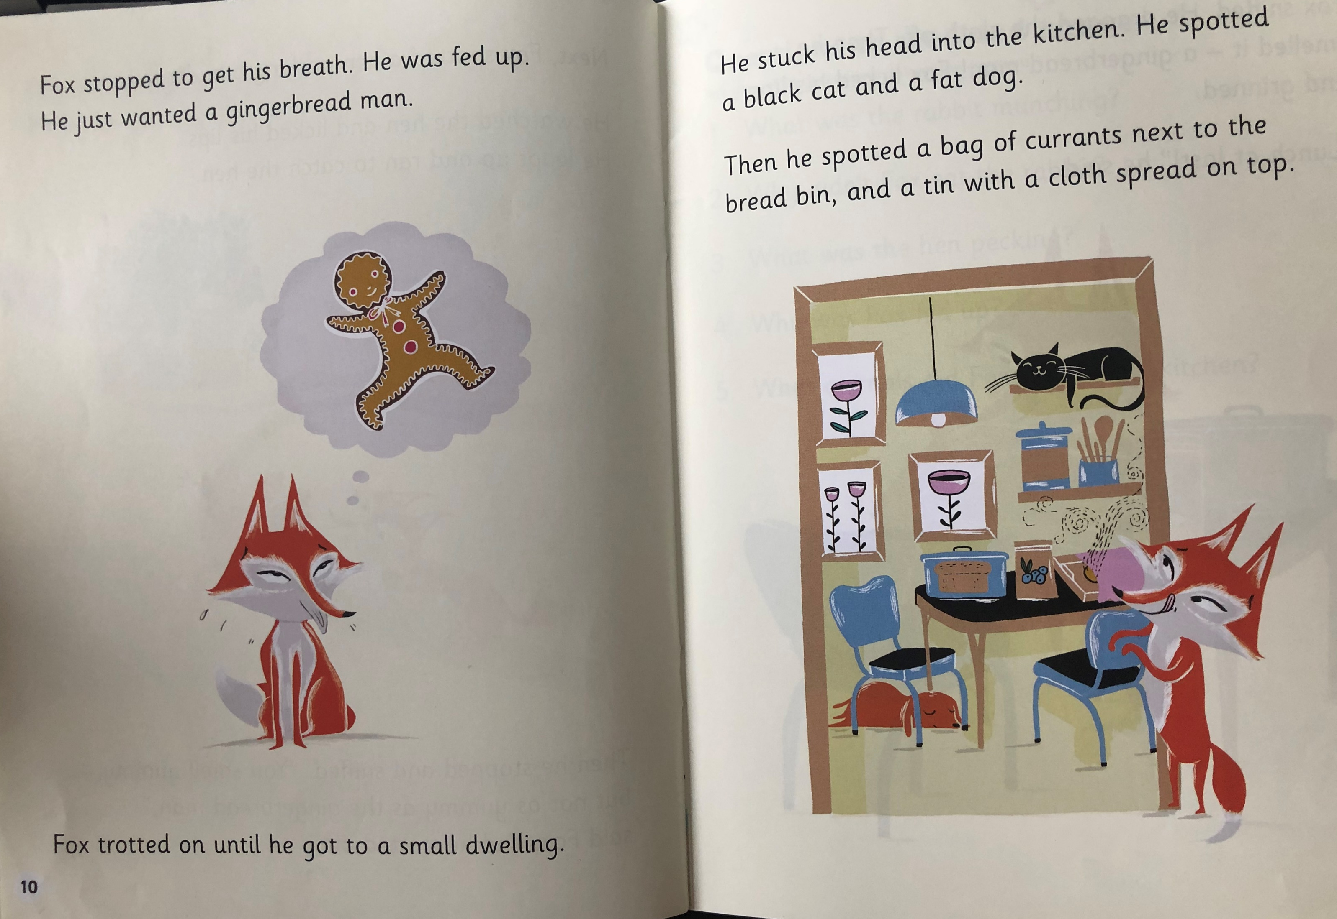
What did Fox want?
Where did Fox trot to?
What did Fox spot?

Slide 7
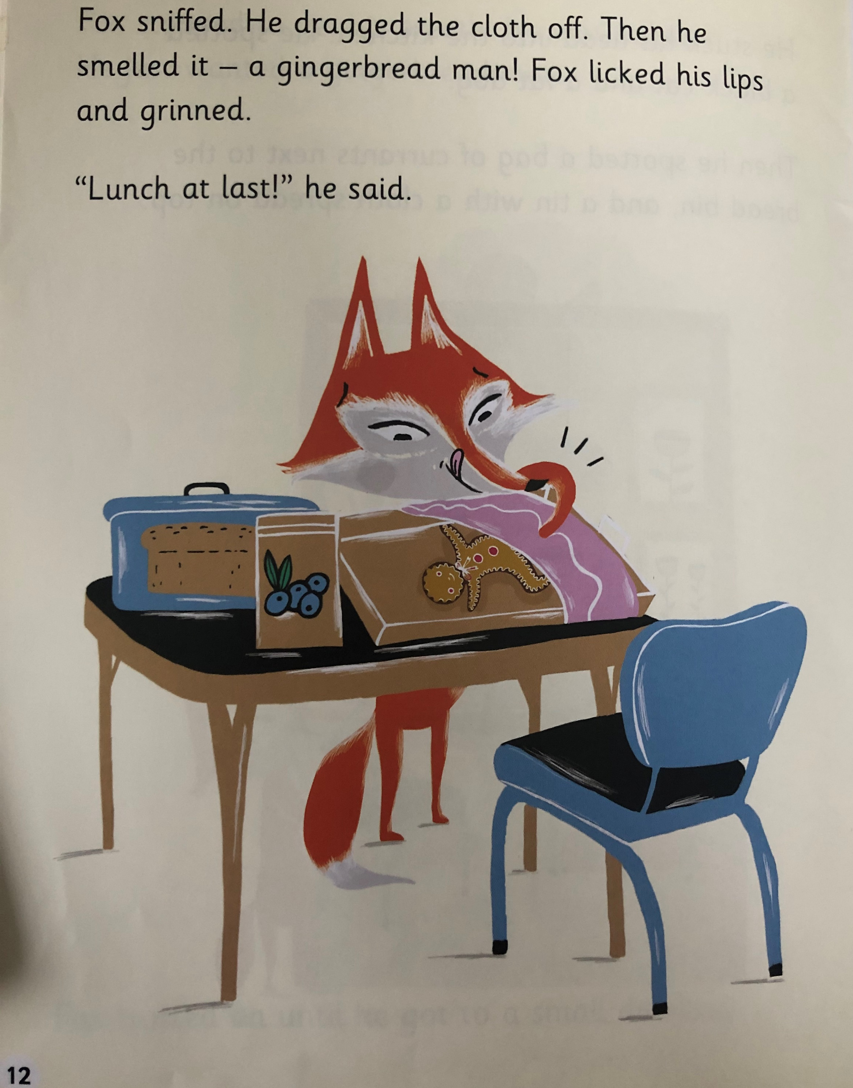
What did Fox see when he dragged the cloth off?
What did he do after he licked his lips?

Slide 8
Recap questions
What was the rabbit munching?
Why didn’t Fox eat the rabbit?
What was the hen pecking?
Why was Fox fed up?
What animals did Fox spot in the kitchen?

