Slide 1
Oh Otto
Part 4

Slide 2
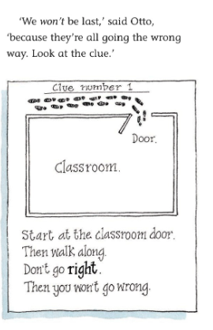
Look carefully at the clue. What direction do the children need to turn?
Why would Miss Underwood add a drawing the clue?

Slide 3
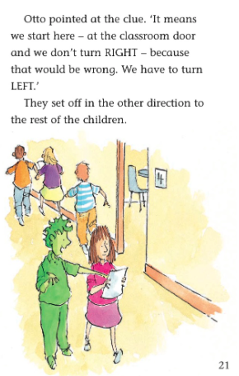
3) What does Otto do to make Jo trust him?
4) Why do you think the children decided to follow Charlie and not Otto?

Slide 4
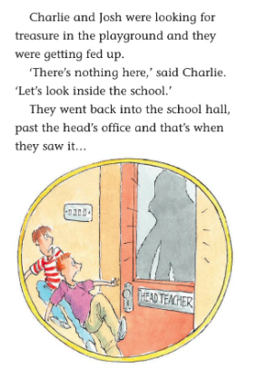
5) What does it mean when the author describes the boys as feeling ‘fed up’?
6) What do you think the boys saw?

Slide 5
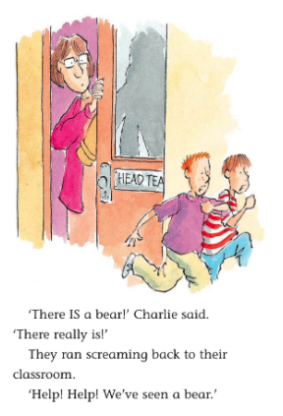
7) Why did the author write the word ‘IS’ in capital letters?
8)Was there really a bear? Explain your answer.

