Slide 1

Learning Intention: To retell a traditional tale
Changing the characters in our story.

Slide 2
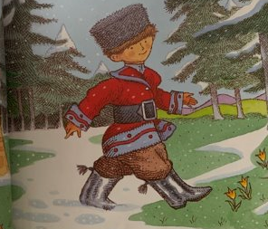
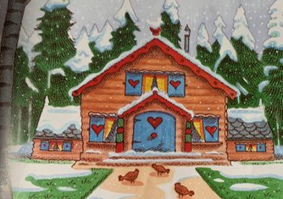
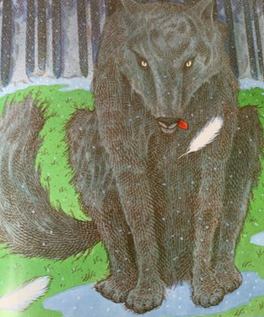
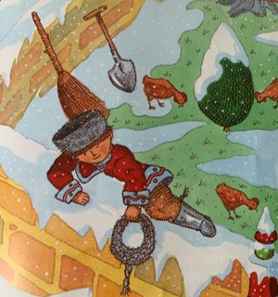
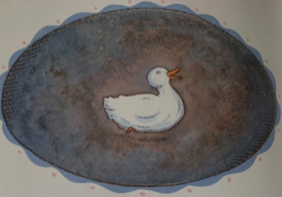
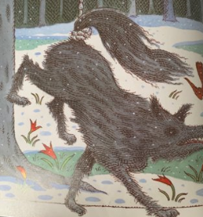
This is my story map.

Slide 3
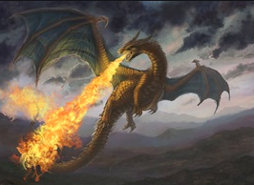
Today we are going to be changing one of the characters in the story.
The first character I am going to change is the wolf.

Slide 4
Now I am going to retell my story using my new character.

Slide 5
Now have a think about a character you will change and think about what you will change them too.

