Slide 1
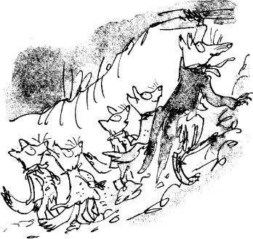

Learning Intention
Writing a story

Slide 2
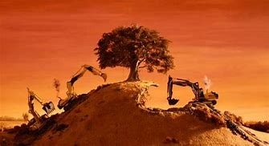
We are going to read the next two chapters of Fantastic Mr Fox. After that, we are going to summarise them. Then we are going to plan our own story and, finally write it based on the events of this part of the book.
Before we do discuss with your adult what has happened so far.

Slide 3
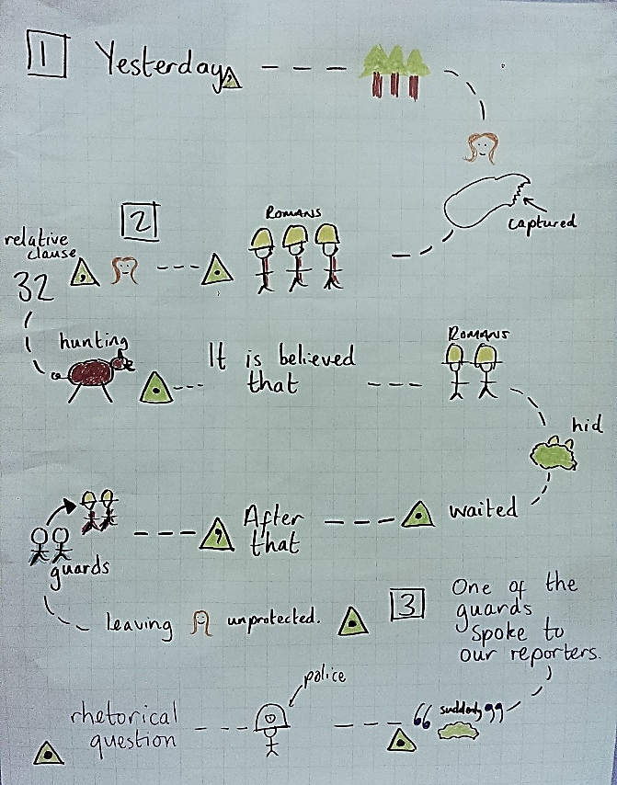
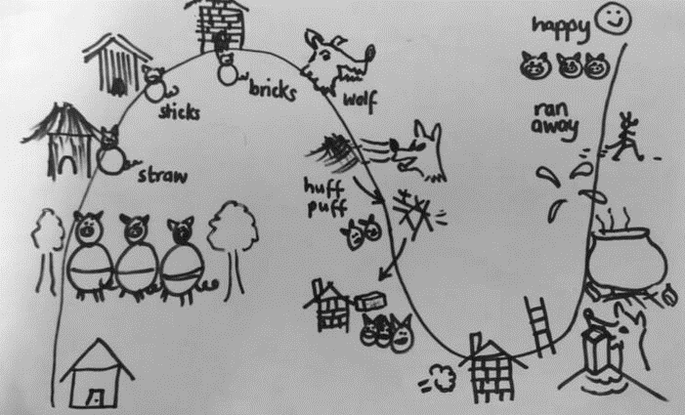
Task
Once we have finished, you will create a story map about what has happened in these two chapters.

Slide 4

Fantastic Mr Fox
Chapters 9 and 10
Mr Fox has a plan
Boggis’s Chicken House Number One
What do you think Mr Fox’s plan could be?

Slide 5
Key Vocabulary
undefeated
handle
marvellous
murky
peep
peek
shriek
prancing
scrambled
teeming
jiffy

Slide 6
Chapter 9
Mr Fox Has a Plan
For three days and three nights this waiting-game went on.
‘How long can a fox go without food or water?’ Boggis asked on the third day.
‘Not much longer now,’ Bean told him. ‘He’ll make a run for it soon. He’ll have to.’
Bean was right. Down in the tunnel the foxes were slowly but surely starving to death.
‘If only we could have just a tiny sip of water,’ said one of the Small Foxes. ‘Oh, Dad, can’t you do something?’
‘Couldn’t we make a dash for it, Dad? We’d have a little bit of a chance, wouldn’t we?’
‘No chance at all,’ snapped Mrs Fox. ‘I refuse to let you go up there and face those guns. I’d sooner you stay down here and die in peace.’

Slide 7
Mr Fox had not spoken for a long time. He had been sitting quite still, his eyes closed, not even hearing what the others were saying. Mrs Fox knew that he was trying desperately to think of a way out. And now, as she looked at him, she saw him stir himself and get slowly to his feet. He looked back at his wife. There was a little spark of excitement dancing in his eyes.

Slide 8
‘What is it, darling?’ said Mrs Fox quickly.
‘I’ve just had a bit of an idea,’ Mr Fox said carefully.
‘What?’ they cried. ‘Oh, Dad, what is it?’
‘Come on!’ said Mrs Fox. ‘Tell us quickly!’
‘Well…’ said Mr Fox, then he stopped and sighed and sadly shook his head. He sat down again. ‘It’s no good,’ he said. ‘It won’t work after all.’
‘Why not, Dad?’
‘Because it means more digging and we aren’t any of us strong enough for that after three days and nights without food.’

Slide 9
‘Yes we are, Dad!’ cried the Small Foxes, jumping up and running to their father. ‘We can do it! You see if we can’t! So can you!’
Mr Fox looked at the four Small Foxes and he smiled. What fine children I have, he thought. They are starving to death and they haven’t had a drink for three days, but they are still undefeated. I must not let them down.
‘I… I suppose we could give it a try,’ he said.
‘Let’s go, Dad! Tell us what you want us to do!’
Slowly, Mrs Fox got to her feet. She was suffering more than any of them from the lack of food and water. She was very weak. ‘I am so sorry,’ she said, ‘but I don’t think I am going to be much help.’
‘You stay right where you are, my darling,’ said Mr Fox. ‘We can handle this by ourselves.’

Slide 10
Chapter 10
Boggis’s Chicken House Number One
‘This time we must go in a very special direction,’ said Mr Fox, pointing sideways and downward.
So he and his four children started to dig once again. The work went much more slowly now. Yet they kept at it with great courage, and little by little the tunnel began to grow.
‘Dad, I wish you would tell us where we are going,’ said one of the children.
‘I dare not do that,’ said Mr Fox, ‘because this place I am hoping to get to is so marvellous that if I described it to you now you would go crazy with excitement. And then, if we failed to get there (which is very possible), you would die of disappointment. I don’t want to raise your hopes too much, my darlings.’

Slide 11
For a long long time they kept on digging. For how long they did not know, because there were no days and no nights down there in the murky tunnel. But at last Mr Fox gave the order to stop. ‘I think,’ he said, ‘we had better take a peep upstairs now and see where we are. I know where I want to be, but I can’t possibly be sure we’re anywhere near it.’
Slowly, wearily, the foxes began to slope the tunnel up towards the surface. Up and up it went… until suddenly they came to something hard above their heads and they couldn’t go up any further. Mr Fox reached up to examine this hard thing. ‘It’s wood!’ he whispered. ‘Wooden planks!’
‘What does that mean, Dad?’
‘It means, unless I am very much mistaken, that we are right underneath somebody’s house,’ whispered Mr Fox. ‘Be very quiet now while I take a peek.’

Slide 12
Carefully, Mr Fox began pushing up one of the floorboards. The board creaked most terribly and they all ducked down, waiting for something awful to happen. Nothing did. So Mr Fox pushed up a second board. And then, very very cautiously, he poked his head up through the gap. He let out a shriek of excitement.
‘I’ve done it!’ he yelled. ‘I’ve done it first time! I’ve done it! I’ve done it!’ He pulled himself up through the gap in the floor and started prancing and dancing with joy. ‘Come on up!’ he sang out. ‘Come up and see where you are, my darlings! What a sight for a hungry fox! Hallelujah! Hooray! Hooray!’

Slide 13
The four Small Foxes scrambled up out of the tunnel and what a fantastic sight it was that now met their eyes! They were in a huge shed and the whole place was teeming with chickens. There were white chickens and brown chickens and black chickens by the thousand!
‘Boggis’s Chicken House Number One!’ cried Mr Fox. ‘It’s exactly what I was aiming at! I hit it slap in the middle! First time! Isn’t that fantastic! And, if I may say so, rather clever!’
The Small Foxes went wild with excitement. They started running around in all directions, chasing the stupid chickens.
‘Wait!’ ordered Mr Fox. ‘Don’t lose your heads! Stand back! Calm down! Let’s do this properly! First of all, everyone have a drink of water!’

Slide 14
They all ran over to the chickens’ drinking-trough and lapped up the lovely cool water. Then Mr Fox chose three of the plumpest hens, and with a clever flick of his jaws he killed them instantly.
‘Back to the tunnel!’ he ordered. ‘Come on! No fooling around! The quicker you move, the quicker you shall have something to eat!’
One after another, they climbed down through the hole in the floor and soon they were all standing once again in the dark tunnel. Mr Fox reached up and pulled the floorboards back into place. He did this with great care. He did it so that no one could tell they had ever been moved.
‘My son,’ he said, giving the three plump hens to the biggest of his four small children, ‘run back with these to your mother. Tell her to prepare a feast. Tell her the rest of us will be along in a jiffy, as soon as we have made a few other little arrangements.’

Slide 15
Quick Quiz
Which describes the Foxes The best at the start of chapter 9?
worried overjoyed starving
Mr Fox’s idea makes the little Foxes…
tired eager unhappy

Slide 16
Why doesn’t Mrs fox help dig?
she is bored she is weak she is annoyed
When he sees the chickens Mr Fox…
whispers quietly dances excitedly cries happily

Slide 17
Task
Create a story map to show what has happened in these two chapters. Include the main events. Use drawings and some key words and phrases to show you have understood the plot of the story.
What has happened at the start of the first slide?
What do the foxes do on the first slide?
What does Mr Fox have in the second slide?
What do the foxes do? (Including Mrs Fox)

