Slide 1
Blending Sounds Quiz
Learning Intention, blend sounds together to make words.

Slide 2
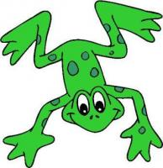
Blend these sounds
m a t

Slide 3
Blend these sounds.
p a n

Slide 4
Blend the sounds
s i p

Slide 5
Blend the sounds
t a p

Slide 6
Blend the sounds
i n

Slide 7
Blend the sounds.
n a p

Slide 8
Blend the sounds
g e t

Slide 9
Blend the sounds
o n

Slide 10
Blend the sounds
c o g

Slide 11
Blend the sounds
k i d

Slide 12
Blend the sounds
u p

Slide 13
Blend the sounds
b i g

Slide 14
Blend the sounds
f i n

Slide 15
Blend the sounds
e n d

