Slide 1
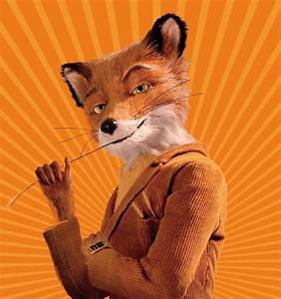

Fantastic Mr Fox
Chapter four
Terrible Shovels
What has happened so far?
What do you think will happen in chapter four?
Remember what the last sentences were from chapter three:
‘I reckon there’s a whole family of them down that hole,’ Bunce said.
‘Then we’ll have the lot,’ said Bean. ‘Get the shovels!’

Slide 2
Today’s focus is to look at the emotions of Mr Fox. We will read each page and discuss how Mr Fox feels.
We will see how his feelings and emotions change as we go through the chapter.
For each page draw an emoticon to describe how Mr Fox is feeling. It might help to pull the same face yourself!
Look at the sheet ‘emoticons’ to help.

Slide 3
Key vocabulary
glum brave worried determined proud petrified terrified frightened relieved loved

Slide 4
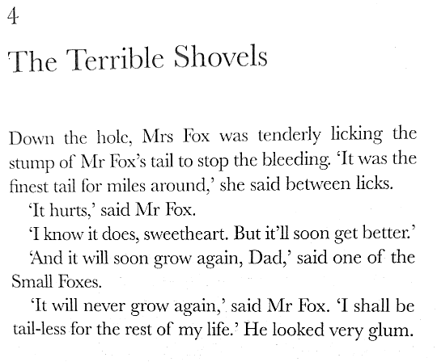

What word has been used to describe how Mr Fox feels?
Glum
Draw an emoticon showing a glum face. Which of these would be best?

Slide 5
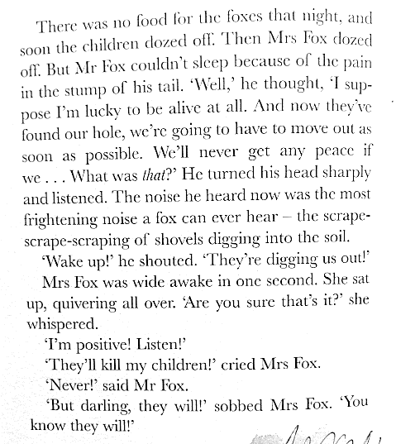
How does Mr Fox feel now? How did he feel at the start of this page? What about at the end?
Draw another emoticon. Which word will help. Here is a clue.

Slide 6
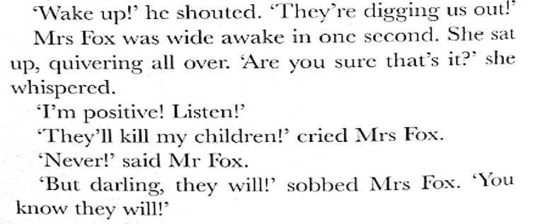

When Mr Fox says ‘,Never!’ it tells the reader that he will not let his family be killed. True or false?
True
Draw another emoticon to show how he feels on this page.

Slide 7
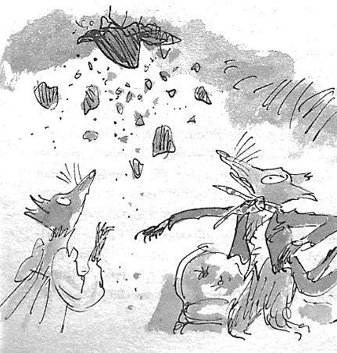
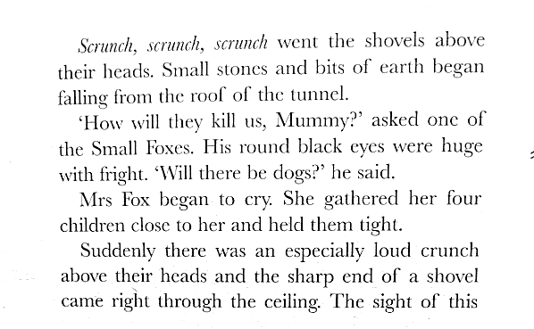

Slide 8
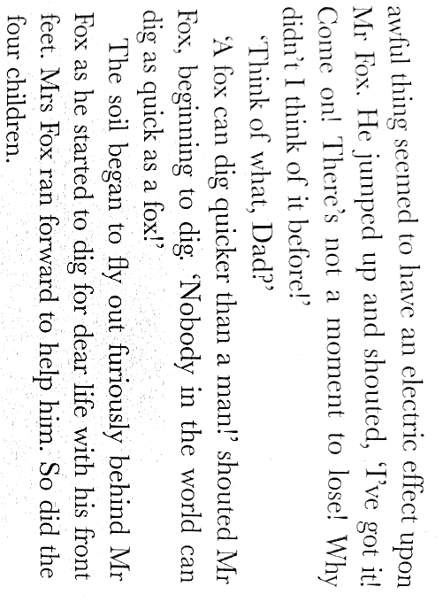
What emoticon can you draw now? Think about what is happenening?
Are the foxes nearly caught?
Are they escaping from the farmers?
Is Mr Fox determined to save his children?
Could it be a similar emoticon to the one before?

Slide 9
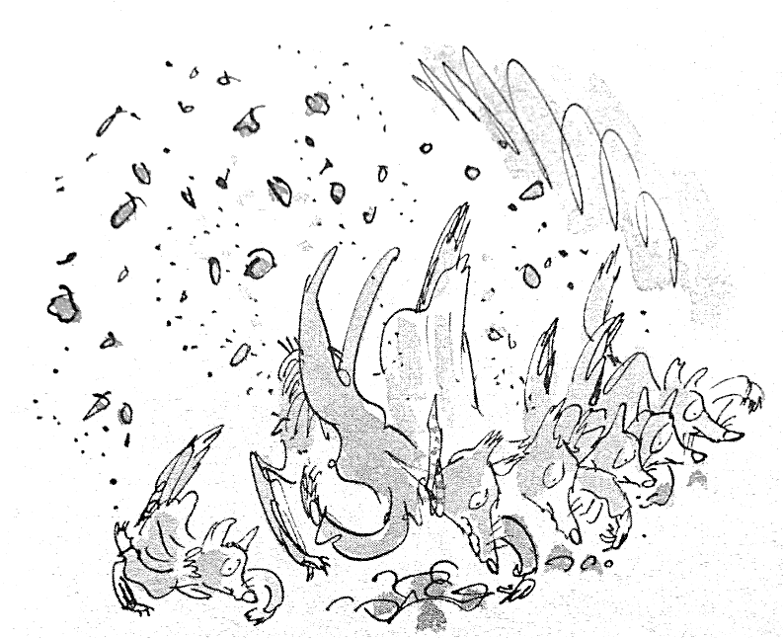
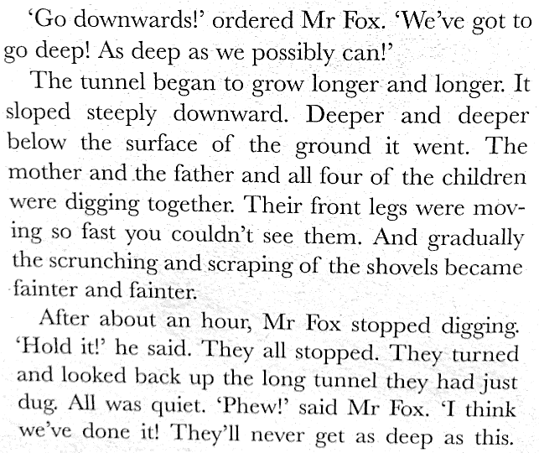
When Mr Fox says, ‘Phew!’ How does he feel.
Which word best describes how he feels?
Relieved angry scared happy

Slide 10
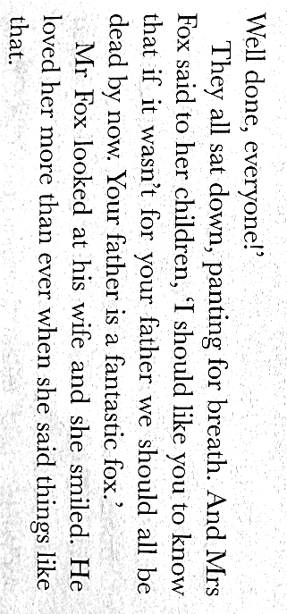
When Mrs Fox says that her husband is, ‘a fantastic fox,’ how does Mr Fox feel?
Which emoticon and word could describe how he feels now?

Slide 11



