Slide 1

Maths
Calculating the area of a rectangle

Slide 2
The area of a shape is the amount of space inside a 2D shape.

Slide 3
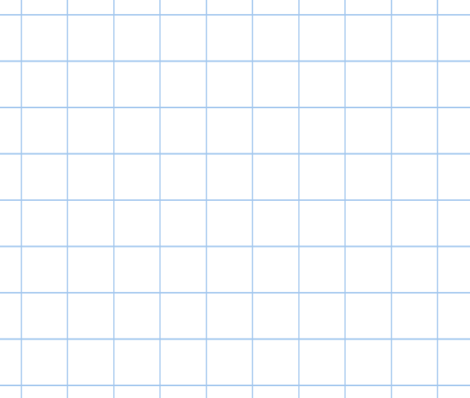

























Area = 10cm²

Slide 4








Area = 4cm²

Slide 5























5cm
5 x 2 = 10
2cm
Area = 10cm²

Slide 6








2cm
2 x 2 = 4
2cm
Area = 4cm²

Slide 7
length
width
Area = length x width

Slide 8
























length
3 x 4 = 12
width
Area = 12cm²

