Slide 1
Today we will be reading…
How to make a peach treat

Slide 2
How to find the book:
Go to the oxford owl website and find the login page. https://www.oxfordowl.co.uk/login?active-tab=students
Log using your details that is included in your learning pack
Click on the Read Write Inc. eBook Library
Find the Blue books and click on
How to make a peach treat

Slide 3
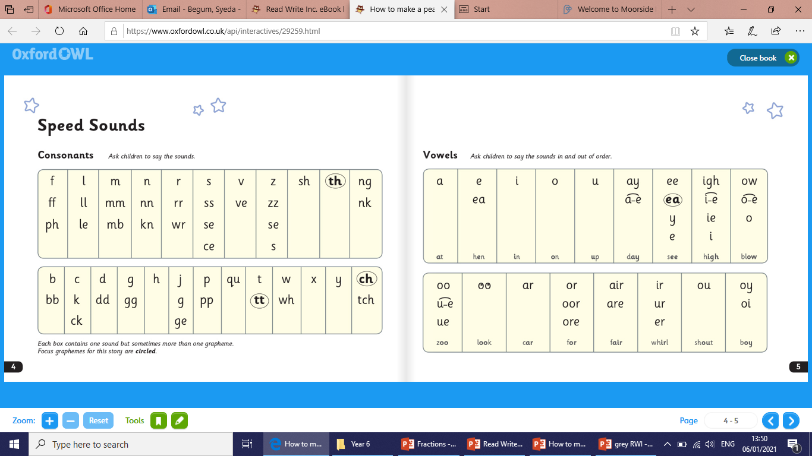
Lets read the speedy sounds

Slide 4
Now lets practice reading the Green Words
Ask an adult to help you if you need to

Slide 5
Have a look at some of these tricky words:

Slide 6
Now lets read the Red Words

Slide 7
Page 10
Question 1: What fruits will you need to make this treat?

Slide 8
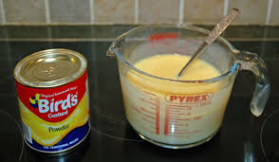
Page 12
Question 2: How many scoops of custard do you need?

Slide 9
Page 11
Question 3: What sort of bowl do you need?

Slide 10
Page 16
Question 4: What do use to eat a peach treat?

Slide 11
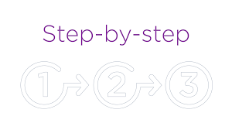
Page 11
Question 5: How many steps are there to make this treat?

Slide 12
Page 16
Question 6: Do you think the girl likes the treat?

