Slide 2
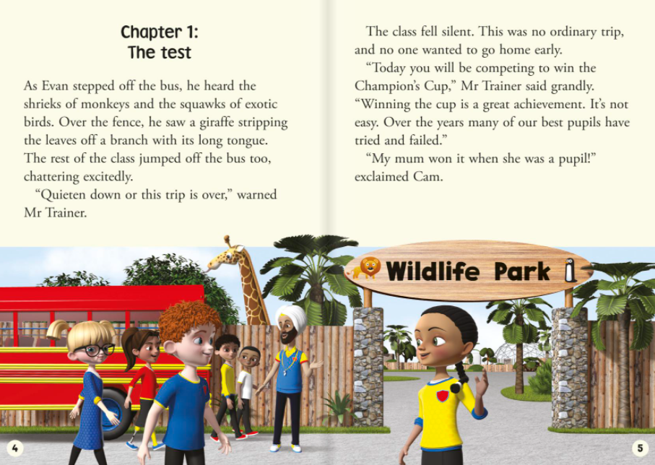

Slide 3
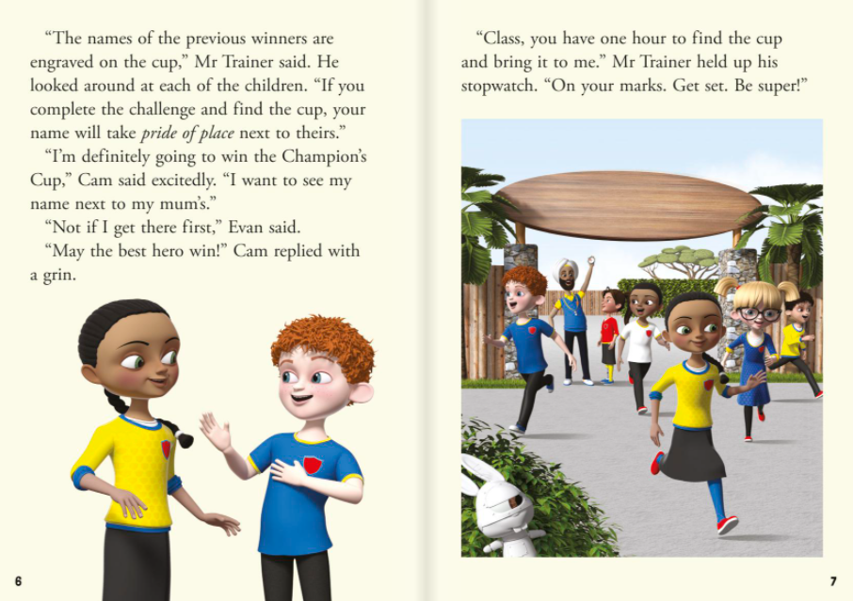

Slide 4
Learning intent: to clarify vocabulary in context
p.4 squawks | winner
p.4 exotic | writing or marks made into a hard object like stone or metal
p.5 champion | a loud bird noise
p.6 previous | finish
p.6 engraved | from a faraway, foreign country
p.6 complete | past

