Slide 1
Learning Intention: To use verbs

Slide 2
What is a verb?
A verb is a word, it is a doing word!
A verb is something that you can do.

Slide 3
Notes:
Do you remember when we found the verbs in our story, ‘Peter and the Wolf’?

Slide 4
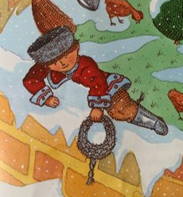
Notes:
We had Peter can walk. Duck can swim. Peter can climb.

Slide 5
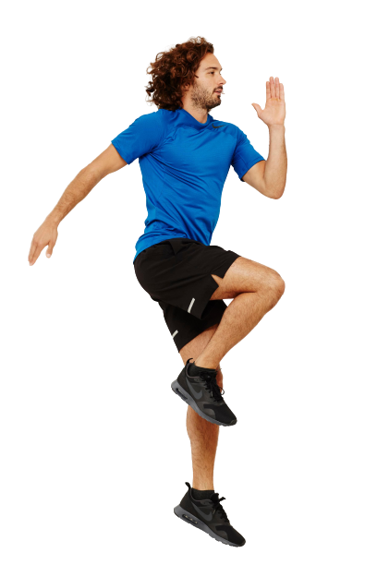
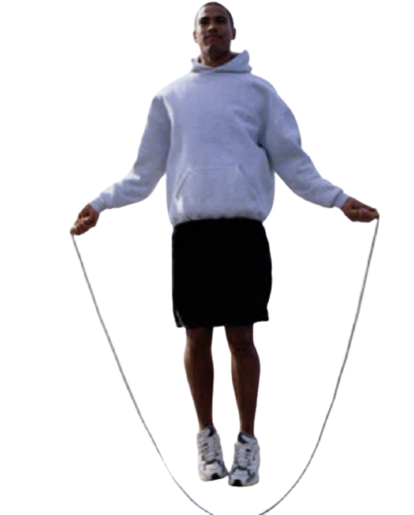
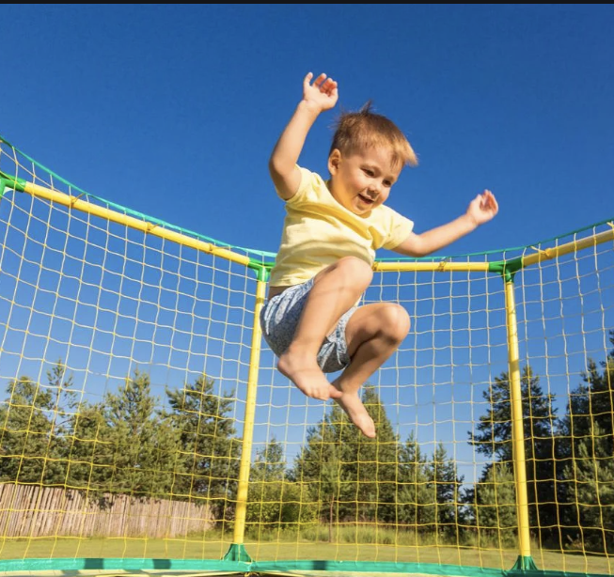
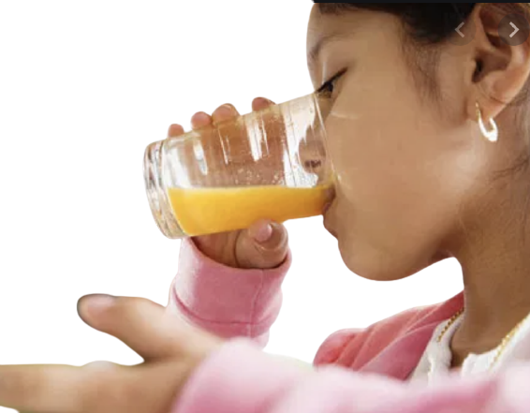
Verb Bank:
Notes:
Today, I want to have a little bit of fun with the verbs. Here are some of the verbs from our verb bank yesterday, and I want to use some of those to change the verbs in ‘Peter and the Wolf’. Let’s look at them again… hop, skip, jump, sing, kick, drink.

Slide 6
My turn:
Peter can walk.
Notes:
My turn. The verb here is walk, Peter can walk. I’m going to get rid of walk, and change it to a new verb… watch!

Slide 7
can
Notes:
I’m going to use the verb bank at the top to choose a new verb. Hop is the verb. Peter can hop.

Slide 8
can

Slide 9
can

Slide 10
can

Slide 11
Your turn:
Duck can swim.
Notes:
Your turn! Time to change the verb, instead of duck can swim…

Slide 12
can
Notes:
Duck can …. Choose a verb from the verb bank and draw it in the box. Then read your sentence!

Slide 13
can
Notes:
Duck can …. Choose a verb from the verb bank and draw it in the box. Then read your sentence!

Slide 14
can
Notes:
Now choose a different verb. Duck can ….

Slide 15
Commentary:
Slide 3:
Do you remember when we found the verbs in our story, ‘Peter and the Wolf’?
Slide 4:
We had… Peter can walk. Duck can swim. Peter can climb.
Slide 5:
Today, I want to have a little bit of fun with the verbs. Here are some of the verbs from our verb bank yesterday, and I want to use some of those to change the verbs in ‘Peter and the Wolf’. Let’s look at them again… hop, skip, jump, sing, kick, drink.
Slide 6:
My turn. The verb here is walk, Peter can walk. I’m going to get rid of walk, and change it to a new verb… watch!

Slide 16
Commentary 2:
Slide 7:
I’m going to use the verb bank at the top to choose a new verb. Hop is the verb. Peter can hop.
Slide 11:
Your turn! Time to change the verb, instead of duck can swim…
Slides 12-14:
Duck can …. Choose a verb from the verb bank and draw it in the box. Then read your sentence! You can choose your own verb too.

