Slide 1
Initial Sounds
Learning Intention, to hear and say the initial sound.

Slide 2

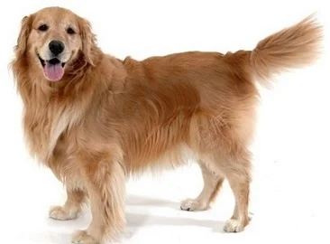
What is an initial sound?
An initial sound is the sound that an object begins with.
For example, the initial sound for dog is ‘d.’

Slide 3
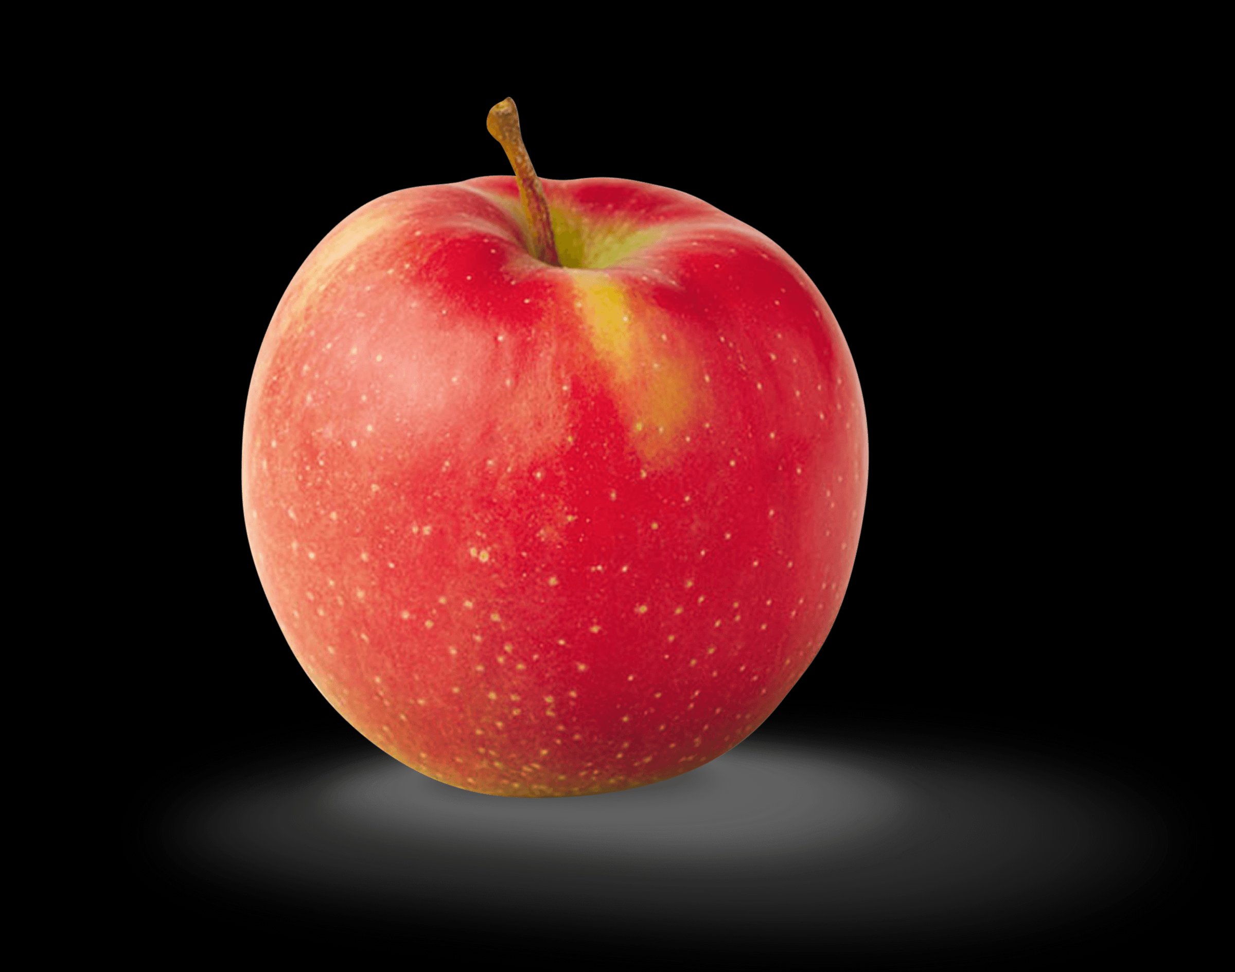
See if you know the initial sound.

Slide 4
This is an apple, the initial sound for apple is ‘a.’

Slide 5
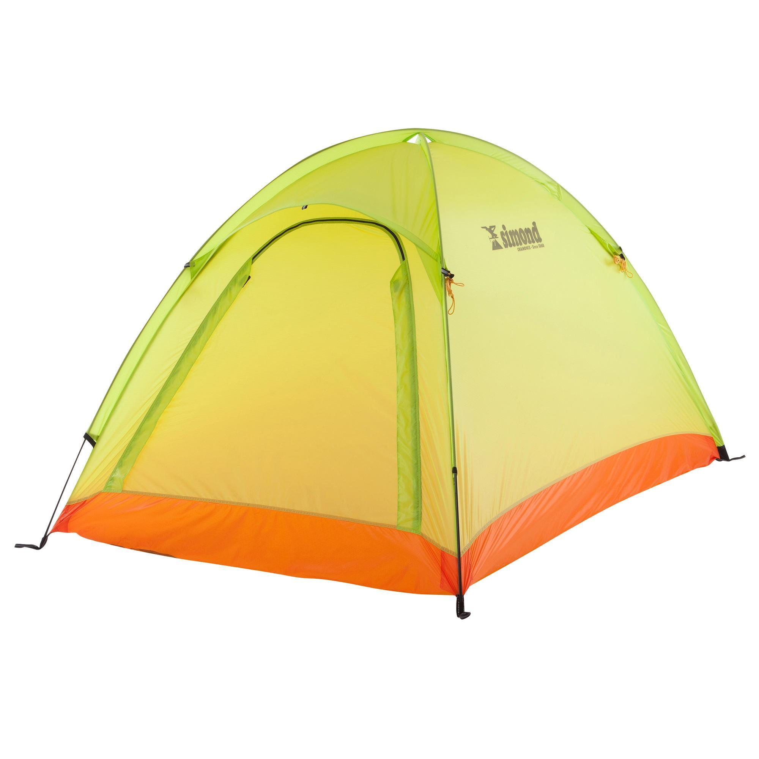
This is a tent.

Slide 6
Tent, the initial sound for tent is …t.

Slide 7
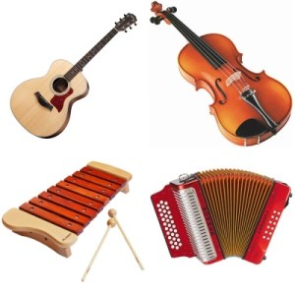
Here are pictures of
instruments.

Slide 8
The initial sound for instruments is….i.

Slide 9
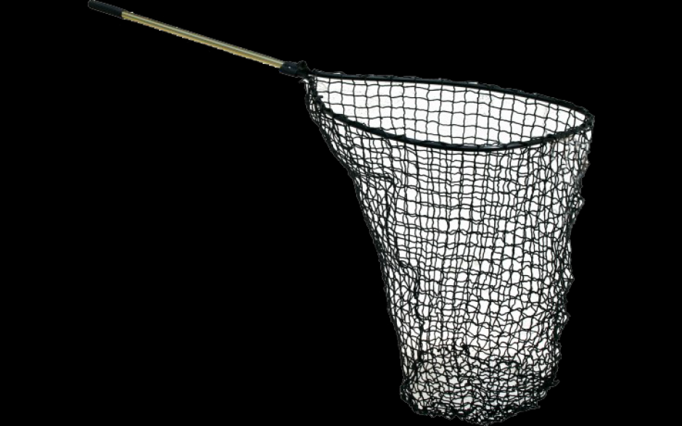
This is a ….net.

Slide 10
The initial sound for net is …..n

Slide 11
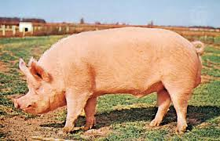
This is a pig.

Slide 12
The initial sound for pig is….p.

Slide 13
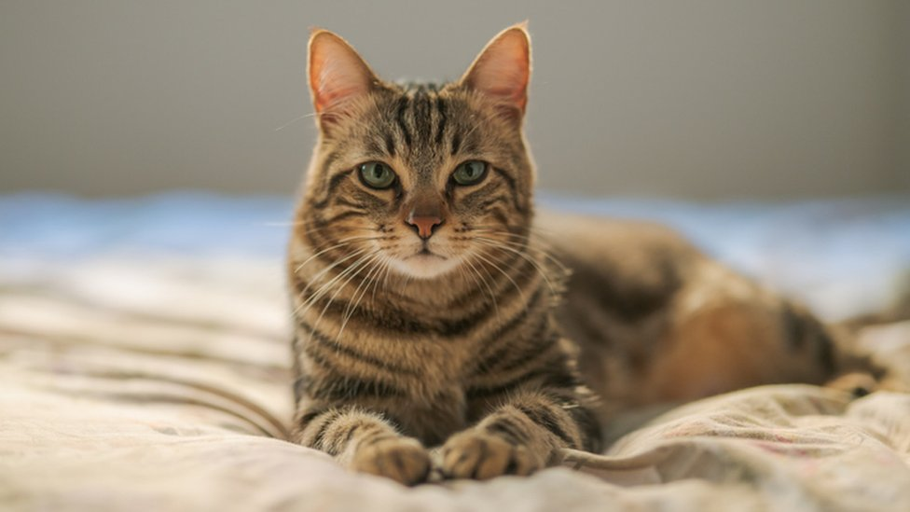
This is a cat.

Slide 14
The initial sound for cat is….c.

Slide 15
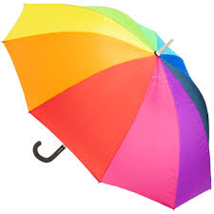
This is an umbrella.

Slide 16
The initial sound for umbrella is…u.

Slide 17
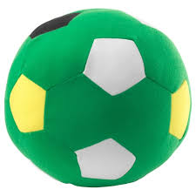
This is a ball.

Slide 18
The initial sound for ball is …..b.

Slide 19
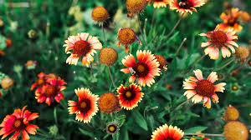
Here are some flowers.

Slide 20
The initial sound for flowers is…f.

Slide 21
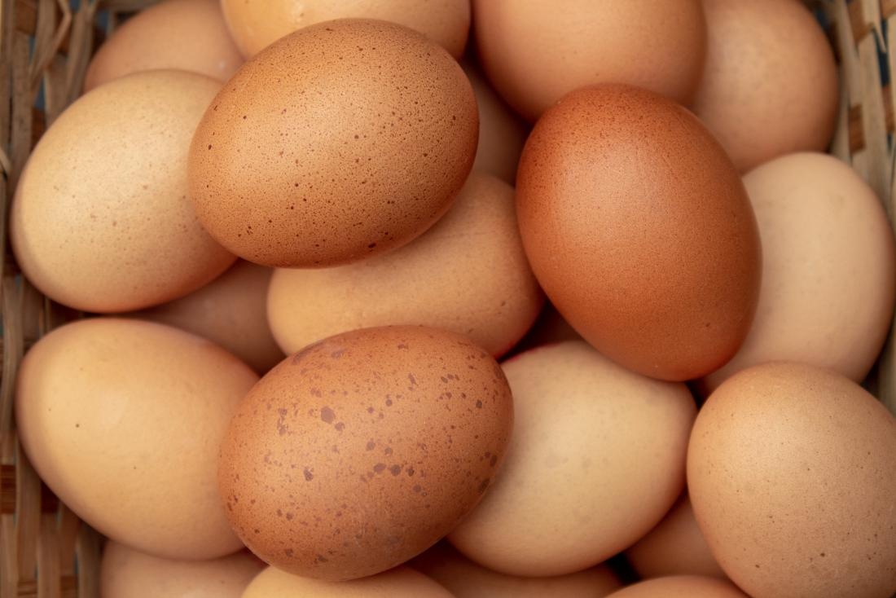
Here are some eggs.

Slide 22
The initial sound for eggs is…e.

