Slide 1
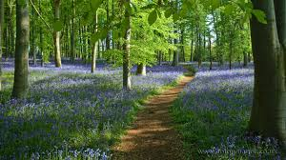
What we might see in the woods

Slide 2
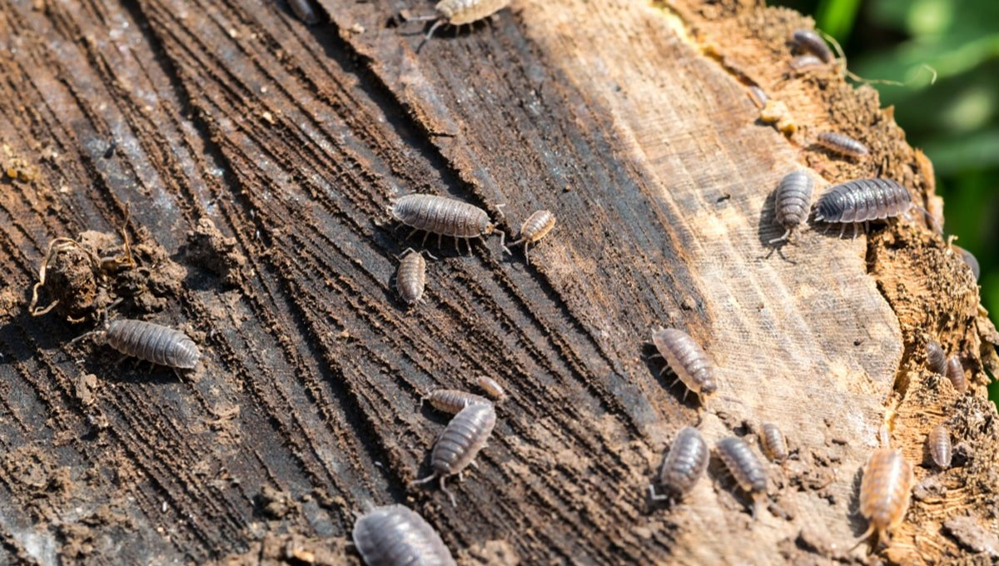
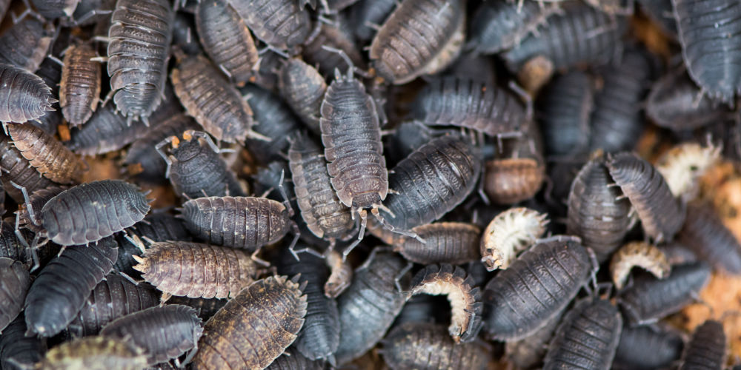
Woodlice
Woodlice are found under the soil, mud, rotten leaves and on the tree trunks. They eat rotten plants and leaves.

Slide 3
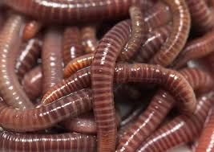
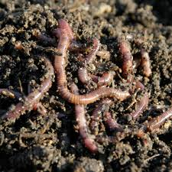
Worms
Worms are soft slimy and pink and its body is divided up into rings or segments. Pointed at both ends. Worms do not have eyes or hands so they use their skin to feel with. Worms eat soil, sand or mud and even dead leaves.

Slide 4
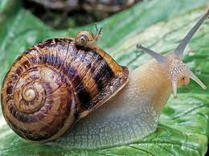
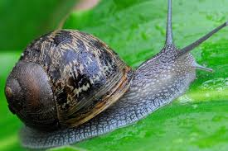
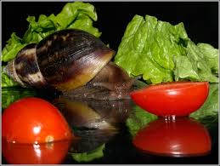
Snails
Snails eat fruit, vegetables and leaves. They carry their house on their back and when they get frighten or in danger they go into their shells to protected them selves. If you look at the picture you will see a baby snail on top of the big snail.

Slide 5
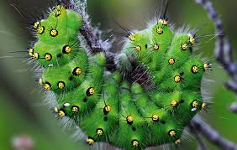
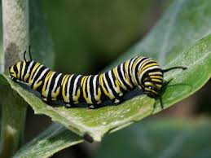
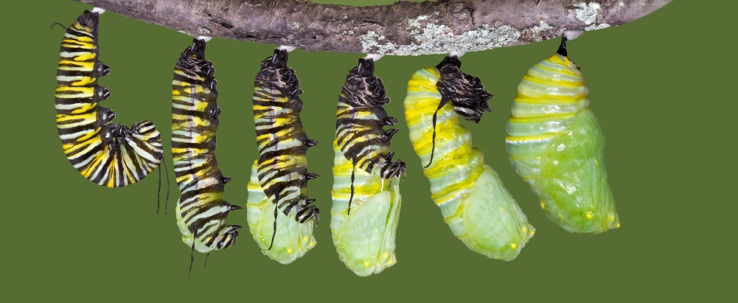
Caterpillar
Caterpillars like to eat grass, leaves, bark, twigs, flowers and moss. When they have had enough to eat the make a cocoon and stay inside the cocoon for ten to 14fourteen days.

Slide 6
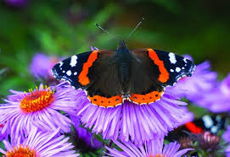
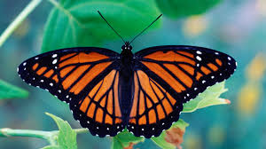
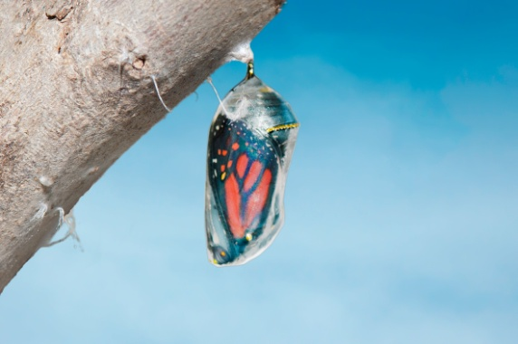
Butterfly
After hatching, the butterfly hangs upside down, flapping its wings to straighten and dry them. The pumping action helps blood flow through the wings. It takes about a day for the wings to fully harden, though the butterflies may be flying within an hour or two.

Slide 7
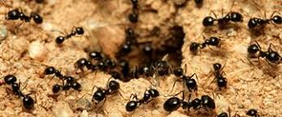
Ants
Ants make their nests in the ground and they will build tunnels to put their eggs, food and their young underground to keep it all safe. Ants will eat anything like live or dead insects, leaves, crisp and sweet things.

Slide 8
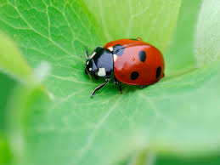
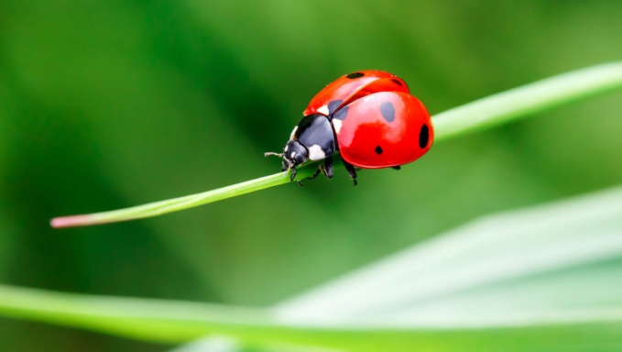
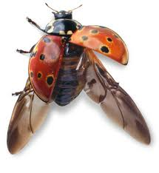
Ladybug/lady bird
Ladybug are also called lady birds or lady beetles. They have small oval shaped wings. Red with black spots or black with red spots on the wings. The number of spots identifies the type of ladybug. They eat small insects.

Slide 9
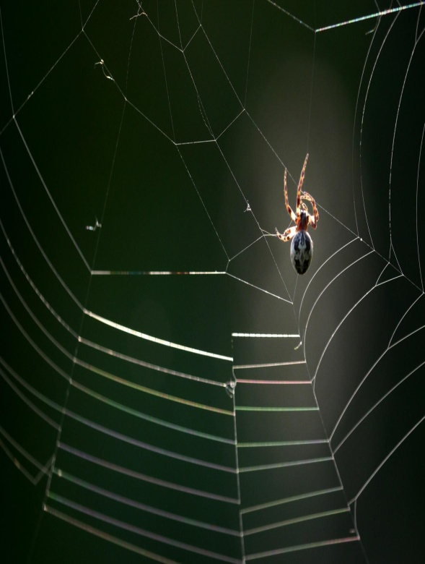
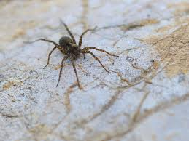
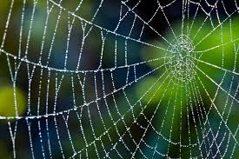
Spiders
Spiders feed on leaves and insects or bugs that are stuck on their web. Spiders web is made from silk that the spider makes and its very strong.

Slide 10
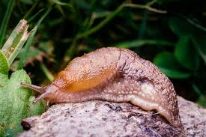
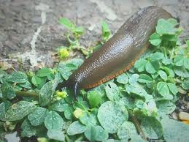
Slugs
Slugs will live where its moist or damp like under logs, rocks, branches on the ground and long grass. They like to eat plants .

