Slide 1
Year 1 - PSHE Healthy eating

Slide 2
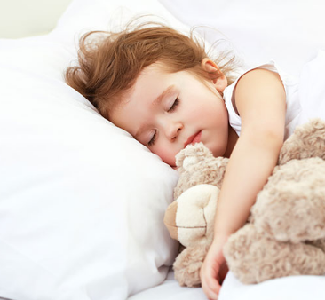
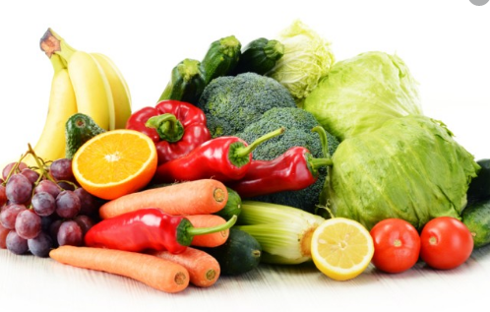
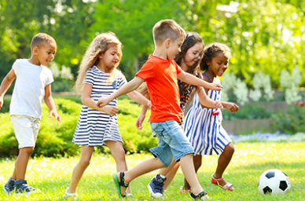
What do we need to be healthy?
Water
Sleep
Healthy foods
Exercise

Slide 3
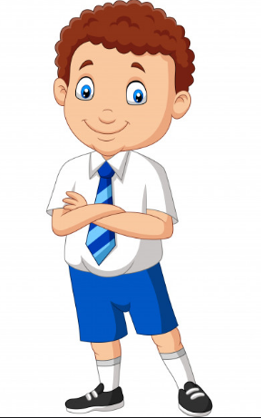
This is Tom. Tom wants to be healthy. We are going to help Tom make good choices about how to be healthy.

Slide 4
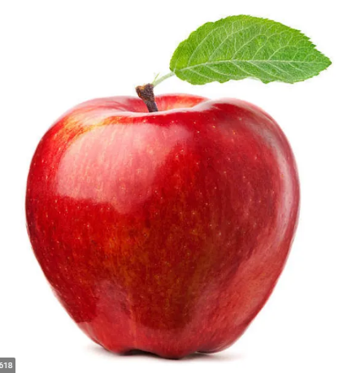
Tom is hungry after school. Should Tom eat these sweets or this apple?

Slide 5
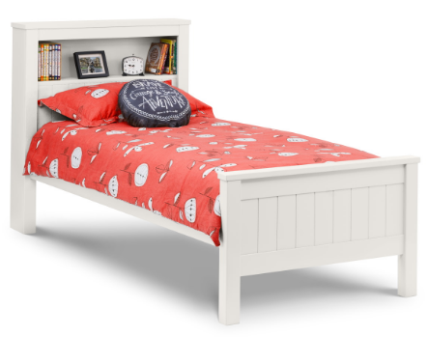
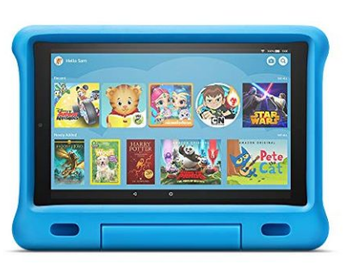
Mum has told Tom that it is bedtime. Should Tom go to sleep or stay up late and play on his tablet?

Slide 6
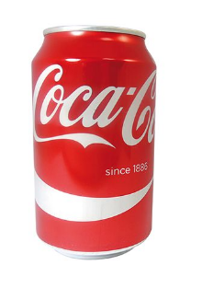
Tom is thirsty. Should Tom drink a can of fizzy cola or a glass of water?

Slide 7
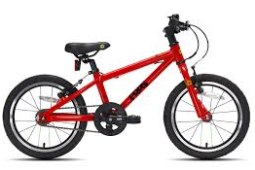
Tom wants to keep fit. Should Tom go for a bike ride or play on his XBox?

Slide 8
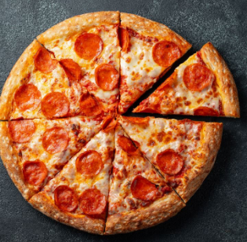
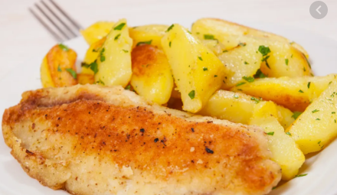
It is tea time. Should Tom have fish and potatoes or a pizza?

Slide 9
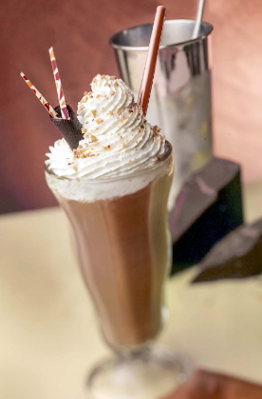
Tom is thirsty. Should Tom have a chocolate milkshake or a glass of water?

Slide 10
Now have a go at the worksheet.

