Slide 1

Learning intention: to talk about Chinese New Year

Slide 2
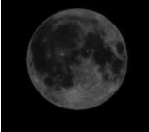
Chinese New Year
The Chinese New Year
Chinese New Year, also known as the Spring Festival, is the main Chinese festival of the year. As the Chinese use the lunar calendar for their festivals the date of Chinese New Year changes from year to year. The date corresponds to the new moon (black moon) in either late January or February. The spring festival celebrates the start of new life and the season of ploughing and sowing.

Slide 3
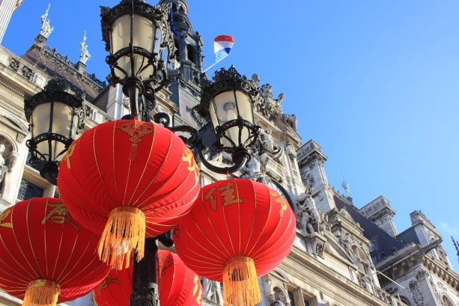
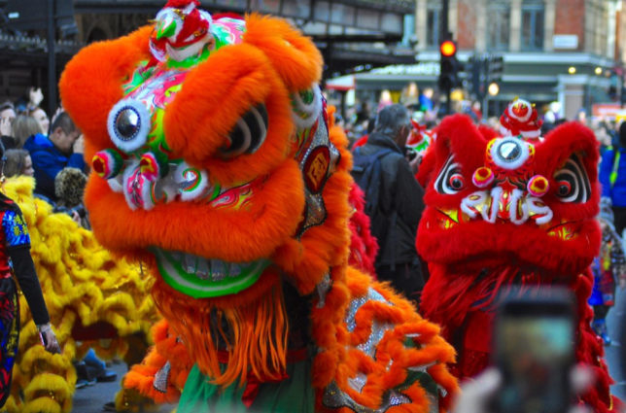
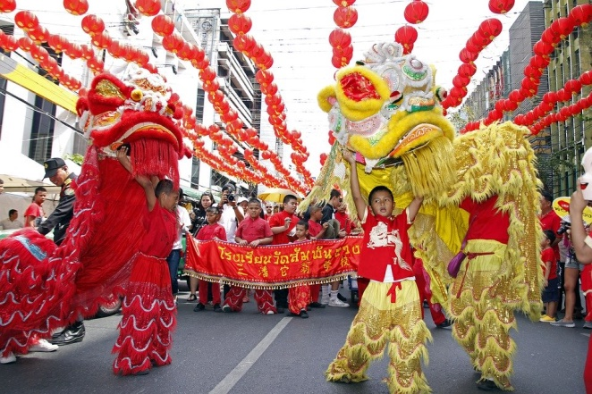
Traditionally, celebrations last for fifteen days, ending on the date of the full moon, when it is at its brightest. The first week is celebrated with visits to friends and family following special traditions designed to bring good luck. The second week ends with the Lantern Festival on the evening of the 15th day of the lunar month.
In China, the public holiday lasts for three days and this is the biggest and most extravagant celebration of the year.

Slide 4
The Chinese calendar
The Chinese calendar is different from that used in the United Kingdom. It is made up of a cycle of twelve years, each of them being named after an animal. There is a story told about how each animal became a year.

Slide 5
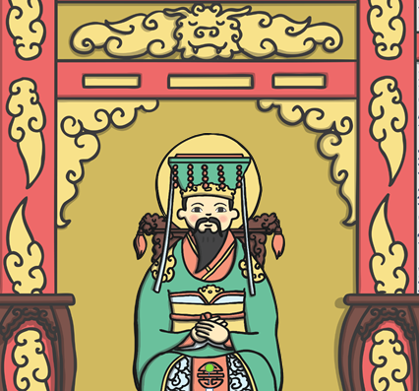
The Chinese New Year story.
A long time ago, in China, the Jade Emperor decided there should be a way to measure time. He told the animals that they were to compete in a race. The first twelve animals would be rewarded by having a year named after them.

Slide 6
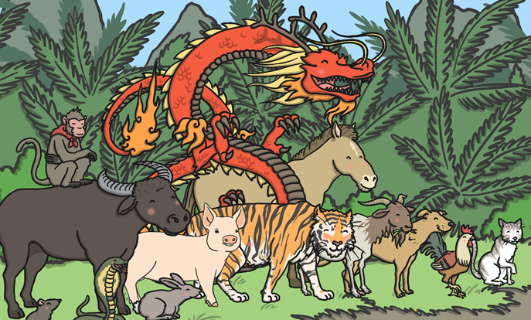
On the day of the race, all the animals lined up beside the river. The rat and the cat, who were good friends, were worried as they were not very good at swimming. They asked the ox if he would carry them across on his back.

Slide 7
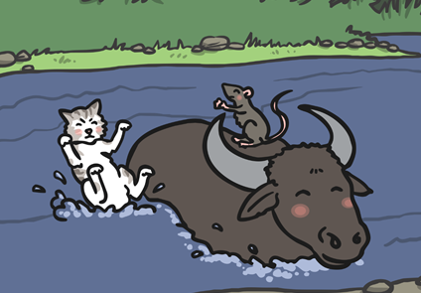
The ox agreed and they jumped on his back. When the race started, the rat and the cat were very pleased that the ox had taken the lead. They were almost across at the other side when the rat pushed the cat into the water and jumped on the bank to finish first!

Slide 8
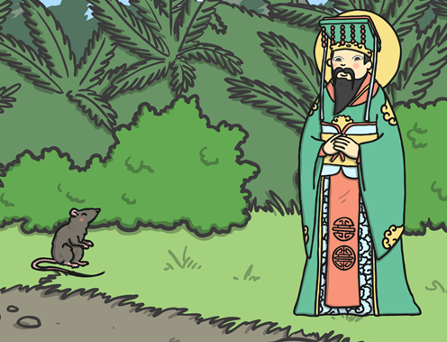
“Well done!” said the Jade Emperor to the rat. “The first year of the Zodiac will be named after you.” The poor ox was tricked into second place and so the second year of the Zodiac was named after him.

Slide 9
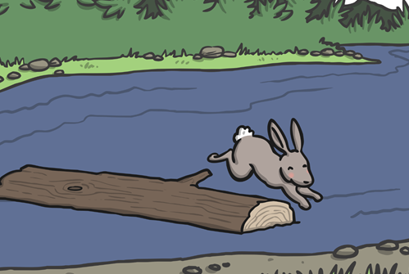
The next to arrive was the rabbit, who hadn’t swum across but hopped across on some stepping stones and then onto a floating log which carried him to the river bank. “I shall call the fourth year after you,” the surprised Jade Emperor said.

Slide 10
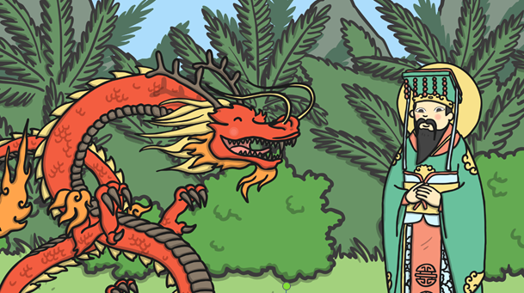
Taking fifth place was the dragon. “How come you didn’t win the race, when you could fly across?” the Emperor asked. “I stopped to help some animals,” the dragon explained.

Slide 11
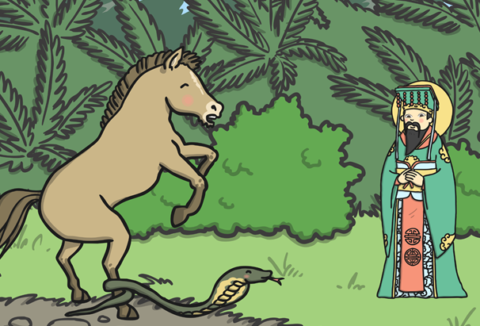
Heading towards the line was the horse. Just as the Emperor thought the horse would cross, the sly snake wriggled around one of the horse’s hooves. The horse was so surprised that he jumped backwards, giving the snake a chance to slither forward and take sixth place. The horse made it for seventh place.

Slide 12
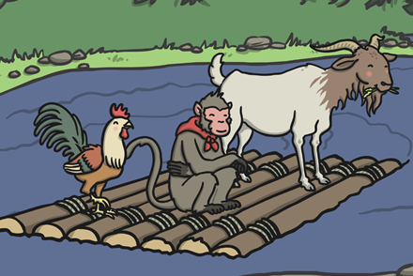
Not long afterwards, a raft arrived carrying the goat, the monkey and the rooster. They explained how they had worked as a team to get across. The Emperor was very pleased. He said the goat would be the eighth year, the monkey the ninth and the rooster the tenth.

Slide 13
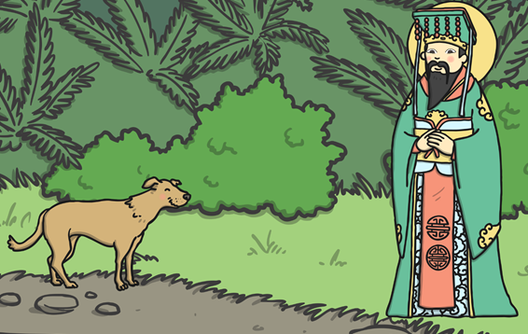
The next animal to arrive was the dog. “What took you so long, when you’re such a good swimmer?” asked the Emperor.
“The river was so clean that I decided to have a bath along the way,” the dog explained. He was rewarded with the eleventh year.

Slide 14
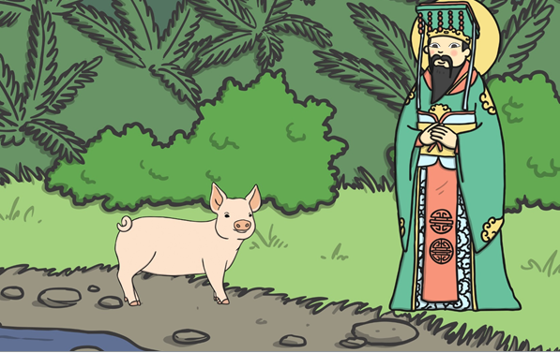
There was one place left in the Zodiac and the Emperor wondered who the last winner would be. All of a sudden, the pig turned up. “You took a long time. What happened?” the Emperor asked. “I was hungry and stopped to eat, then I fell asleep,” said the pig. The twelfth year was given to the pig.

Slide 15
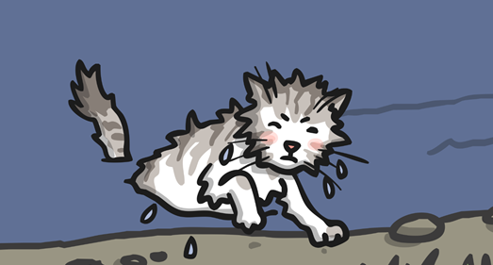
As for the cat, he finally crawled out of the river, but was too late to have a year named after him. He was very angry with the rat for pushing him in and since then, cats have never been friends with rats!

Slide 16
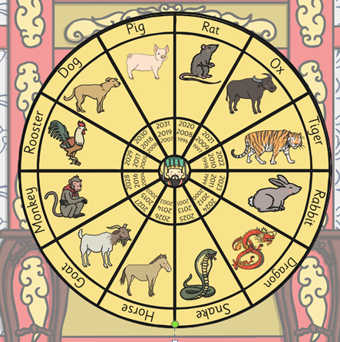
From that day to this, the Chinese Zodiac has followed this cycle of years, named after the twelve animals.

