Slide 1
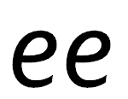

Focus: ee
e – start with a loop, then make a curve
e – start with a loop, then make a curve

Slide 2
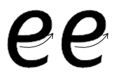
Your turn! Write ee in your book using the lines.
Then try:
see
peel
week

