Slide 1
Learning Intention: To observe the changing seasons

Slide 2
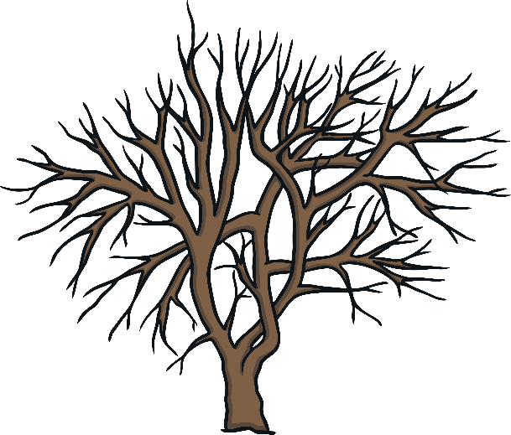
The Seasons:

Slide 3
We are in Winter, but soon it will be…
February
(Winter)
March
(Spring)
Notes:
Now we are in February, but soon we will be in March. February is Winter but March is Spring!

Slide 4
How can we spot the signs of Spring?
What does Spring look like?

Slide 5
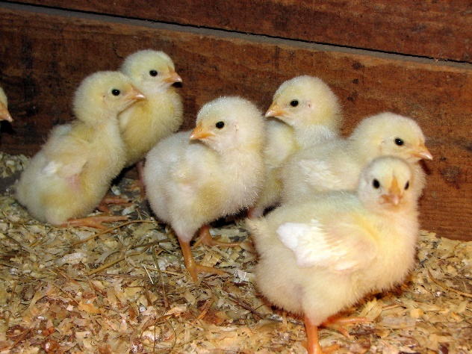
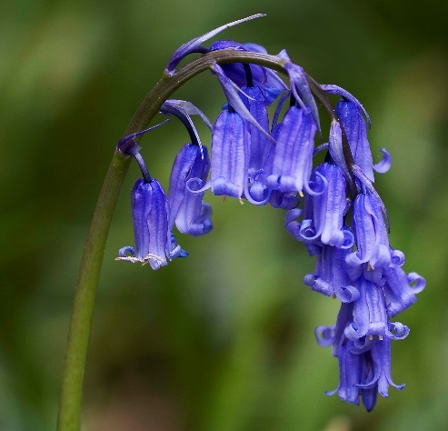
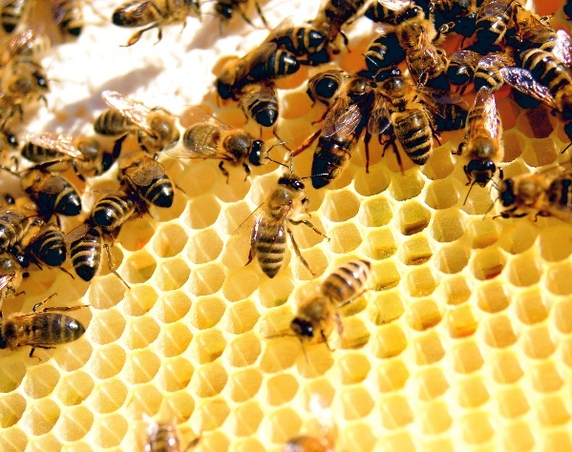
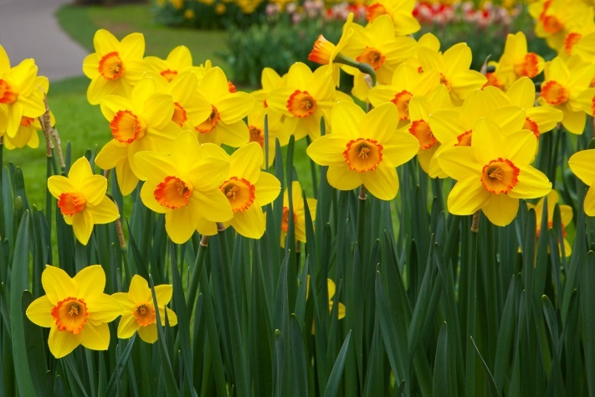
chicks
bluebells
bees
daffodils

Slide 6
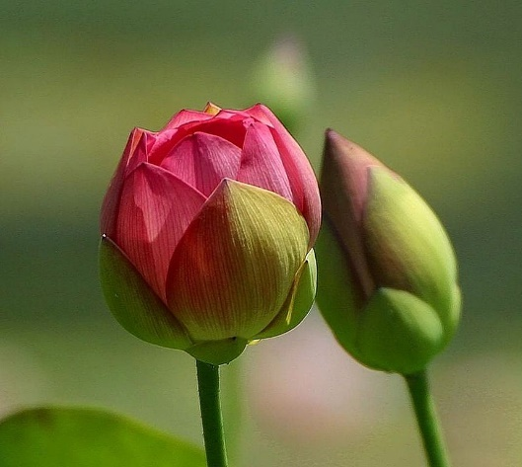
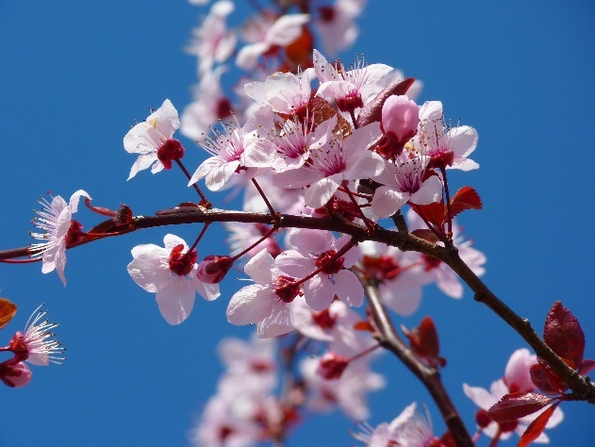
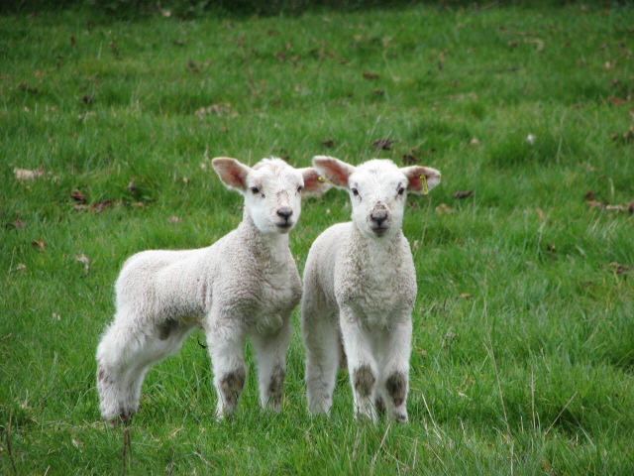
flower buds
blossom
lambs

Slide 7
Your turn:
1) Talk to your grown up. Are there any early signs of Spring outside?
2) Draw the early signs of Spring on your worksheet.

Slide 8
The Seasons - Answers
Spring
Summer
Autumn
Winter

Slide 9
Commentary:
Slide 3: Now we are in February, but soon we will be in March. February is Winter but March is Spring!

