Slide 1
1960s and 1970s Music
Notes:
In todays music lesson we will be looking at and listening to bands and music from the 1960s and 1970s

Slide 2
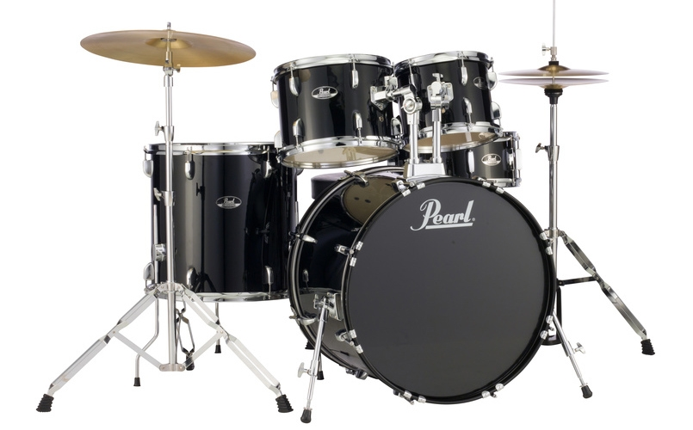
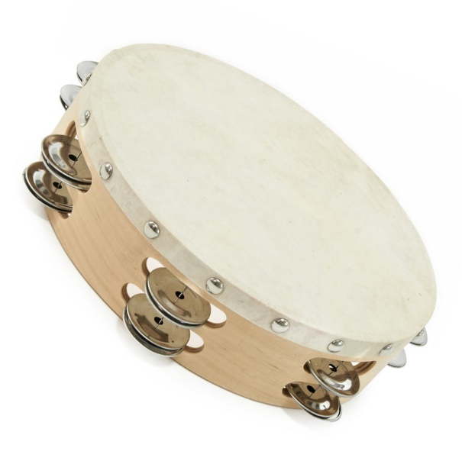
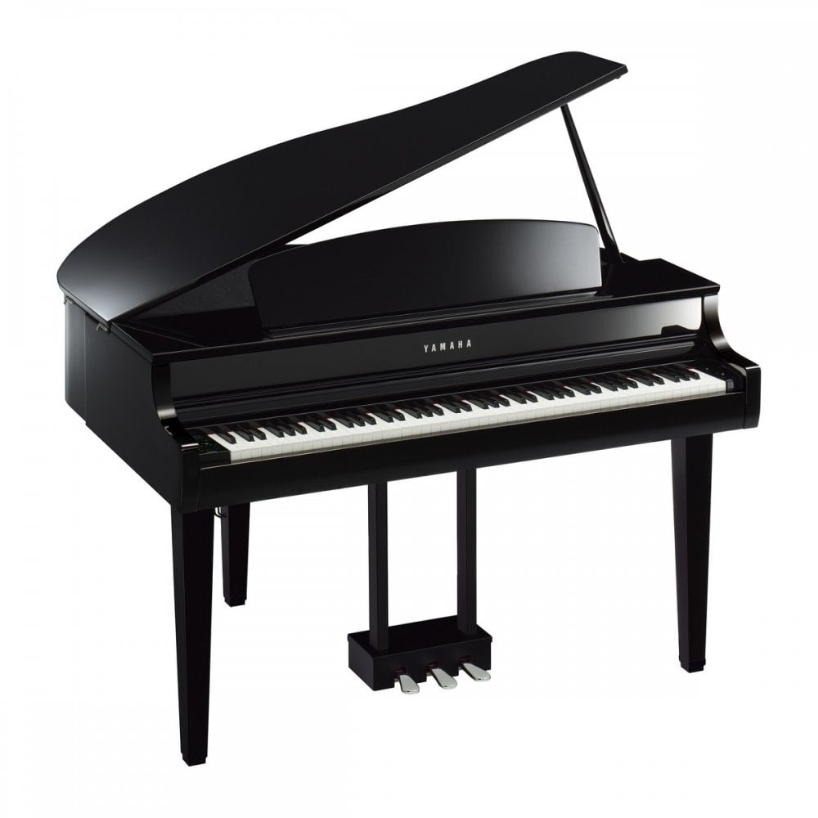
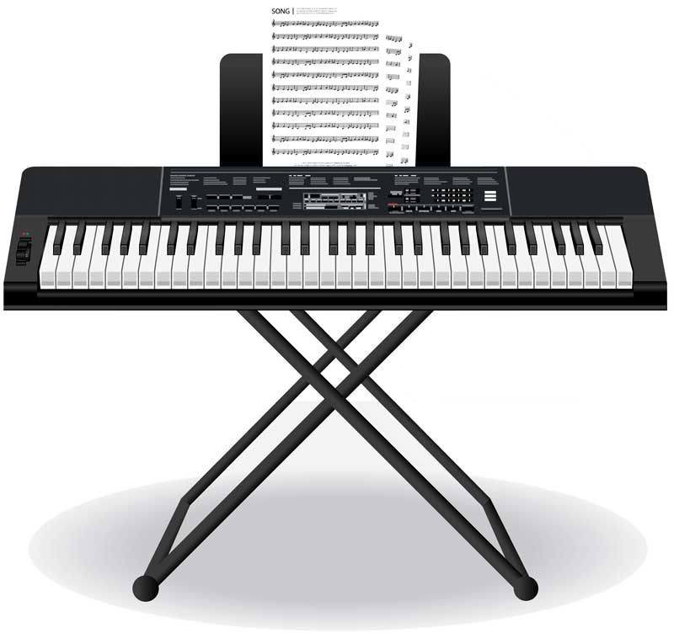
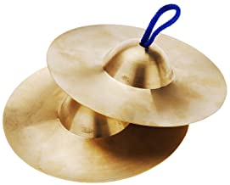
Instruments we know
Notes:
First, lets look at some common instruments that were and still are used… we have some of these in school! tambourine, symbols, trumpet, acoustic guitar, electric guitar, piano, drums, hand bells

Slide 3
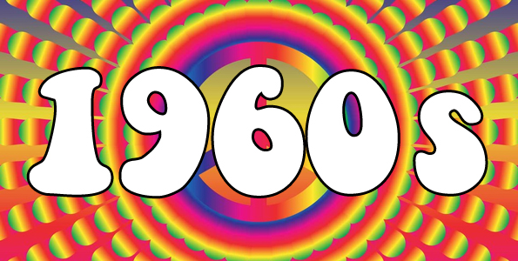
Notes:
The 1960s were very popular for rock music, also known as a music genre, all around the world. Lets look at some bands and listen to some of the music from the 1960s.

Slide 4
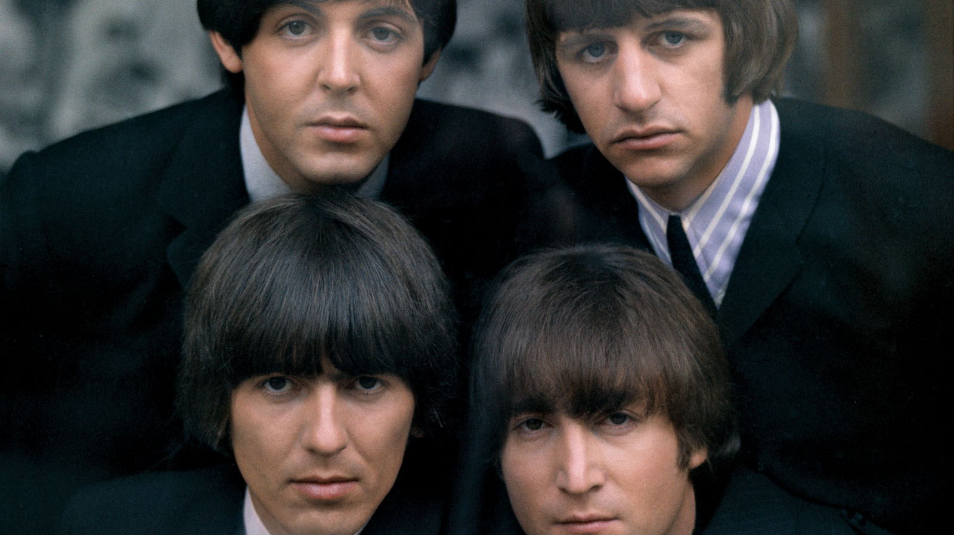
The Beatles
Notes:
This is the beatles, they are still very popular today. There were a British rock band.

Slide 5
Penny Lane
Notes:
This song is called penny lane, how many different instruments can you hear?

Slide 6
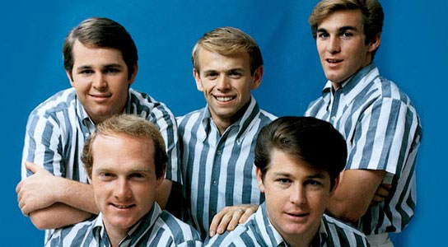
The Beach Boys
Notes:
This is the beach boys, there were an American rock band. Lets listen to one of their songs, is it similar or different to the British rock we just listened to?

Slide 7
Good Vibrations
Notes:
This song is called good vibrations, what instruments can you hear?

Slide 8
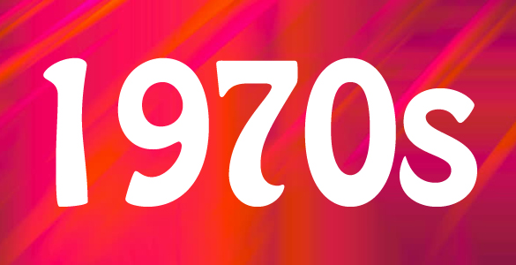
Notes:
Pop music and soft rock, music genres, were popular in the 1970s. Soft rock was different to the rock music of the 1960s as it was usually slower and used less electric intrustments. Lets look at some popular 1970s bands and their music.

Slide 9
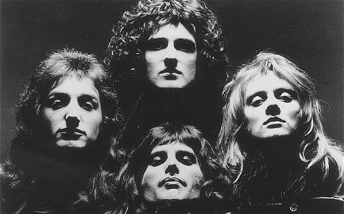
Queen
Notes:
This is queen, they were a 1970s rock band. Lets have a listen to their music, does it sound the same as the 1960s rock?

Slide 10
Don’t Stop Me Now
Notes:
This song is called don’t stop me now and is still played today. Lets listen for the instruments.

Slide 11
David Bowie
Notes:
This is solo musician David bowie and his music was pop rock – lets listen to his music, is it similar to Elton johns pop or queens rock?

Slide 12
Starman
Notes:
This song is called starman, what instruments can you hear?

Slide 13
Next
What was your favourite instrument used in the 1960s or 1970s?
Can you draw a picture of it and explain to your adult why it was your favourite? Maybe it sounded the best in a certain piece of music. Maybe it made you dance!
Notes:
Time for a challenge!

