Slide 1

Inference

Slide 2


Inference
What is Inference?
Inference is where we 'read between the lines' to gain a greater understanding of what we are looking at and to reach logical conclusions.

Slide 3
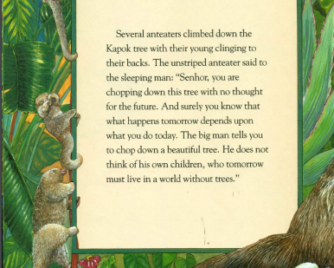
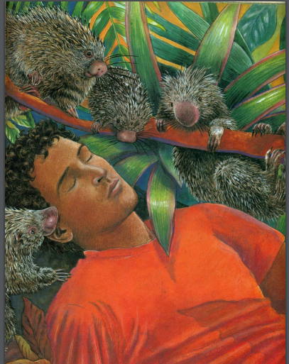
Look at the image and read the text carefully.

Slide 4
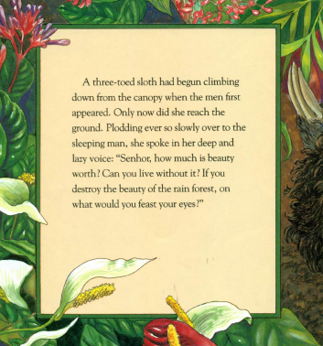
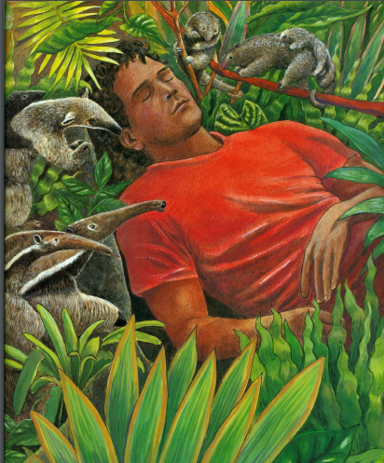
Look at the image and read the text carefully.

Slide 5
Today read and think about these questions
How do these animals feel towards the big man at the beginning of the story?
How do they feel towards the woodcutter who is sleeping?
What do the anteaters mean when they say?
‘what happens tomorrow depends on what you do today.’
Why do you think the three-toed sloth was only reaching the ground now ?
The sloth asks, ‘If you destroy the beauty of the rain forest, on what would you feast your eyes?’
What do you think the sloth means?

