Slide 1
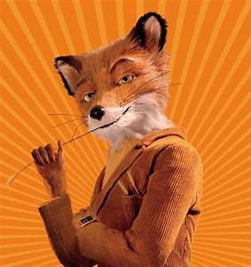

Fantastic Mr Fox
Chapter four
Terrible Shovels
What has happened so far?
What do you think will happen in chapter four?
Remember what the last sentences were from chapter three:
‘I reckon there’s a whole family of them down that hole,’ Bunce said.
‘Then we’ll have the lot,’ said Bean. ‘Get the shovels!’

Slide 2
Todays focus is to look at the emotions of Mr Fox. We will read each page and discuss how Mr Fox feels.
We will see how his feelings and emotions change as we go through the chapter.
We will make an emotion graph at the end to describe how his feelings and emotions change. We will talk more about this at the end

Slide 3
Key vocabulary
glum annoyed upset excited brave anxious worried determined proud petrified terrified frightened relieved
We will begin by reading the first page. I want you to think about how Mr Fox feels at the end of it?
What word is used to describe how he feels?
Why does he feel like this?

Slide 4
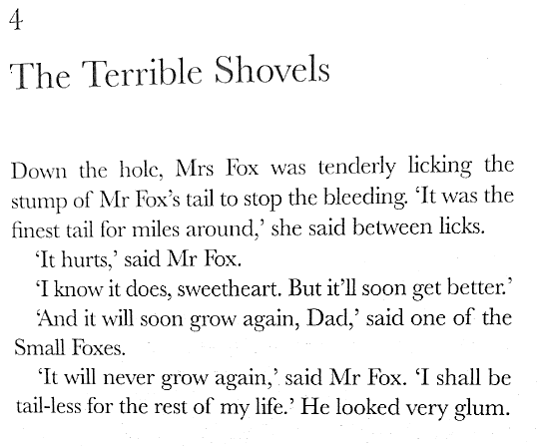
What word has been used to describe how Mr Fox feels?
Glum
Do you know any other words that mean the same?
down sad unhappy gloomy

Slide 5
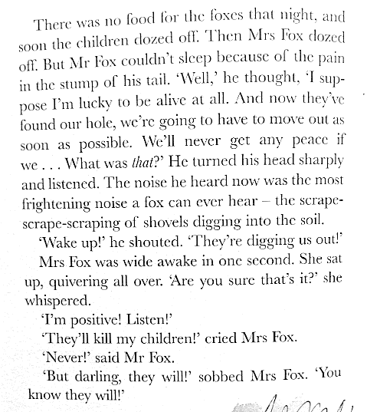
How does Mr Fox feel now? How did he feel at the start of this page? What about at the end?
What word has been used to describe the noise of the shovels?

Slide 6
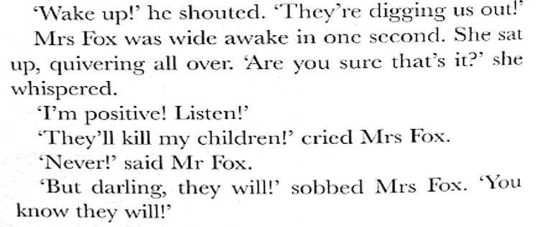
When Mr Fox says ‘,Never!’ How does he feel?
Why?

Slide 7
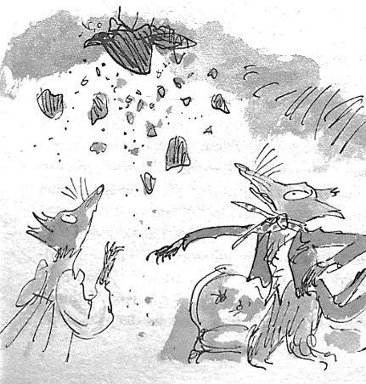
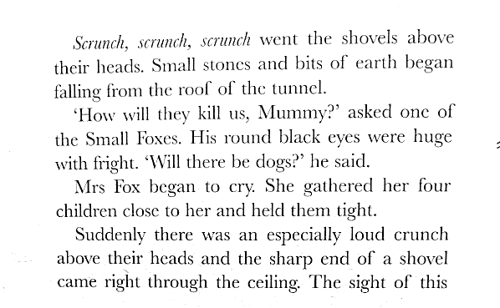

Slide 8
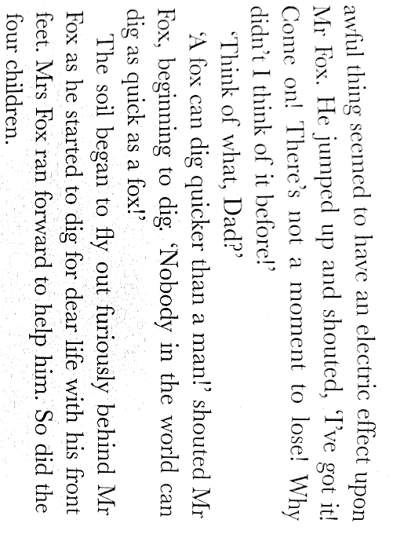
At the top of the page it says this awful thing had an electric effect on Mr Fox.
What does that mean?
What does furiously mean in this section?
At the bottom of the page how does Mr Fox feel?

Slide 9
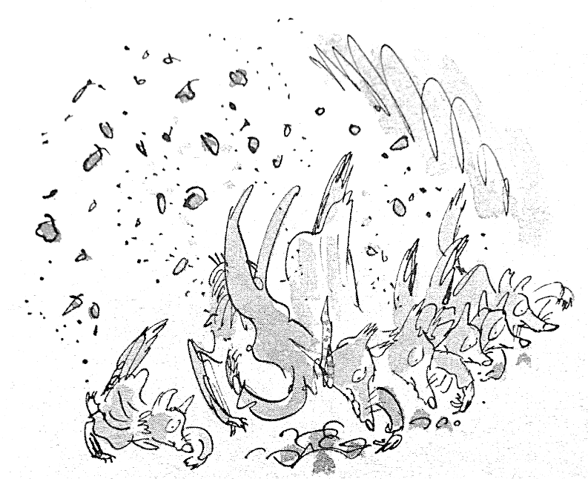
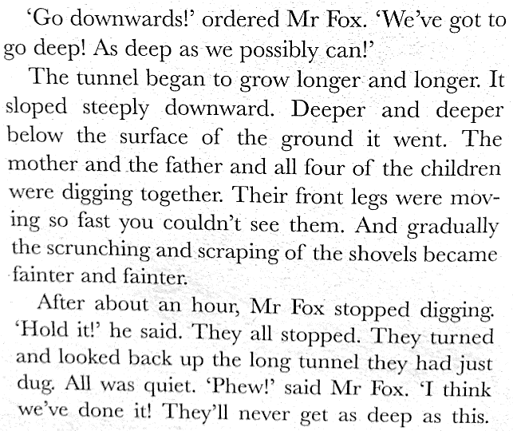
What words could describe how Mr Fox feels when he says, ‘Phew!’
relieved thankful happier

Slide 10
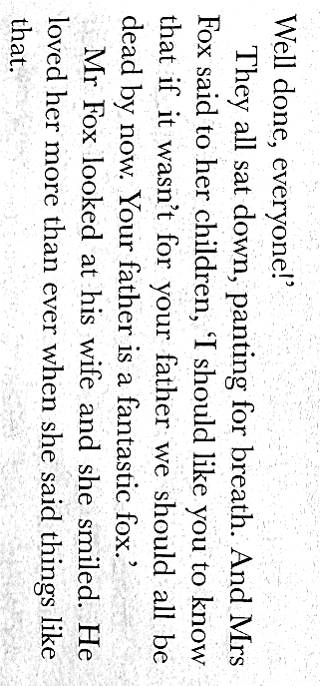
When Mrs Fox says that her husband is, ‘a fantastic fox,’ how does Mr Fox feel?
What words could we use to describe his feelings now?

Slide 11
Emotion graph
An emotion graph shows how a characters emotions and feelings change through a story or part of a story.
They key events or actions that take place in this chapter are;
Mr Fox has had his tail shot off.
They hear the sound of shovels.
Mrs Fox thinks her family is going to die, Mr Fox says, ‘Never!’
The shovels breaking through the ceiling, has an effect on Mr Fox.
Sounds of the shovels gets less and less as the foxes dig.
Finally can no longer hear the shovels and Mrs Fox says Mr Fox is, ‘fantastic.’
You need to decide how Mr Fox felt at each of these key events and label the axis of you graph with these emotion words and then plot them on a graph. Look at the next slide to see an example.

Slide 12
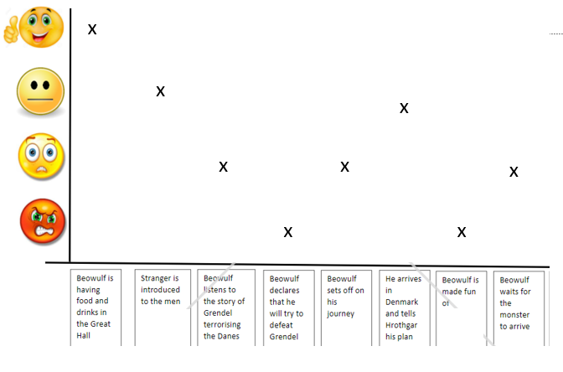
Here is an example of an emotion graph. You can use the emotion words or draw smiley faces to show the emotions. You plot the emotions on the graph then join the dots in order, to show you understand how a characters feelings have changed.

Slide 13
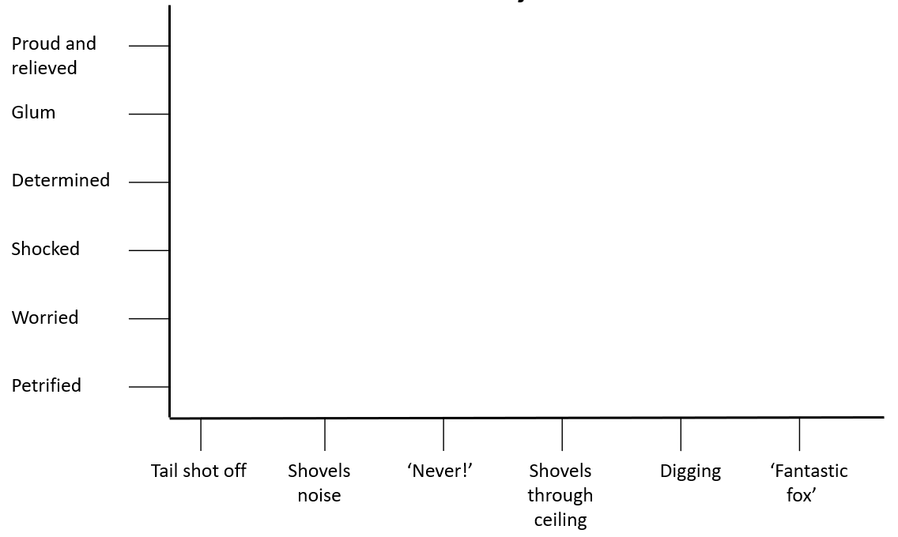
Your graph could look like this. Start by drawing the axis as below, label each event along the bottom and emotion words up the side. Then just put the crosses to show Mr Fox’s emotions at each event and join the crosses in order.
x

Slide 14



