Slide 1
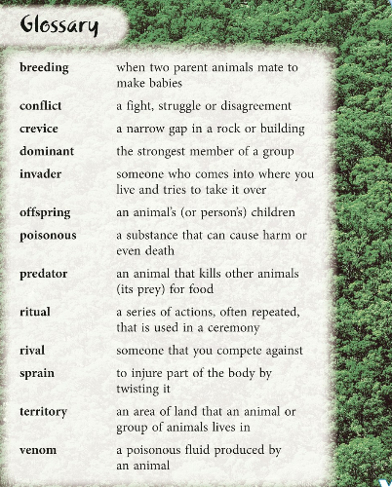
Here is the glossary with the vocabulary that we have been exploring over the past couple of days.
What is the purpose of a glossary?

Slide 2
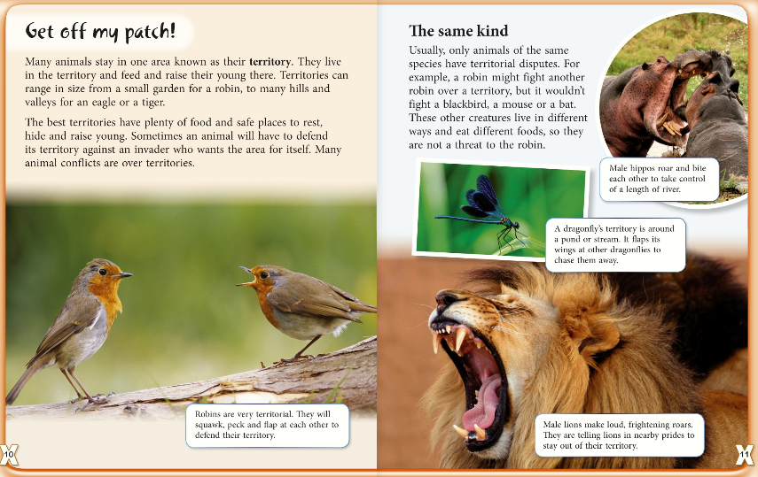
Read this text carefully with someone at home. Can you orally summarize the main ideas?

Slide 3
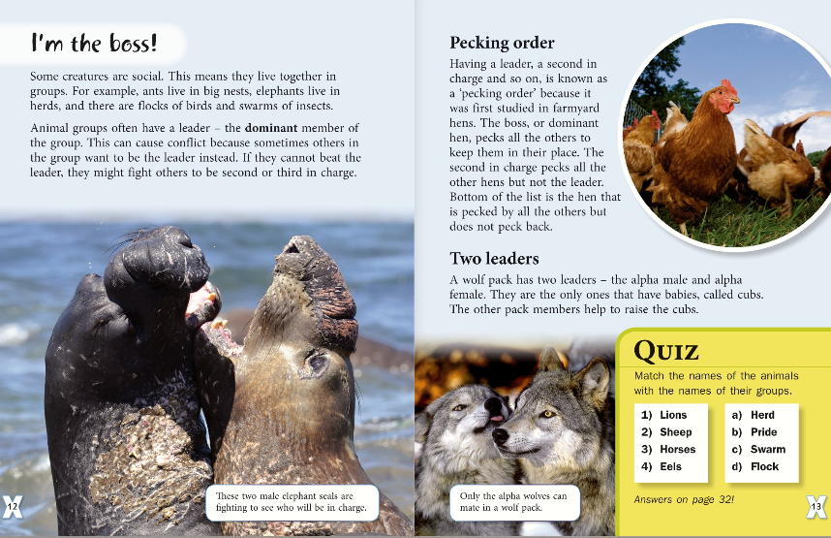
Read this text carefully with someone at home. Can you orally summarize the main ideas?

