Slide 1
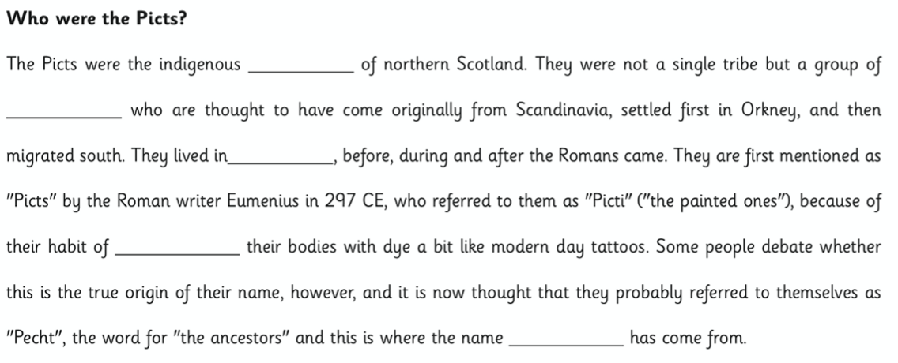
I will read out the paragraph and leave a gap where there is a missing word.

