Slide 1

Poems
To listen to and join in with poems.
To identify words that rhyme.
Rhyme means words that sound the same. They can be spelt differently. EG- me and sea

Slide 2
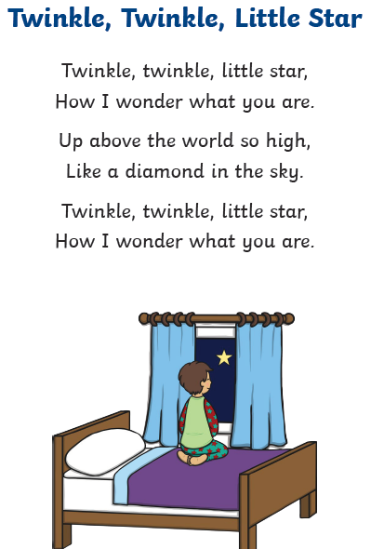
Listen to the poem or ask someone in your bubble to read it to you.

Slide 3
Star and are rhyme. They sound the same when you say them.
high and sky rhyme. They sound the same when you say them.
These two verses are repeated. They are the same

Slide 4
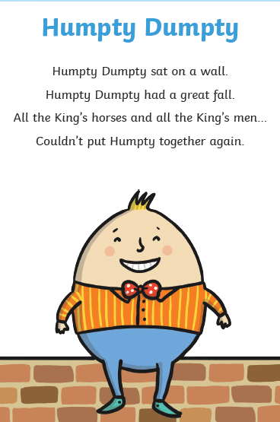

Slide 5
Wall and fall are spelt the same and sound the same. They rhyme.
Men and again are not spelt the same but they sound the same. They rhyme.
Listen to the poem or ask someone in your bubble to read it to you.

Slide 6
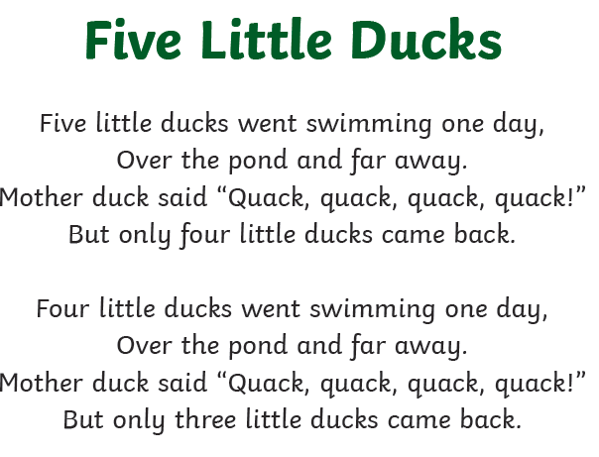
Day and away rhyme
There is a pattern. Both verses are the same. Only the numbers change when one duck doesn’t come back
Quack and back rhyme
Listen to the poem or ask an adult to read it to you. I have put the full poem on the next slide.
You might already know these rhymes from when you were younger and be able to say them yourself.

Slide 7
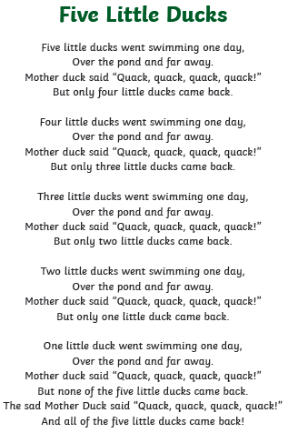

Slide 8
Task:
Listen to the poem being read on the PowerPoint or ask someone in your bubble to read it.
Can you join in with the poem?
Can you find the words that rhyme?

