Slide 1

Finding Percentages of Amounts

Slide 2
What does the term ‘per cent’ actually mean?
Per cent means out of 100.
So 50% is 50/100.

Slide 3
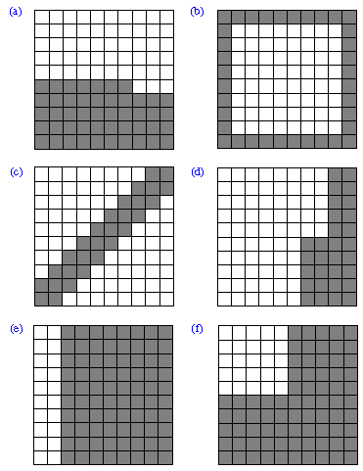
These are 100 grids. Each small square is equal to one. The shaded areas is the percentage. SO in grid A 46/100 small squares are shaded so there is 46% shaded.
Can you work out the percentages represented in the other grids?

Slide 4
To find 10% divide the original number by ten.
To find 20% find 10% and double it.
To find 50% half it.
To find 25% half it, and half it again.
To find 5% find 10% and half it.
To find 1% divide by 100.

Slide 5
When finding percentages of numbers, where the percentages are multiples of 10, you simply divide by 10 and then multiply by the percentage number.
Example, 30% of 60
We need to divide 60 by 10 and then multiply it by three because we are finding 30% and there are three tens in 30%
The calculation looks like this,
60 ÷ 10 = 6
6 x 3 = 18 (we multiply by three here because there are three tens in 30)
30% of 60 is 18

Slide 6
When finding percentages of numbers when the percentage is not a multiple of 10, we first need to find one percent and then multiply.
To find 1% of a number, we divide the number by 100. As we said earlier, percent means out of 100, so we divide by 100 to find 1.
Example:
42% of 300 =
First find 1% = 1% of 300 = 300 ÷ 100 = 3
SO 1% of 300 is 3.
Next we find 42%. To do this we take the answer of 1% and multiply it by 42 as this is the percentage we are trying to find. SO the calculation is:
3 x 42 = 126
SO 42% of 300 = 126

Slide 7
Use what you have learnt in this PowerPoint to complete the calculations on the worksheet.

