Slide 1
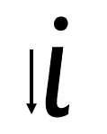
Your turn! Write i in your book using the lines.
i - Start at the top, come down and flick. Lift and dot.

Slide 2
Your turn! Write i in your book using the lines.
Then try:
in
sit
it

