Slide 1
Learning intention: To learn about time.

Slide 2
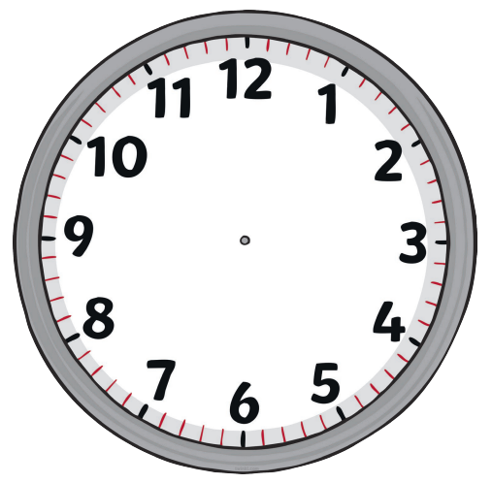
Can you remember what this is? That’s right this is a clock.
It tells us the time.
This is the minute hand. When it is pointing at 12 it means o’clock.
This is the hour hand. This hour hand is pointing at number 3 so that means it is 3 o’clock.

Slide 3
I want this clock to say 5 o’clock. Can you tell your grown up where the hands would go on the clock to say 5 o’clock?
5 o’clock

Slide 4
That’s right! The minute hand is pointing at 12 and the hour hand is pointing at 5 which means it is 5 o’clock.
5 o’clock

Slide 5
I want this clock to say 7 o’clock. Can you tell your grown up where the hands would go on the clock to say 7 o’clock?
7 o’clock

Slide 6
That’s right! The minute hand is pointing at 12 and the hour hand is pointing at 7 which means it is 7 o’clock.
7 o’clock

Slide 7
I want this clock to say 10 o’clock. Can you tell your grown up where the hands would go on the clock to say 10 o’clock?
10 o’clock

Slide 8
That’s right! The minute hand is pointing at 12 and the hour hand is pointing at 10 which means it is 10 o’clock.
10 o’clock

Slide 9
I want this clock to say 2 o’clock. Can you tell your grown up where the hands would go on the clock to say 2 o’clock?
2 o’clock

Slide 10
That’s right! The minute hand is pointing at 12 and the hour hand is pointing at 2 which means it is 2 o’clock.
2 o’clock

Slide 11
I want this clock to say 6 o’clock. Can you tell your grown up where the hands would go on the clock to say 6 o’clock?
6 o’clock

Slide 12
That’s right! The minute hand is pointing at 12 and the hour hand is pointing at 6 which means it is 6 o’clock.
6 o’clock

Slide 13
I want this clock to say 12 o’clock. Can you tell your grown up where the hands would go on the clock to say 12 o’clock?
12 o’clock

Slide 14
That’s right! The minute hand and the hour hand are both pointing at 12 which means it is 12 o’clock.
12 o’clock

