Slide 1
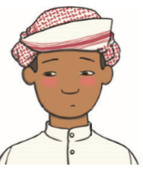
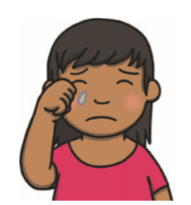
Warm up! Name the feeling:
Notes:
Hello! Before we start our PSHE work, let’s remember some of the different feelings. Look at the pictures – can you say how each child is feeling? Do you ever feel those feeling? Talk to your grown up about it.
It’s important to remember that we all feel different feelings sometimes, even grown ups! Shock, sadness, embarrassment and happiness are all feelings that we share.

Slide 2
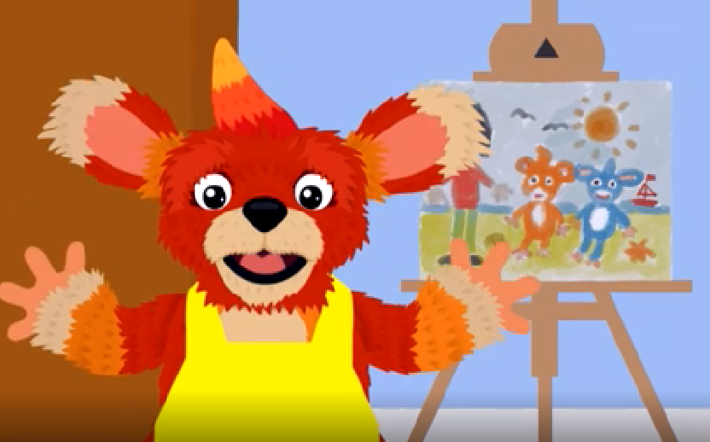
This is Ben.
Notes:
This is Ben, he has been working hard on his painting.

Slide 3
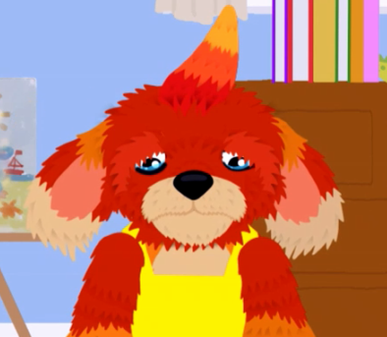
How is Ben feeling? How do you know?
Notes:
Oh… Something looks different here. How is Ben feeling now?
How do you know?

Slide 4
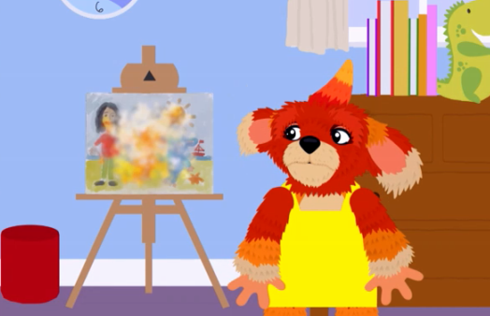
Why do you think Ben is feeling sad?
Notes:
Why do you think Ben is feeling sad and upset?
Different things upset different people, it is ok to feel sad but it’s important to talk to others.

Slide 5
How can we help Ben feel better?
Notes:
How can we help Ben feel better? Talk to your grown ups or think about it. Maybe you can write it down or draw some pictures!

Slide 6
Here are some ideas that you might have come up with:
Talking to someone you trust (a family member, a teacher or a friend)
Looking at your favourite book
Singing a song
Doing a dance or some exercise
Breathing 4 deep breaths
Writing it down
Giving someone or something a HUGE hug!
Notes:
Here are some more ideas that you might have said:
Talking to someone you trust (a family member, a teacher or a friend)
Looking at your favourite book
Singing a song
Doing a dance or some exercise
Breathing 4 deep breaths
Writing it down
Giving someone or something (like a teddy or a cushion) a HUGE hug!
I know that when I feel sad, I like to have some quiet time and read my favourite book and give my dog a cuddle. When I’m ready, then I talk about my feelings.

Slide 7
Commentary:
Slide 1: Hello! Before we start our PSHE work, let’s remember some of the different feelings. Look at the pictures – can you say how each child is feeling? Do you ever feel those feeling? Talk to your grown up about it. It’s important to remember that we all feel different feelings sometimes, even grown ups! Shock, sadness, embarrassment and happiness are all feelings that we share.
Slide 2: This is Ben, he has been working hard on his painting.
Slide 3: Oh… Something looks different here. How is Ben feeling now? How do you know?
Slide 4: Why do you think Ben is feeling sad and upset? Different things upset different people, it is ok to feel sad but it’s important to talk to others.
Slide 5: How can we help Ben feel better? Talk to your grown ups or think about it. Maybe you can write it down or draw some pictures!
Slide 6: Here are some more ideas that you might have said: Talking to someone you trust (a family member, a teacher or a friend), looking at your favourite book, singing a song, doing a dance or some exercise, breathing 4 deep breaths, writing it down, giving someone or something (like a teddy or a cushion) a HUGE hug! I know that when I feel sad, I like to have some quiet time and read my favourite book and give my dog a cuddle. When I’m ready, then I talk about my feelings.

