Slide 1

Learning intention: to understand imperative verbs (bossy verbs)
Instructions tell us how to do something or make something.
For example:
Build a
Lego car
Make a cake

Slide 2

Instructions usually start with a bossy word to tell us what to do. We call these imperative verbs (verbs are doing words, things that you do).
Listen to and follow the instructions. Which word tells us what to do?

Slide 3
Listen to or read the instruction. What do you need to do?
Stand up.
The bossy word (bossy verb) is ‘stand’ because that is what we do. It is usually the first word in the sentence!

Slide 4
Listen to or read the instructions. What do you need to do? Find the bossy imperative verb!
Get a pen.
Tap your leg.
Go to the sink.
Give a hug.
Jump up.
Run fast.

Slide 5
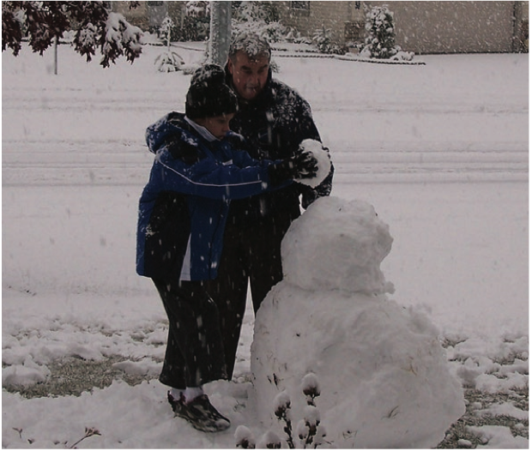


Try being bossy. Tell the people in the pictures what to do. Say your instruction as a sentence. There are some ideas in the word bank.
Word bank
kick put brush get

Slide 6

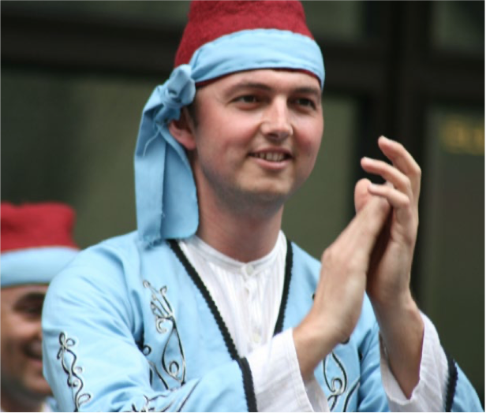
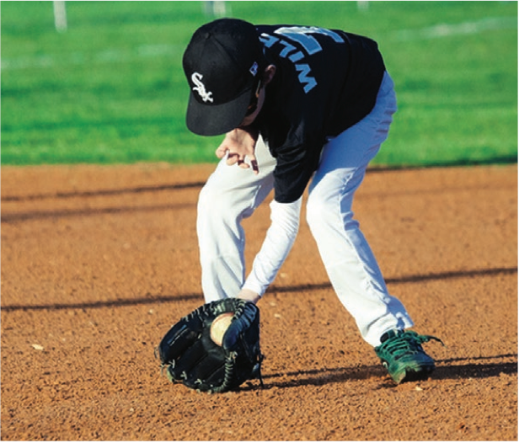
Try being bossy. Tell the people in the pictures what to do. Say your instruction as a sentence. There are some ideas in the word bank.
Word bank
clap mix catch

