Slide 1

Music in the
1960’s & 1970’s

Slide 2
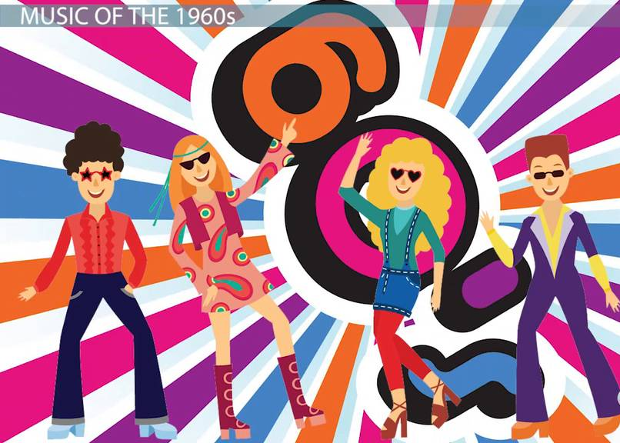
Popular styles of music in the 1960’s
The 1960’s was known for it’s popularity and evolution of rock, and R&B music.
It was also an important decade for the development of other genres such as: Jazz and Classical.

Slide 3
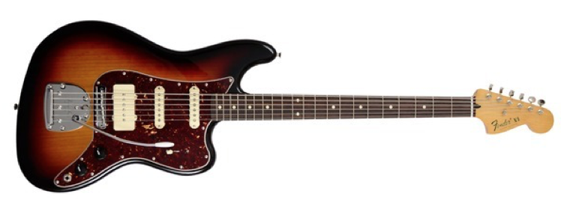
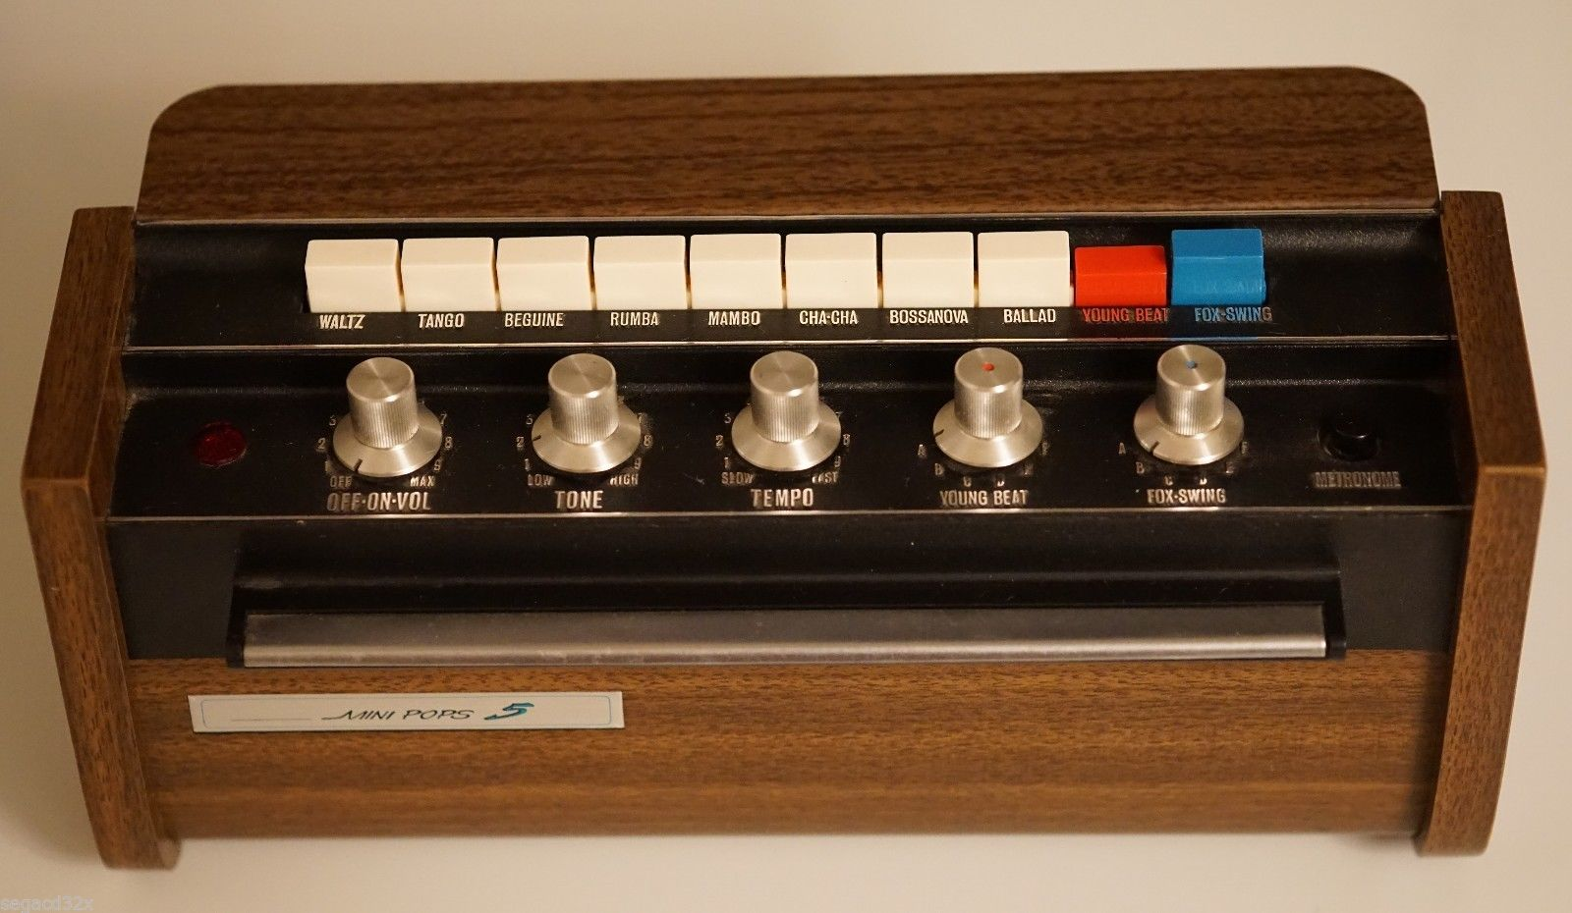
Musical Instruments in the 1960’s
This is a Fender Bass Guitar. It is a six-string bass Guitar which was first invented in 1961 and is still popular till this day!
Click on the guitar to listen.
This is a Korg Mini Pops drum machine. It is an electronic musical instrument that creates percussion sounds, drum beats, and patterns.
Click on the instrument to listen.

Slide 4
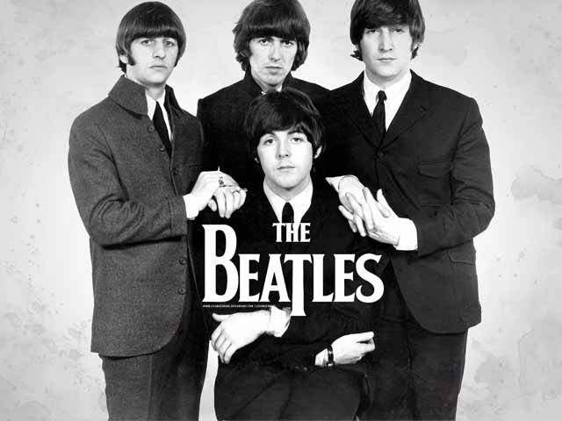
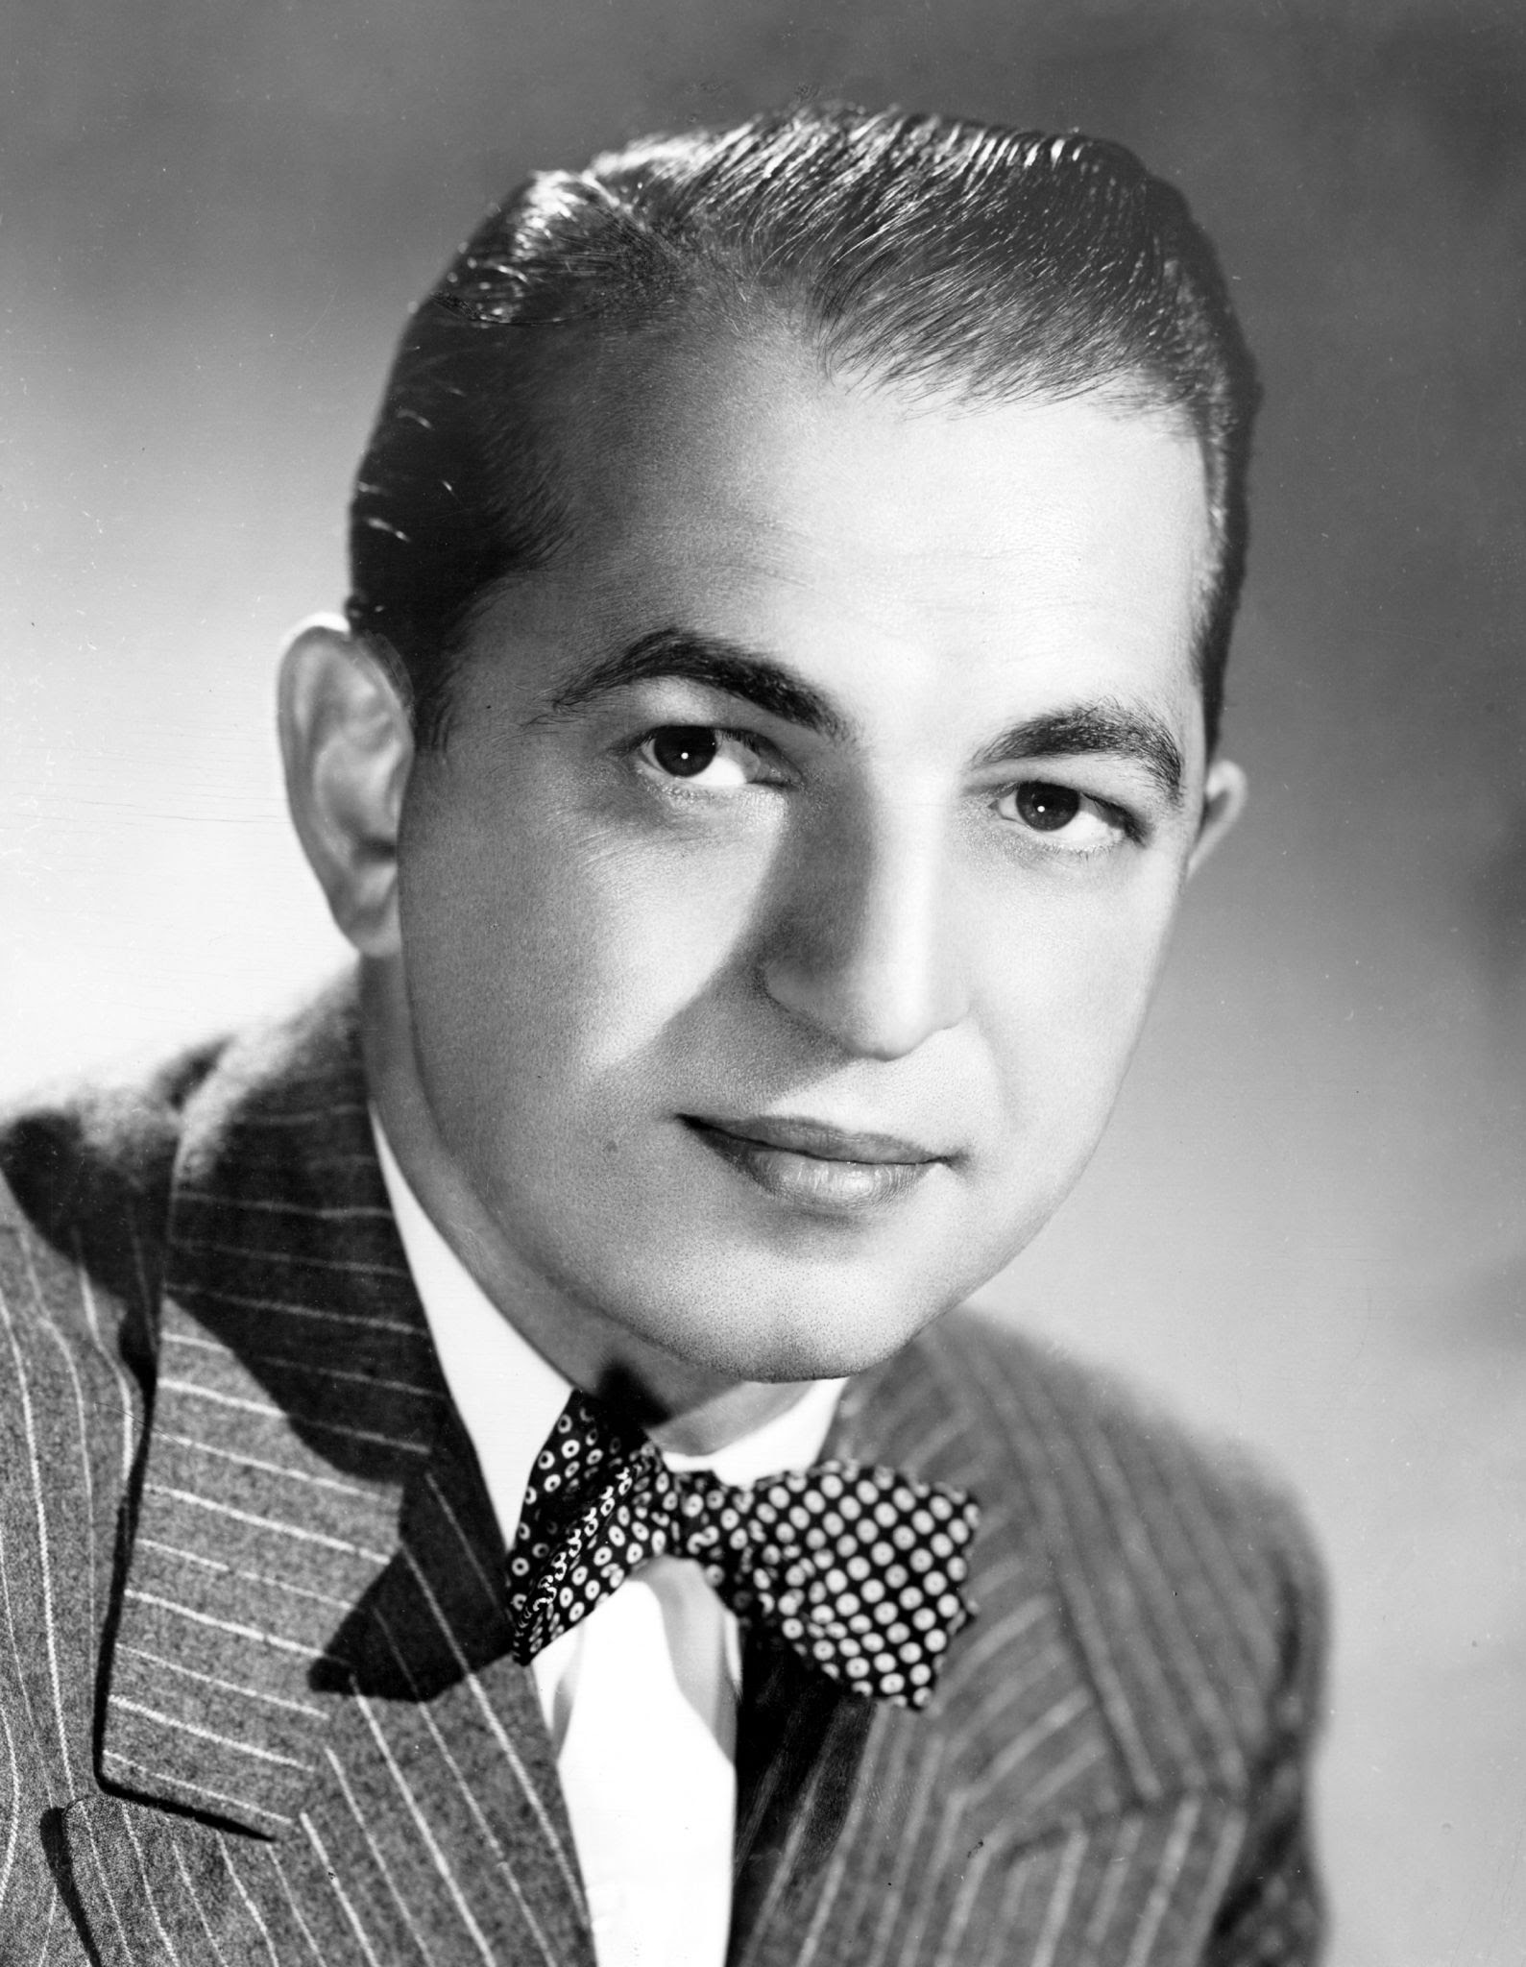
Famous artists in the 1960’s
This is Percy Faith. He was an orchestrator, composer and conductor and was known for his ‘easy listening’ and ‘mood music’ format.
Click on his picture to listen to a snippet of his song – ‘Theme From a Summer Place’.
The Beatles were one of the most famous bands of the 1960’s. They were an English Rock band who incorporated classical music and traditional pop into their sound as well.
Click on the picture to listen to a snippet of their song -‘I’m only sleeping’.

Slide 5
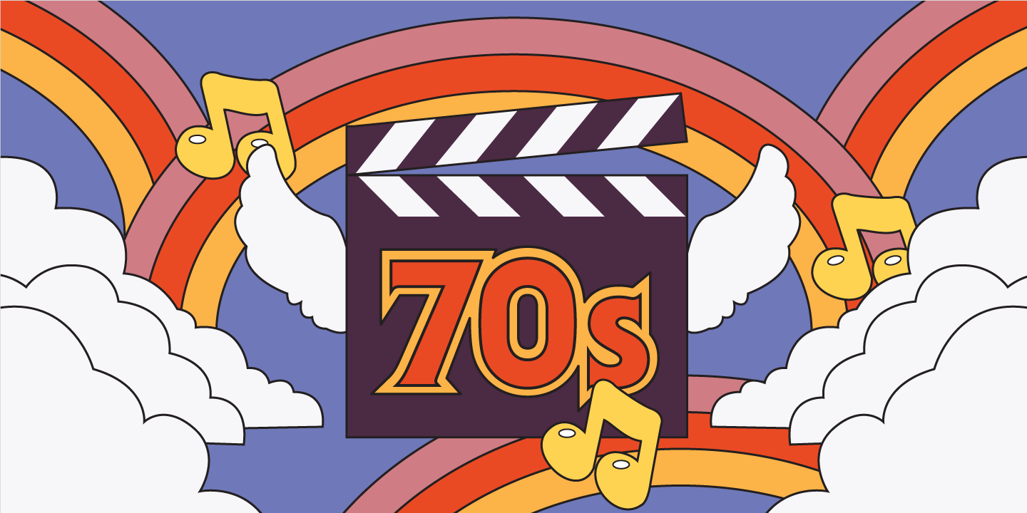
Popular styles of music in the 1970’s
Funk, Soul, R&B, Pop, Hard Rock, Soft Rock and Disco all carved out their place in the music world in the 1970s
A new style of music was introduced in the late 1970’s: Hip-Hop.

Slide 6
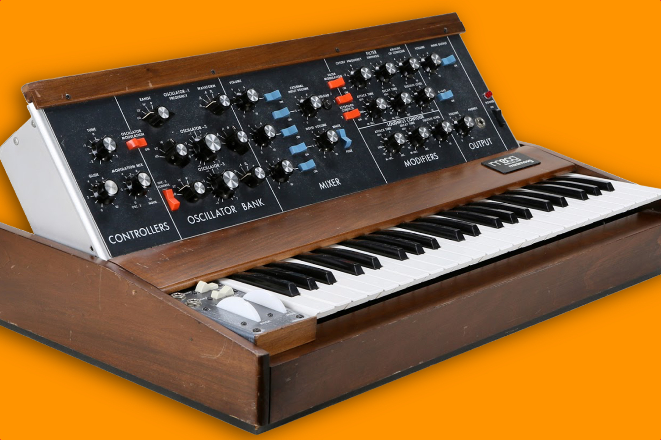
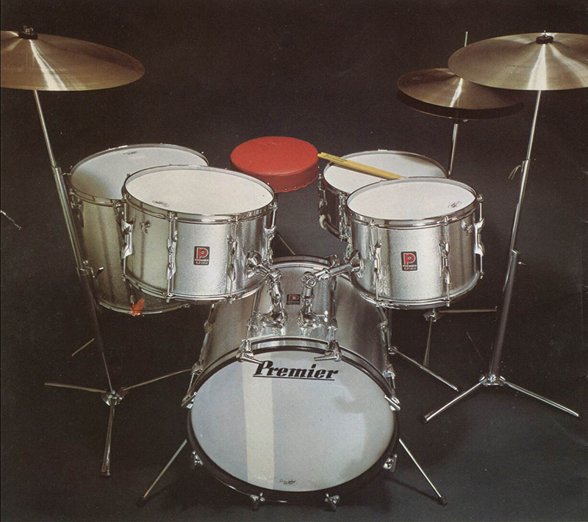
Musical Instruments in the 1970’s
Synthesizers and keyboards became popular in 1970’s in order to achieve a new modern sound.
Click on the picture to listen.
Drum sets had grown in popularity in the 1970’s and many artists incorporated these in their music.
Click on the picture to listen.

Slide 7
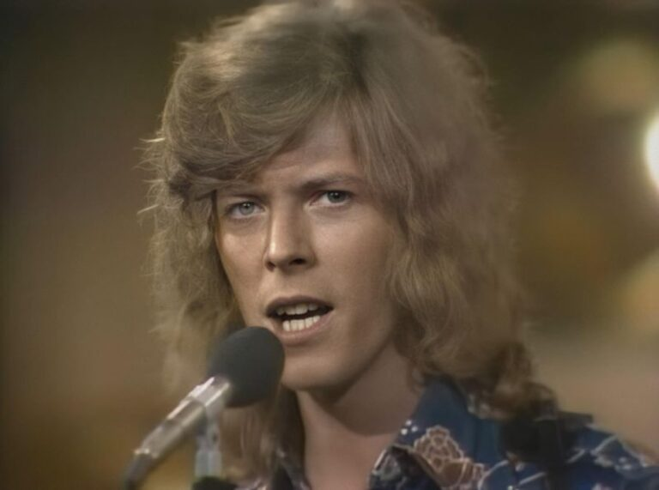
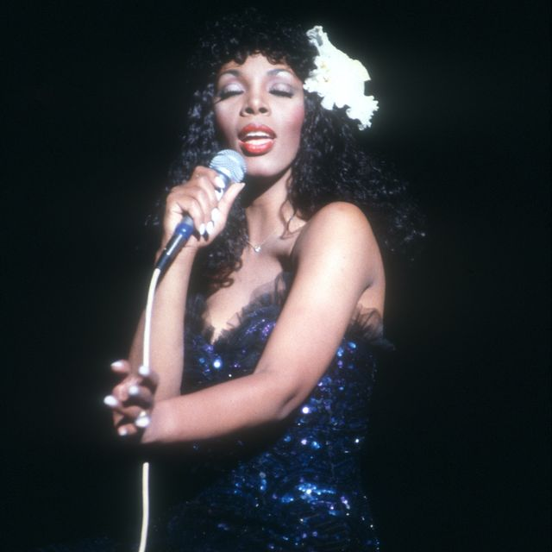
Famous artists in the 1970’s
This is Donna Summer. She was popular in the 1970’s for her genre of Disco music which earned her the title ‘Queen of Disco’
Click on her picture to listen to a snippet of her song – ‘Once upon a time’.
David Bowie was very popular in the 1970’s for his take on Glam Rock music.
Click on the picture to listen to a snippet of his song –’Ziggy Stardust’.

Slide 8
What do you think?
Having looked at the different styles of music in the 1960’s & 1970’s, which one do you like better?
Have a look at other songs of the year that you like.

