Slide 1
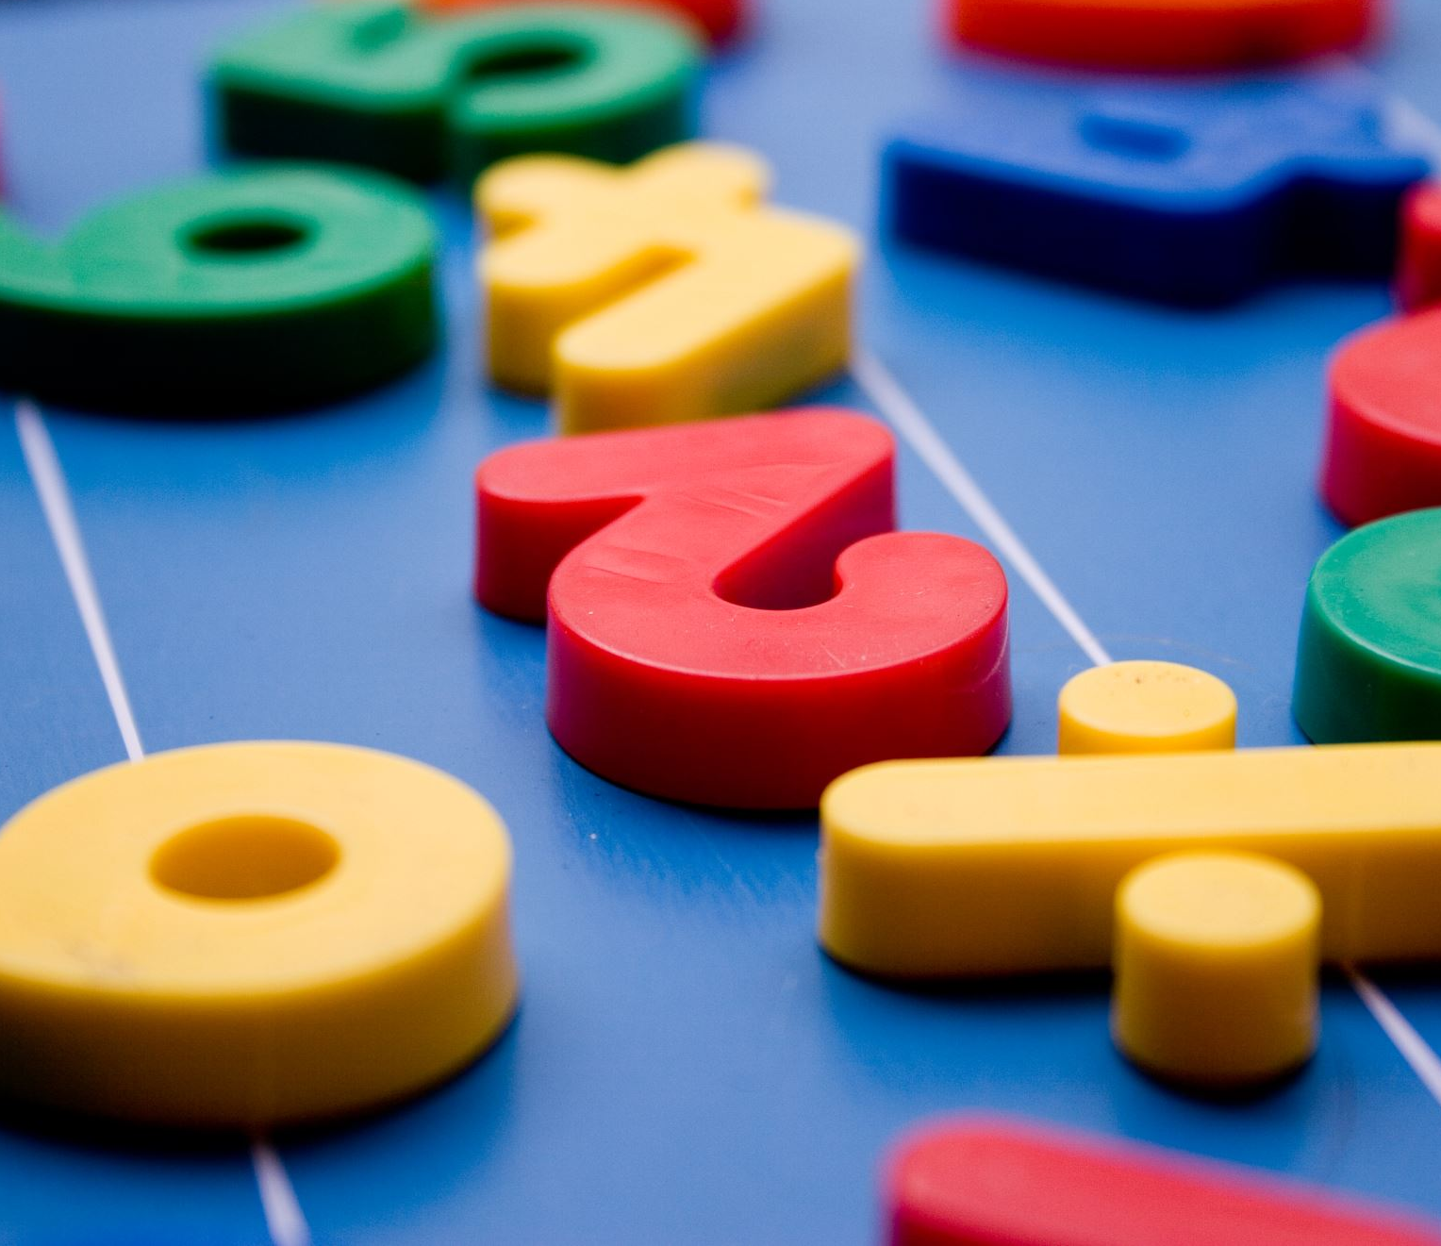
Year 1
Number bonds
to 10

Slide 2
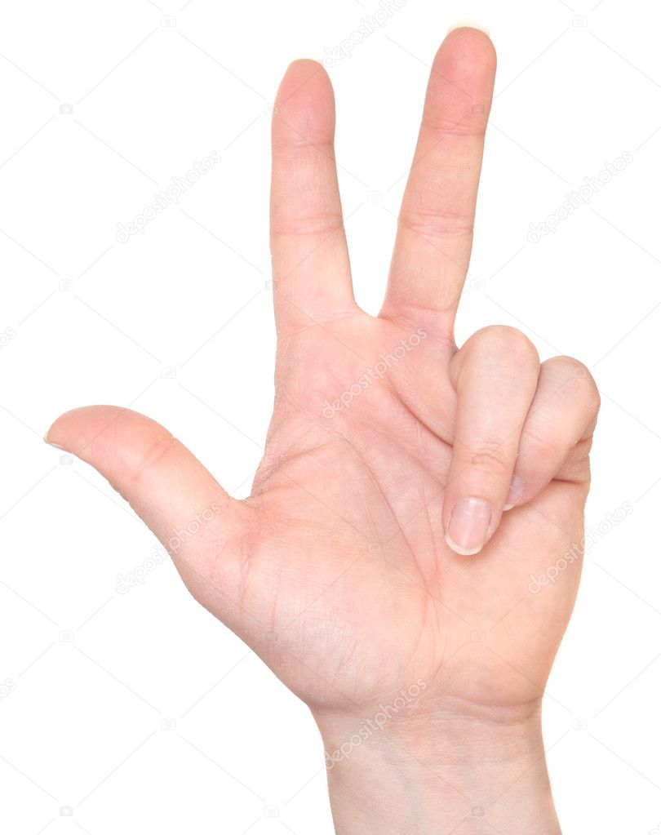
Addition
+ = 1 0

Slide 3
+ = 1 0
7
+ =

Slide 4
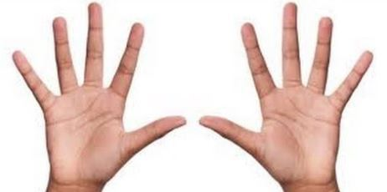
Subtraction
1 0 - = 5

Slide 5
1 0 - = 5
5
x
x
x
x
x
- =

Slide 6
Now it’s your turn!
0 + = 1 0
1 + = 1 0
2 + = 1 0
3 + = 1 0
4 + = 1 0
5 + = 1 0
6 + = 1 0
7 + = 1 0
8 + = 1 0
9 + = 1 0
1 0 + = 1 0

Slide 7
1 0 - = 1 0
1 0 - 1 =
1 0 - = 8
1 0 - = 7
1 0 - 4 =
1 0 - 5 =
1 0 - = 4
1 0 - = 3
1 0 - = 2
1 0 - 9 =
1 0 - = 0

