Slide 1
Guess the reading characters.

Slide 2
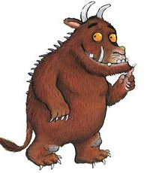
Who is this character?

Slide 3
What book is this character from? Extra point – Can you name two of the animals she travels with?

Slide 4
Whose house does this character break into?

Slide 5
What is this character called? Extra point – What does she loose?

Slide 6
What is this bear called? Extra point – What does he like in his sandwiches?

Slide 7
What is the name of this character?

Slide 8
What is this book called? Extra point what did Jack sell?

Slide 9
What is this character’s name?

Slide 10
What did this character come to the little girls house for?

Slide 11
What is the name of this elephant?

Slide 12
What are these character’s going on?

Slide 13
What is the name of this book?

Slide 14
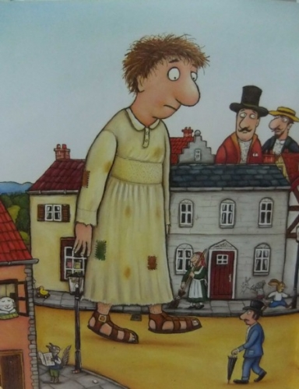
What is the name of the book this character is in?

Slide 15
Who are these little men? Can you name each of them?

Slide 16
What is the name of this character?

Slide 17
Can you name two different books that this character is in?

Slide 18
What do the characters in this book love?

Slide 19
What is this book called?

Slide 20
What is this book called?

Slide 21
Name two animals that the zoo sends to the little boy.

Slide 22
What book does this character belong to?

Slide 23
What is the name of the book that this character belongs to? Extra point – Name one thing he eats.

Slide 24
What is the name of this fairy tale? Extra point – What makes her fall asleep?

