Slide 1
To find out how London has changed over time.

Slide 2
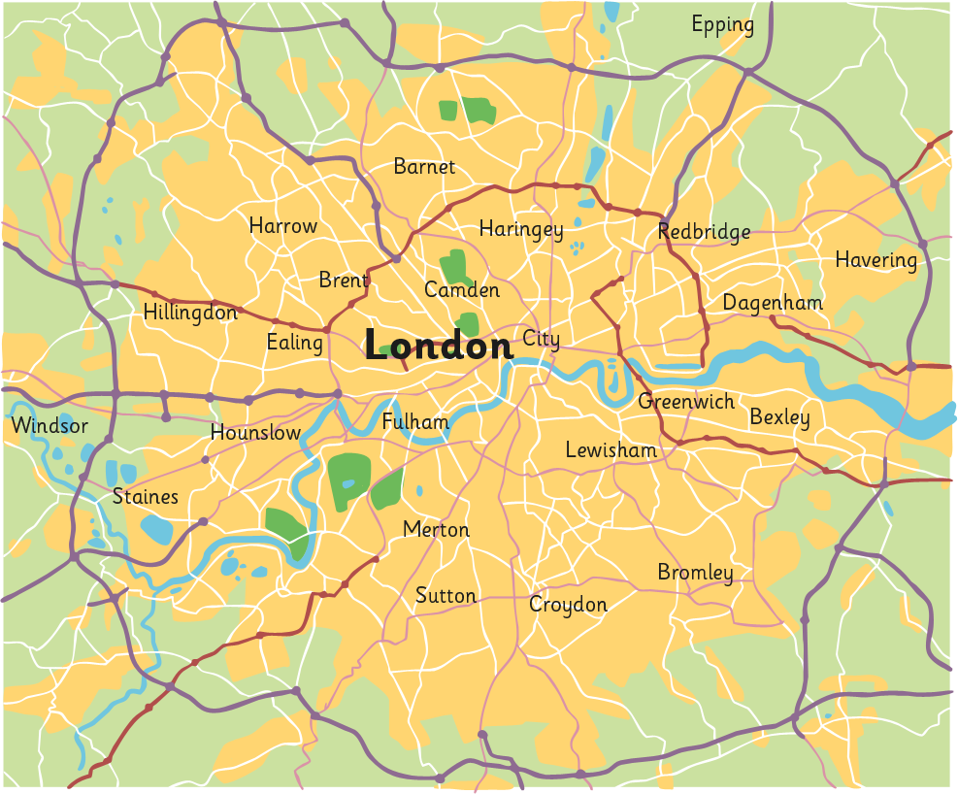
Where Is London?
M25
River Thames
Greater London
City of London

Slide 3
Where Is London?
Map of London
London

Slide 4
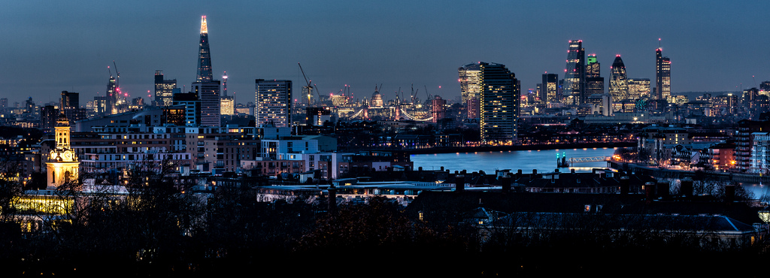
Who Built London?
?
How old do you think London is?
?
Has it always looked like this?
?
Who were the first people to live in London?

Slide 5
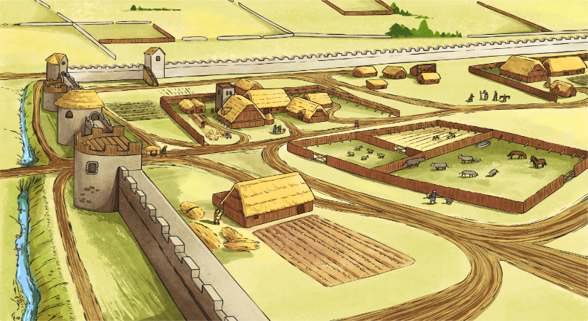
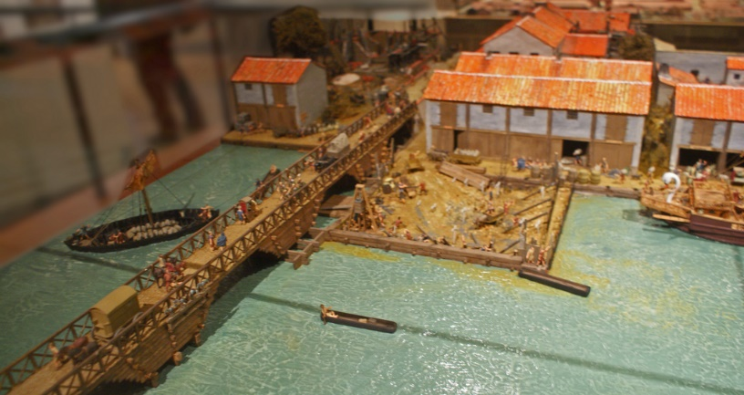
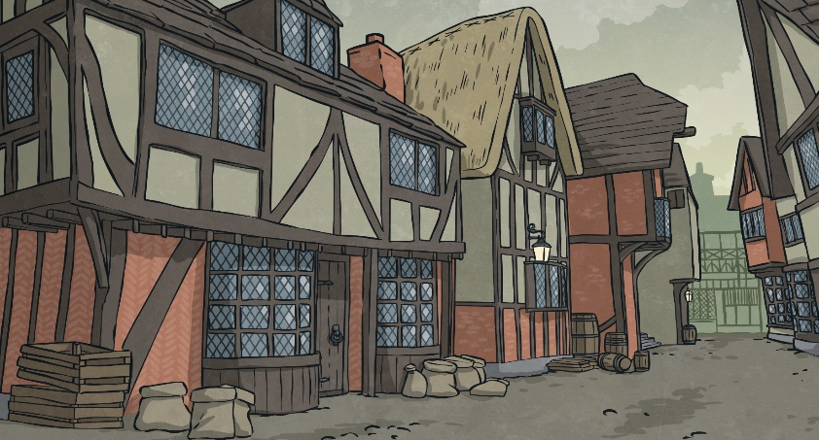
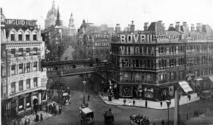
How Did London Change?

Slide 6
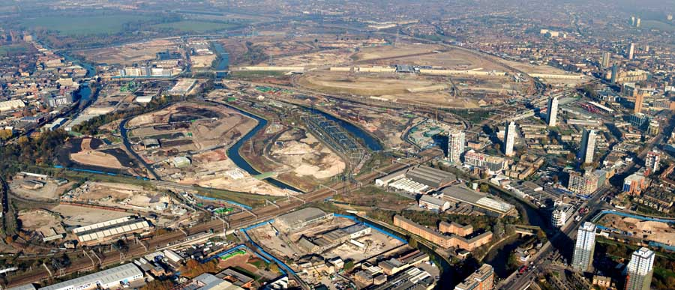
Now it’s your turn
This is an area of London called East London in 2008.
What human and physical features can you see?

Slide 7
Now it’s your turn
This is an area of London called East London in 2008.
What human and physical features can you see?
What human features can you see?
Remember this means made by people
Flats
Roads
Factories
What physical features can you see? Rivers, fields

Slide 8
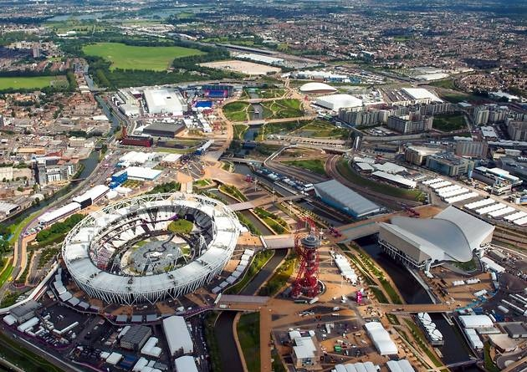
Now it’s your turn
This is the same area of London but in 2012. It was transformed ahead of the Olympic Games.
What is different? How has it changed?

Slide 9
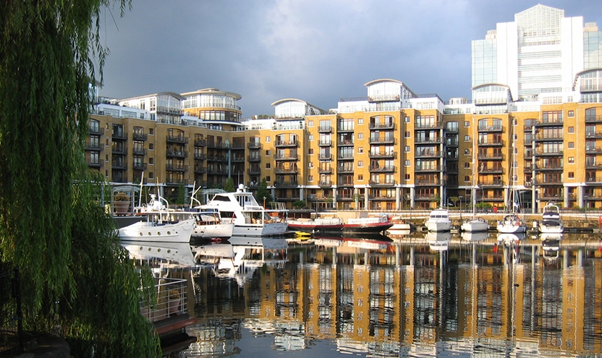
How has the area changed?

