Slide 1
English Alternative Quiz

Slide 2
Look at the word below, sound it out and blend. What does it say?

Slide 3
Look at the word below, sound it out and blend. What does it say?

Slide 4
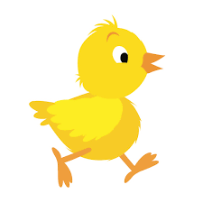
Look at the word below, sound it out and blend. What does it say?
ch i ck

Slide 5
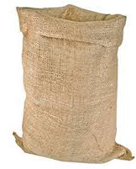
Look at the word below, sound it out and blend. What does it say?
s a ck

Slide 6
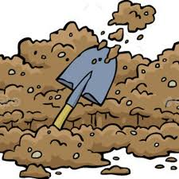
Look at the word below, sound it out and blend. What does it say?
d i g

Slide 7
Look at the word below, sound it out and blend. What does it say?
r u n

Slide 8
Guess the character below using these clues:
Fat
Small
cross

Slide 9
Guess the character below using these clues:
Fat
Small
Cross
Bunce

Slide 10
Guess the character below using these clues:
fluff
mum
nice

Slide 11
Guess the character below using these clues:
fluff
mum
nice
Mrs Fox

Slide 12
What is missing from this sentence?
A fat man

Slide 13
What is missing from this sentence?
Full stop
A fat man.

Slide 14
What is missing from this sentence?
the fluffy fox.

Slide 15
What is missing from this sentence?
Capital letter
The fluffy fox.

