Slide 1

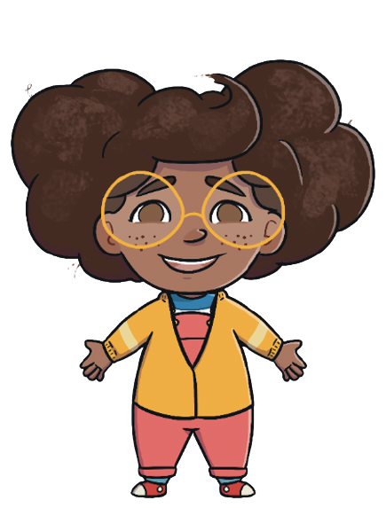

I am Mel.
This is what a Tuesday is like for me!
What is Tuesday like for you?

Slide 2
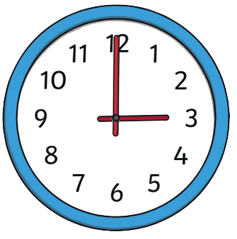
On each slide you will see a clock. Lets have a look. This clock says 3 o’clock. That is because the minute hand or the big hand is pointing to 12 which means o’clock and the hour hand or the little hand is pointing to 3 which means it is 3 o’clock.
hour hand
minute hand

Slide 3
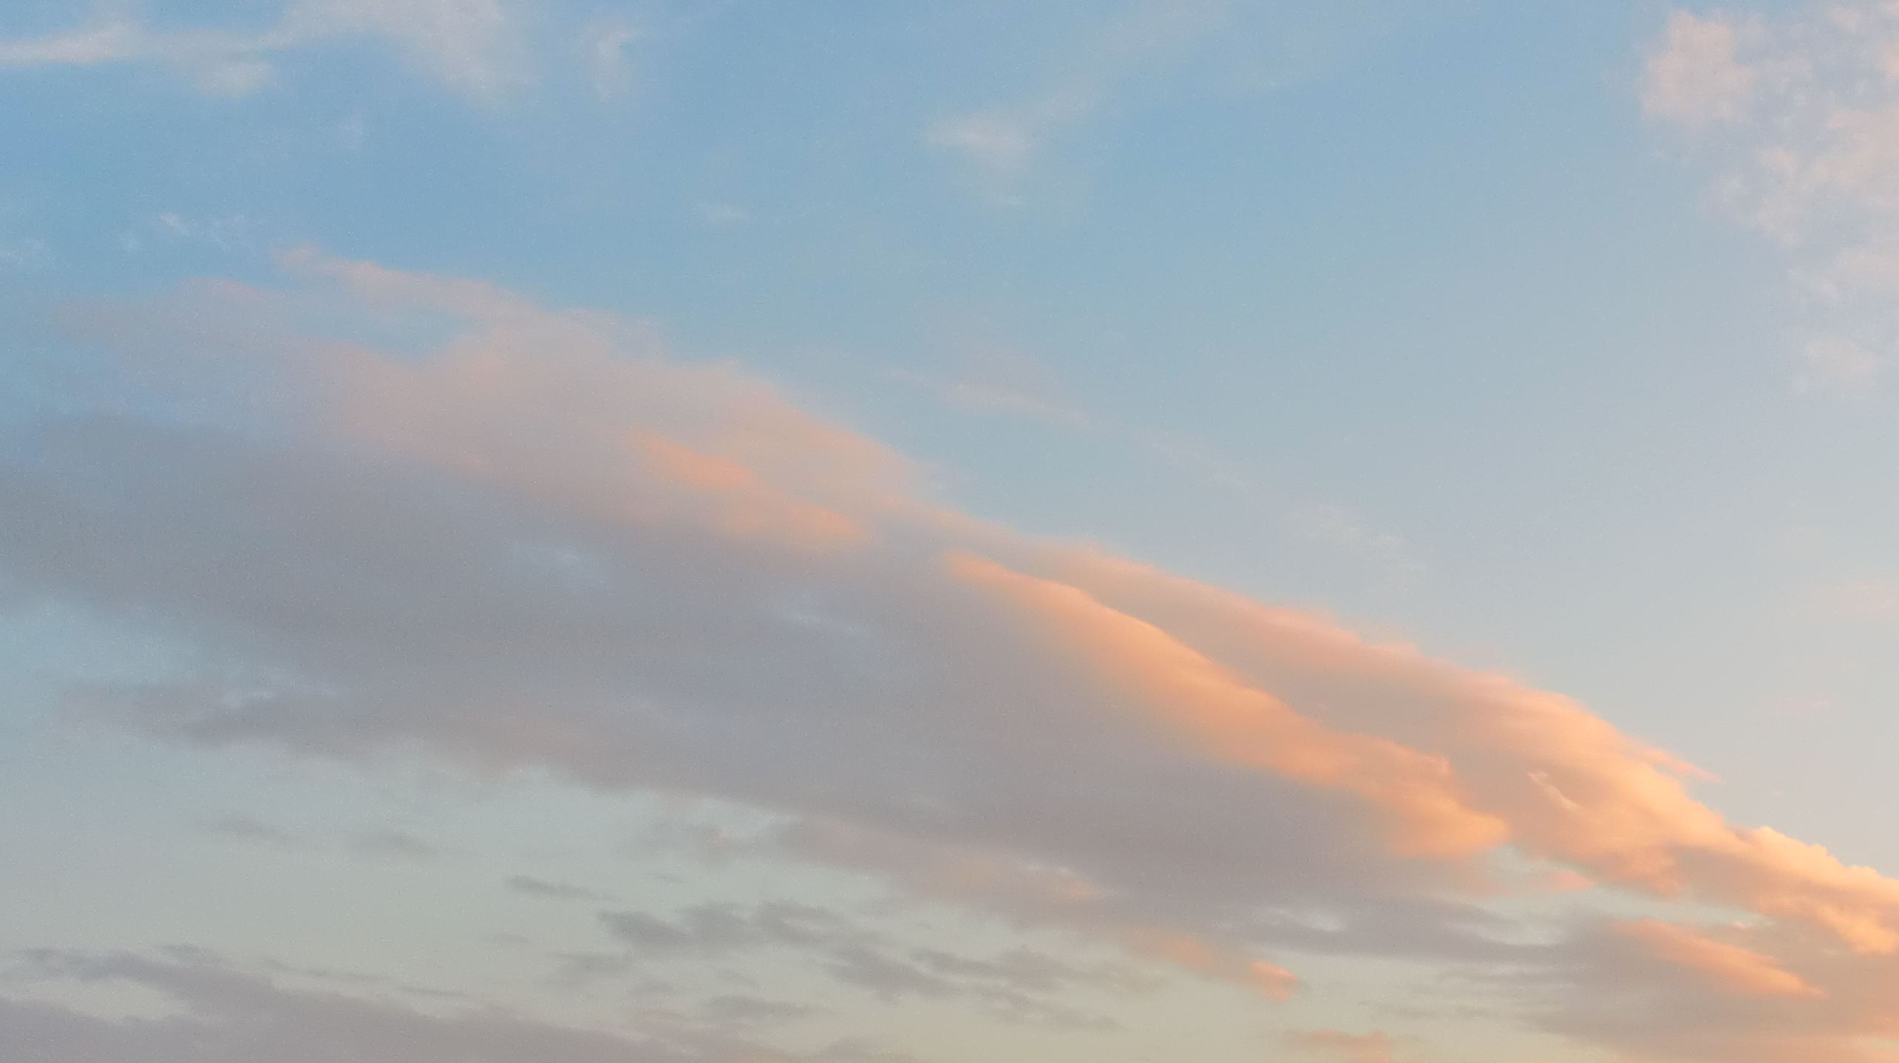
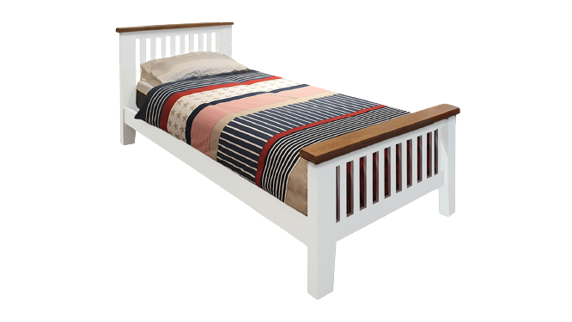
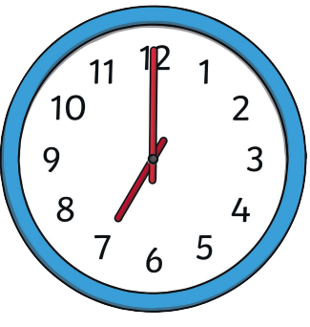
I wake up at…
7:00
7 o’clock

Slide 4
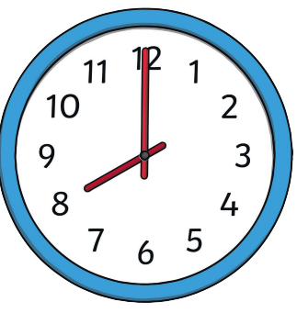
Breakfast
I eat breakfast at…
8:00
8 o’clock

Slide 5
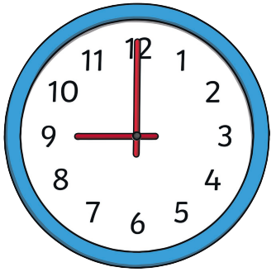
Go to school
I get to school at…
9:00
9 o’clock

Slide 6
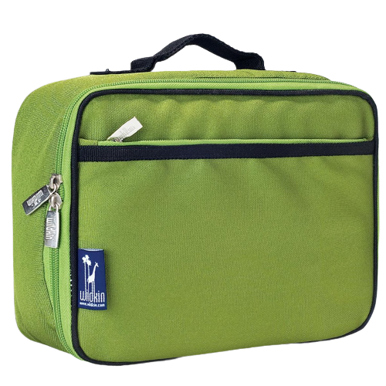
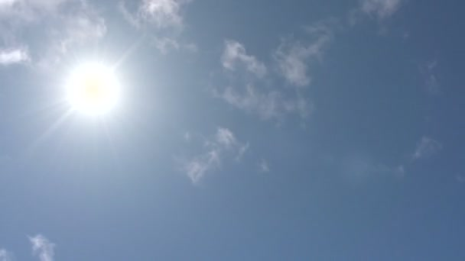
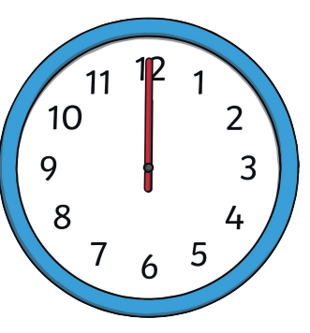
I eat lunch at…
12:00
12 o’clock

Slide 7

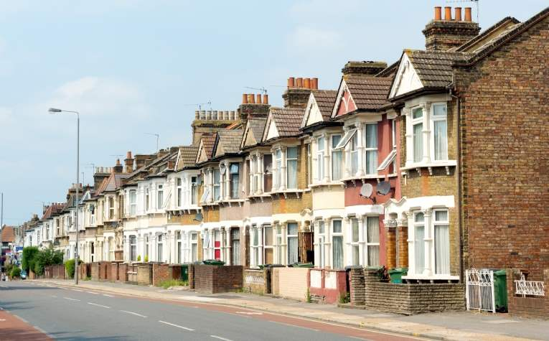
I go home at…
3:00
3 o’clock

Slide 8
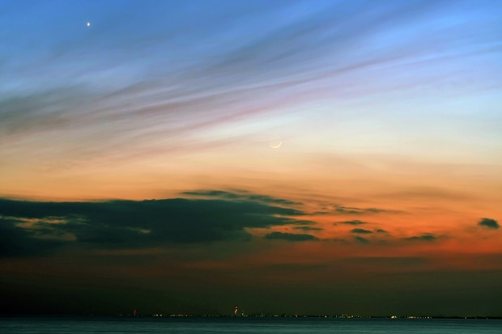
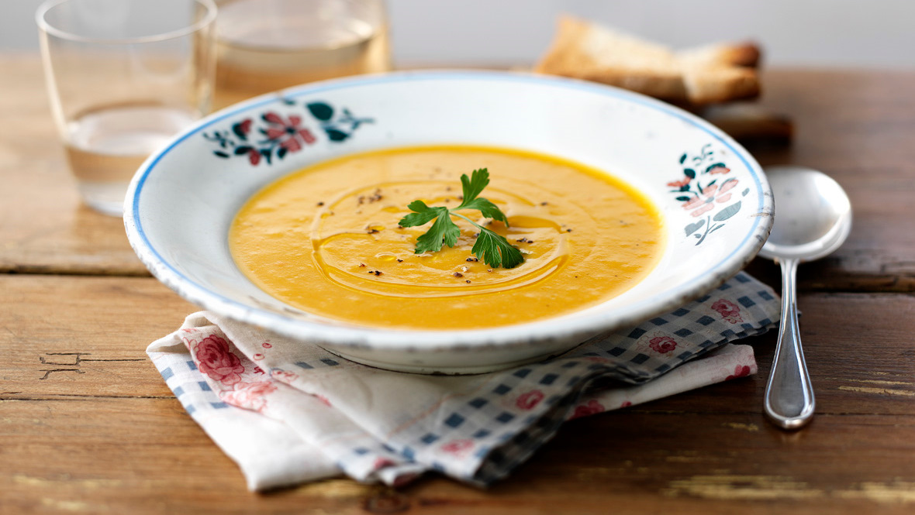
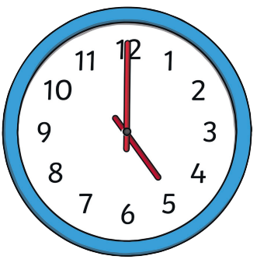
I eat tea at…
5:00
5 o’clock

Slide 9
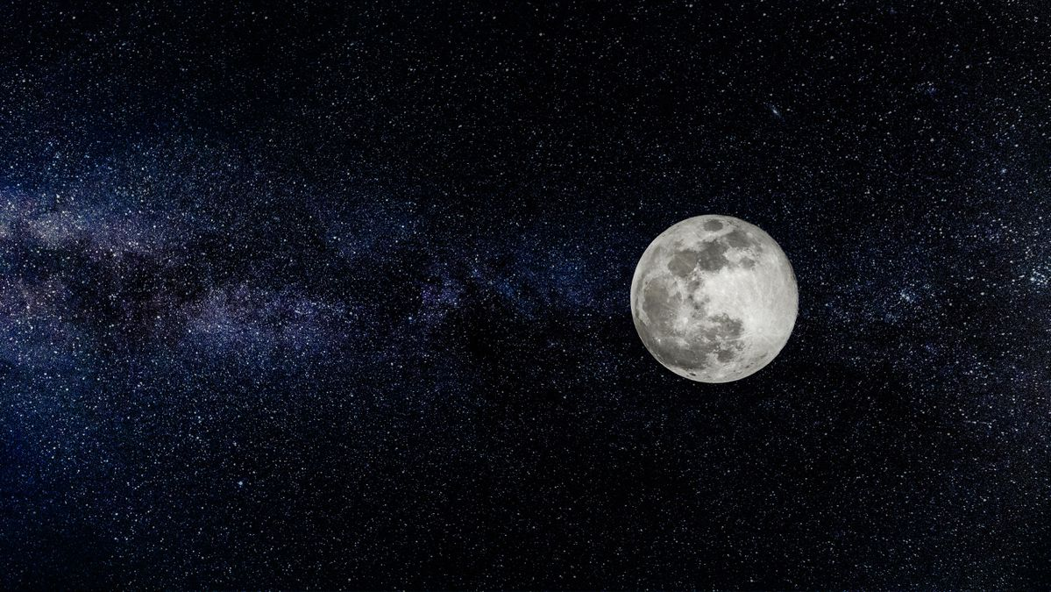
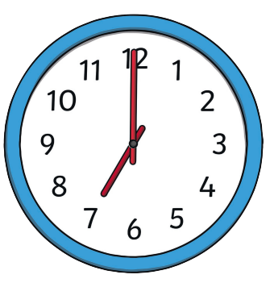
I go to bed at…
7:00
7 o’clock

Slide 10
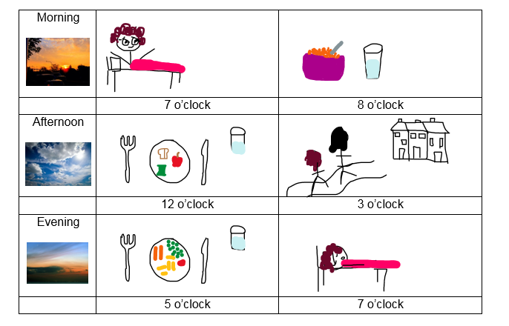
This is my time diary,
Now it is your turn!

